Slide 1


eSourcing Training for Suppliers
Notes:
ERIC

Slide 2
What is Coupa?
Coupa is a cloud-based procurement platform. Coupa eSourcing facilitates finding, evaluating, and engaging suppliers and internal stakeholders for acquiring goods and/or services. It will be used to facilitate the entire Sourcing process transparently from:
Opportunity identification
Bid creation
Supplier engagement
Bid evaluation and ranking
Bid award
Benefits of Coupa Sourcing:
Elimination of current manual processes
Portal for supplier bid submission
HUB evaluation
Supplier Bid scoring and evaluation
Notes:
SEGAY

Slide 3
How to Participate in a Sourcing Event
All bid opportunities are posted on the UTHealth Bid Opportunities website (https://www.uth.edu/buy/bid-list.htm).
Review the list for any bid opportunities in which you would like to participate. Locate the name of the buyer in charge of that specific bid.
Please email the Buyer with your intention to participate in bid # RFP/ITB 744-xyz.
The Buyer will add you to the Bid/Event in the Coupa Portal. You will then receive an email that includes the event details and an invitation to participate in the sourcing event.
Follow the instructions on the email to access the Event.
Notes:
SEGAY

Slide 4
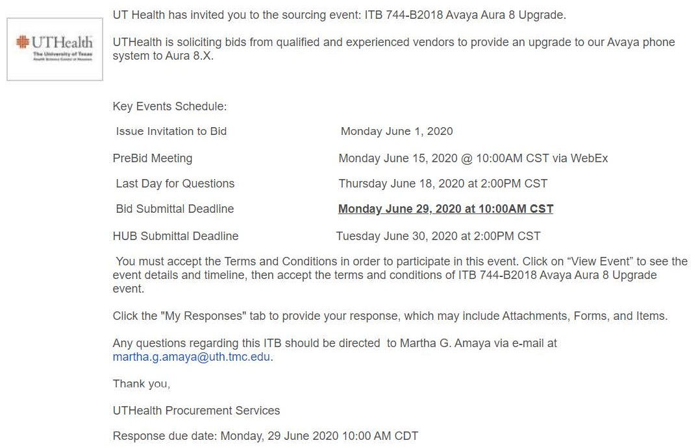
Event invitation email
Once a buyer launches an event, Suppliers will receive an email that provides information about the bid:
Notes:
SEGAY

Slide 5
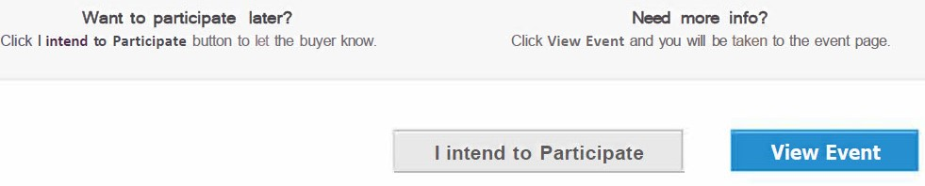
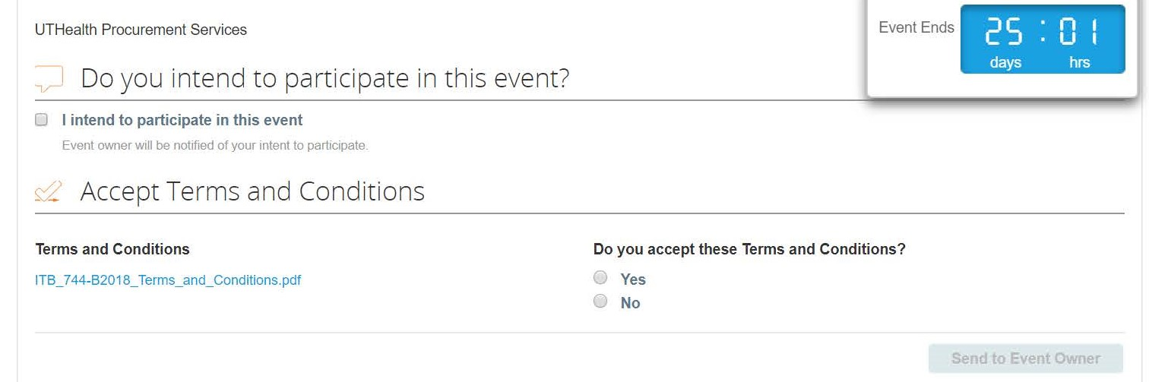
Intent to Participate
At the bottom of the invitation email, Suppliers have the option to indicate their intent to submit a bid response by clicking the “I intend to Participate button” below:
This will take you to the event page. You must click the checkbox next to “I intend to participate in this event”, review the Terms & Conditions document, and accept the T&Cs to proceed with the event.
Notes:
SEGAY

Slide 6
View Event
If a Supplier is ready to respond to the event, they can click on “View Event” from the email. You will still need to accept the Terms and Conditions to proceed to the response section of the event:
Notes:
SEGAY

Slide 7
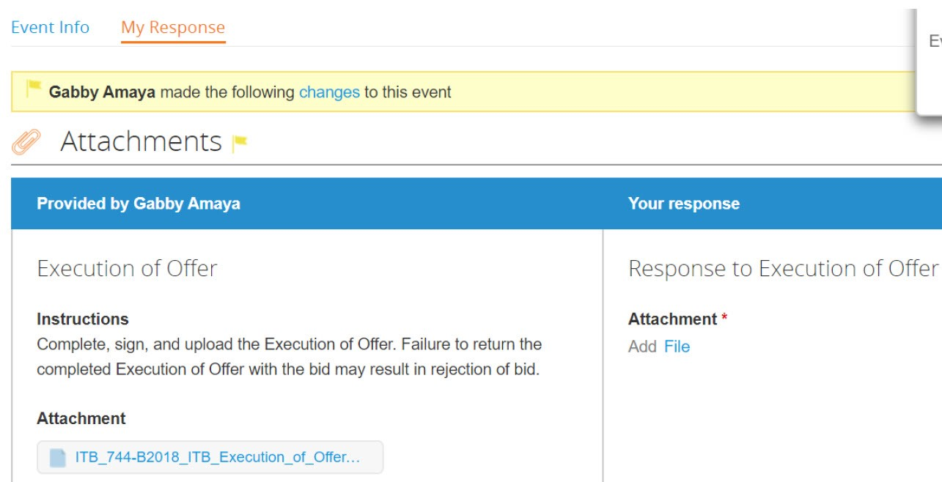
Bid Response (Attachments)
If a Supplier is ready to respond to the event, they can click on “View Event” from the email. You will still need to accept the Terms and Conditions to proceed to the response section of the event. You will then see the Attachments associated with the event:
Upload your completed Execution of Offer file here
You must download the document, respond to the questions and save your document.
Notes:
SEGAY

Slide 8
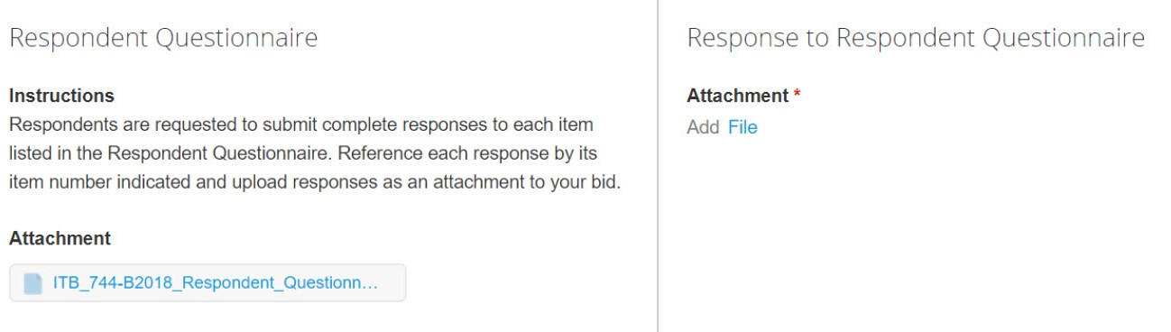
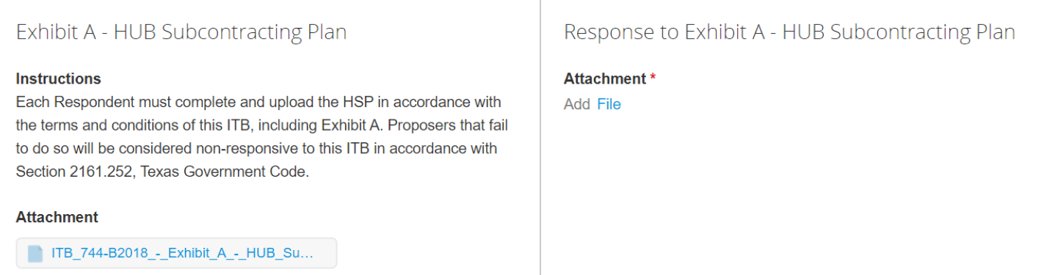
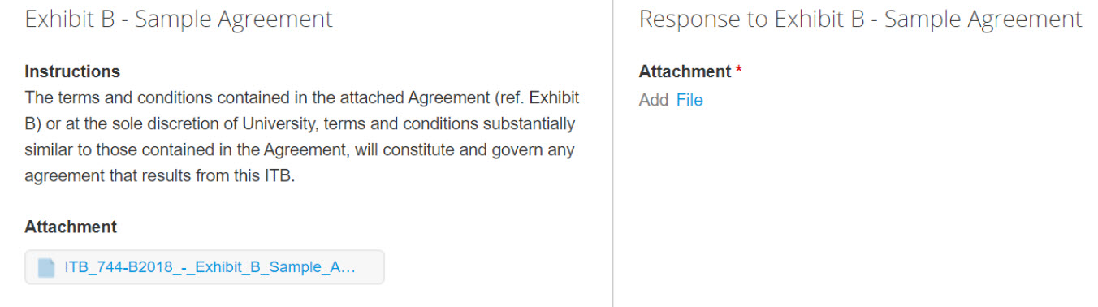
Bid Response (Attachments)
Repeat these steps with the remaining attachments:
Download the Questionnaire, complete the form and upload your response here.
Upload your HUB Subcontracting Plan here if one is required for the bid.
Review the UTHealth Agreement and mark up any requested changes if applicable.
Notes:
SEGAY

Slide 9
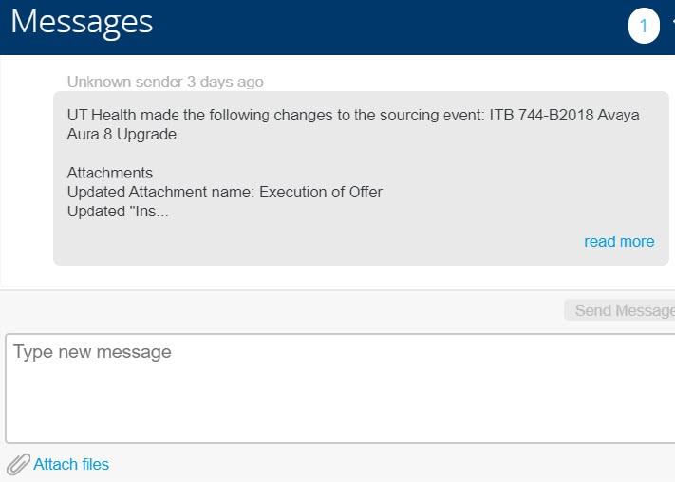
Message Feature
On the bottom left of the screen, there is a “Messages” box. Click this to open a window to send the Buyer a message.
Notes:
SEGAY

Slide 10
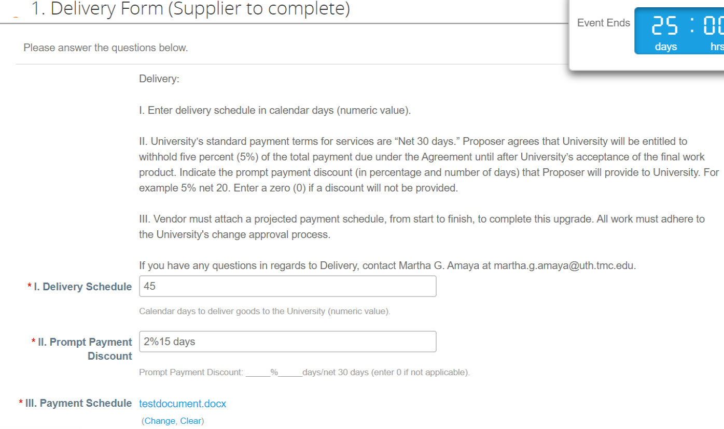
Bid Response (Delivery section)
Complete the Delivery Form to provide the number of days to deliver goods/services and to provide the Prompt Payment Discount if applicable:
Notes:
SEGAY

Slide 11
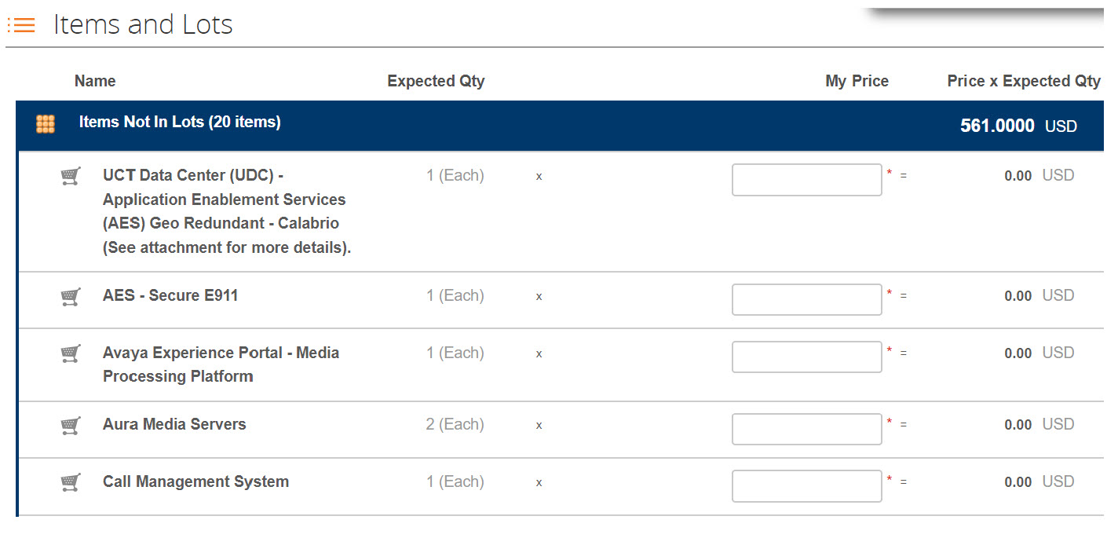
Bid Response (Pricing)
Submit Pricing in the “Items and Lots” section of the event form by entering your line pricing under the “My Price” column:
Notes:
SEGAY

Slide 12
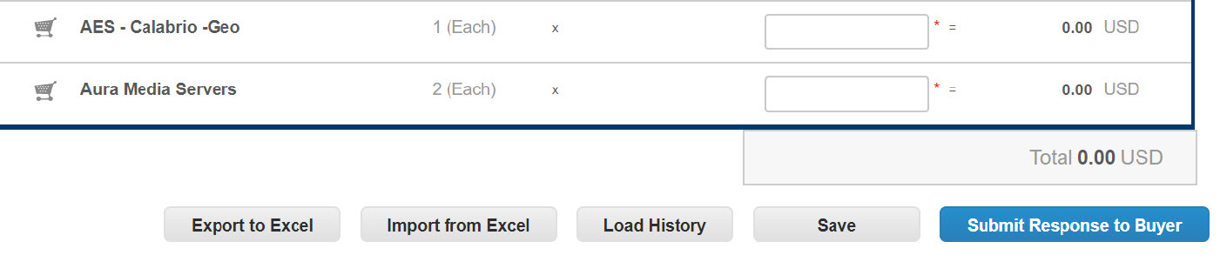
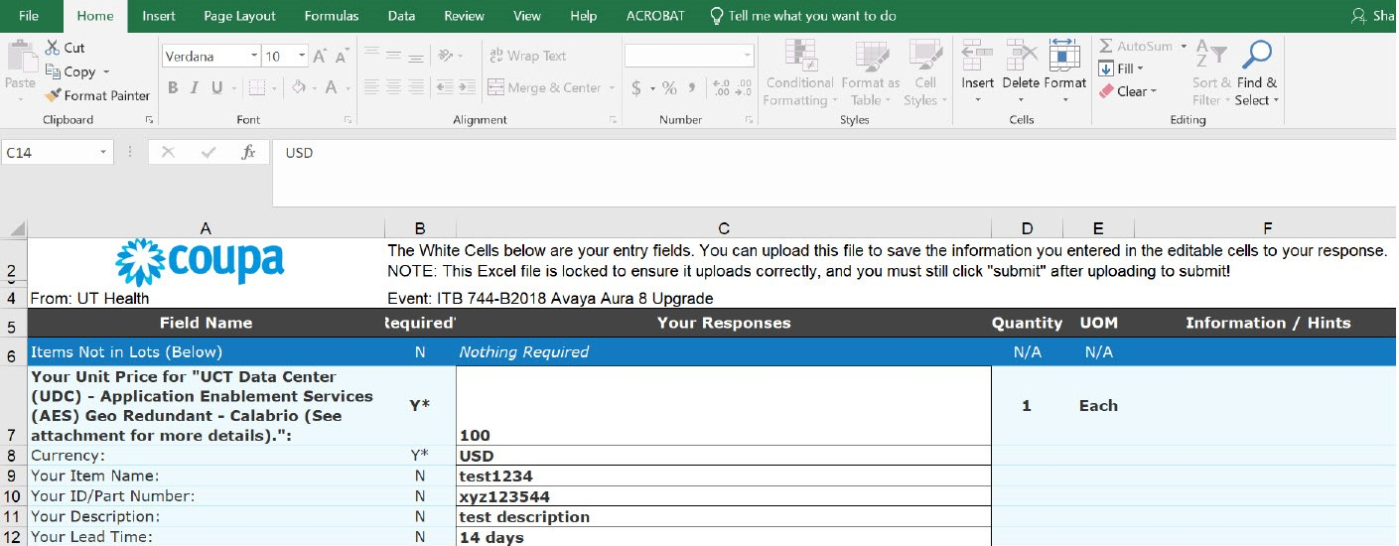
Bid Response (Pricing)
You can also use the “Export to Excel” button to download an Excel pricing template. Complete the Excel form, save the file, and then hit the “Import from Excel” button to upload your document:
Notes:
SEGAY

Slide 13
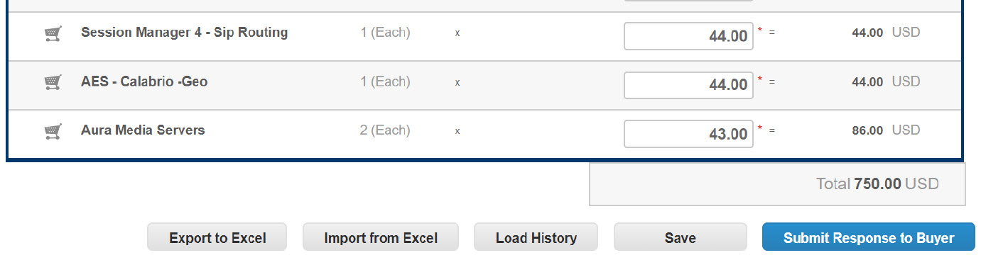
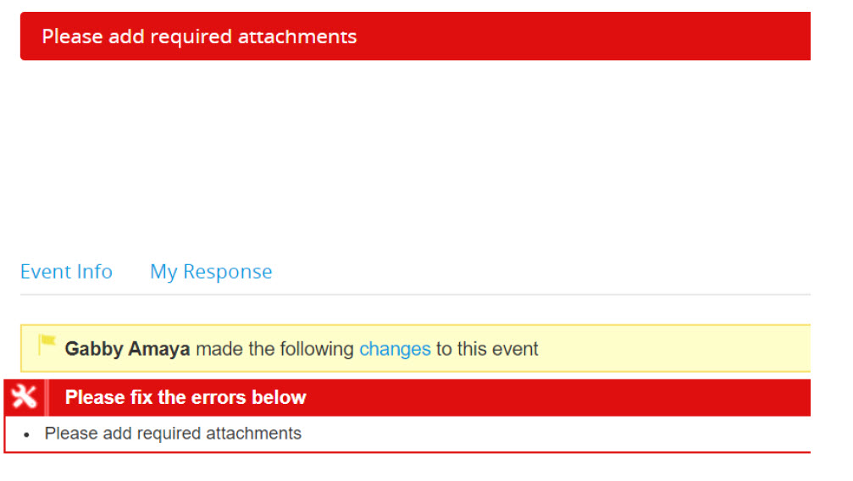
Bid Response (Submit)
After completing pricing, click the “Submit Response to Buyer”:
If any required Attachments were left off, you will receive an error message directing you to upload all required documents.
Notes:
SEGAY

Slide 14
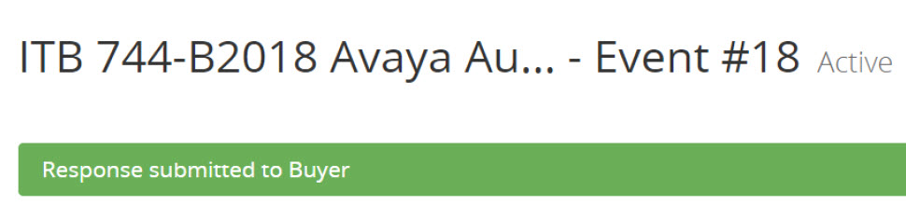
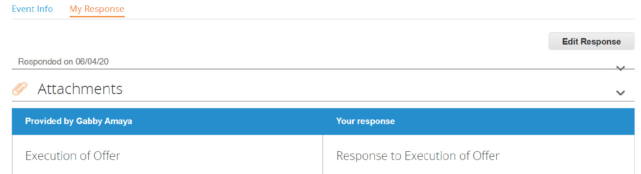
Response Submitted
After submitting response, Supplier will see the message below indicating the response was submitted to the Buyer:
To edit response after submitting, hit the “Edit Response” button, make the necessary edits, and then hit the “Submit Response to Buyer” button. (Note – you may only edit your response up to the time of the Bid Deadline):
Notes:
SEGAY

Slide 15
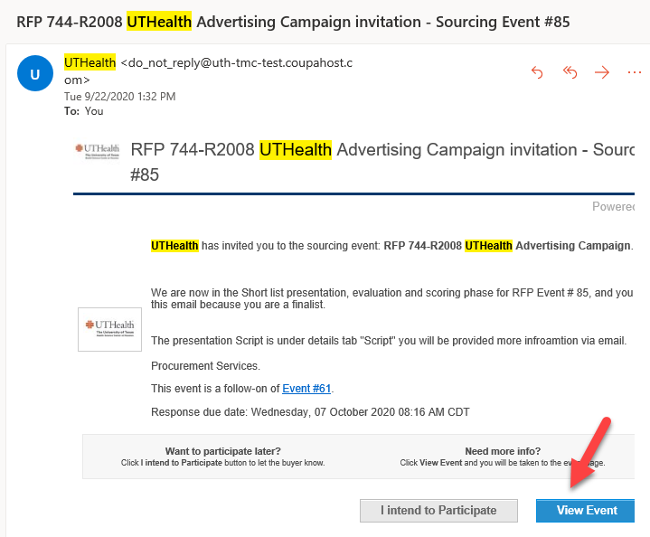
Shortlist (Follow-On Event)
After the initial round of evaluations, the team may decide to move into shortlist presentations. If your company is chosen to participate in the shortlist, you will receive an email notifying you of the follow on event. Click View Event from the email.
Notes:
SEGAY

Slide 16
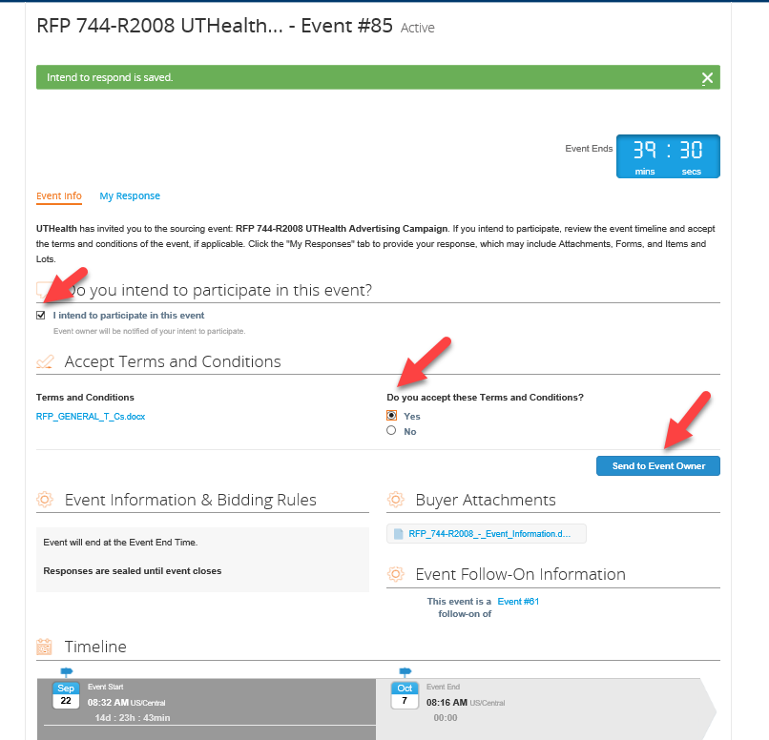
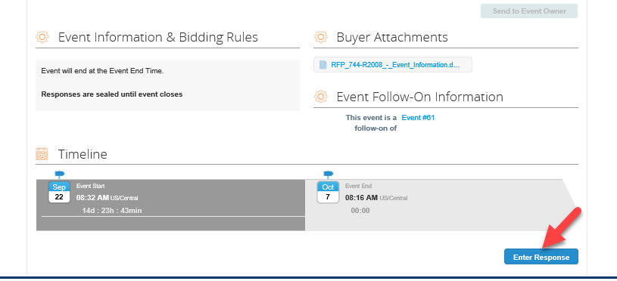
Shortlist (Follow-On Event)
Supplier must check the box next to “I Intend to participate in this event” and select Yes to accept the terms and conditions. Then Enter Response.
Notes:
SEGAY

Slide 17
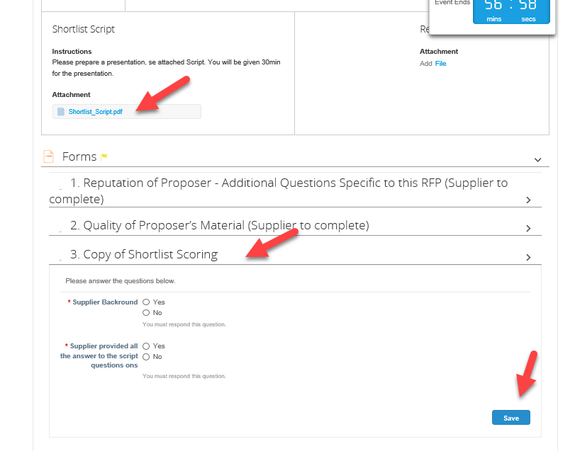
Shortlist (Follow-On Event)
You must review the Shortlist Script attachment and provide a response to the questions in the Shortlist Scoring section, if applicable. Then hit Save.
Notes:
SEGAY

Slide 18
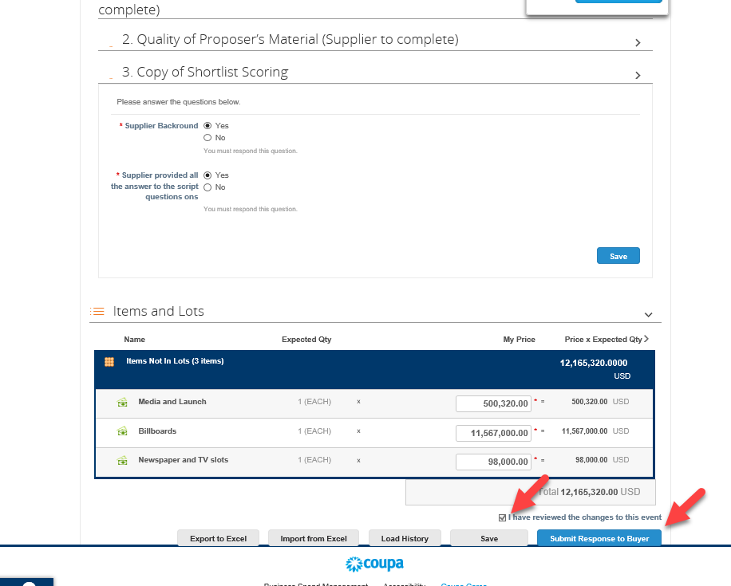
Shortlist (Follow-On Event)
Review the changes and check “I have reviewed the change to this event” box, and click the “Submit Response to Buyer” button.
Notes:
SEGAY

Slide 19
Thank You!
Procurement Services

