Slide 1
What Every Safety Professional Should Know About
“Global Health Security”
Robert Emery DrPH, CHP, CIH, CBSP, CSP, CHMM, CPP, ARM
Professor of Occupational Health
The University of Texas School of Public Health
Vice President for Safety, Health, Environment & Risk Management
The University of Texas Health Science Center at Houston

Slide 3
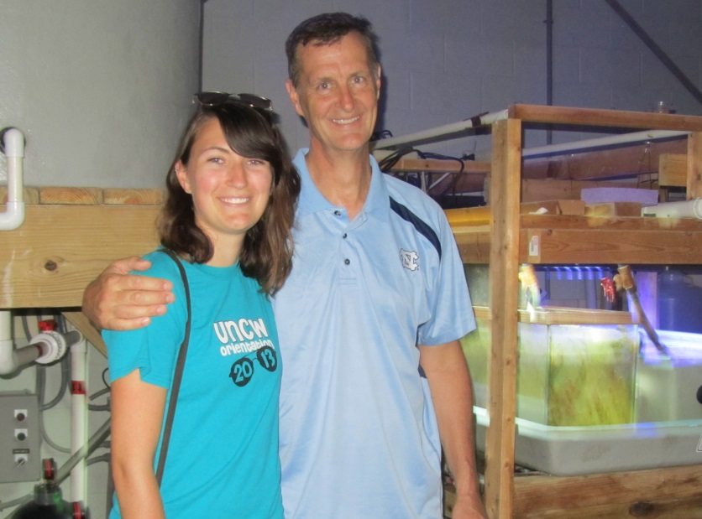

Slide 4
Learning Objectives
Define “Global Health Security” and describe its importance
List the 5 strategic objectives established for enhancing Global Health Security
Describe examples of current threats to our Global Health Security
Discuss the steps that should be taken o not only protect yourself and your families, but also the organizations you serve
Review the likely impacts of this initiative on research
Provide a useful list of references

Slide 5
Summary of the first 10 Confirmed Cases of Ebola Virus on US Soil
(up til November 30, 2014)
NO. | NAME | REMARKS | CONTRACTED EBOLA IN THE USA?
1 | Kent Brantley | Purposely transported to US for treatment in specialized facility, survived | NO
2 | Nancy Writebol | Purposely transported to US for treatment in specialized facility, survived | NO
3 | Rick Scara | Purposely transported to US for treatment in specialized facility, survived | NO
4 | Unnamed person | Purposely transported to US for treatment in specialized facility, survived | NO
5 | Askoka Mukpo | Purposely transported to US for treatment in specialized facility, survived | NO
6 | Thomas Duncan | Flew to US while asymptomatic, treated, but died | NO
7 | Nina Pham | Healthcare worker directly involved in Mr. Duncan’s care, survived | YES
8 | Amber Vinson | Healthcare worker directly involved in Mr. Duncan’s care, survived | YES
9 | Craig Spencer | Patient contact in West Africa, flew asymptomatic, survived | NO
10 | Martin Salia | Purposely transported to US for treatment in specialized facility, died | NO
Note: 43 community contacts with Mr. Duncan passed the 21 day incubation period and came off “fever watch” and “enforceable control orders”. 75 health care workers who supported Mr. Duncan’s care also were cleared.

Slide 6
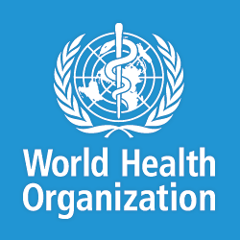
Health
WHO Definition:
“Health is a state of complete physical, mental, and social well-being and not merely the absence of disease or infirmity.”
Preamble to the Constitution of the World Health Organization as adopted by the International Health Conference, New York, 19-22 June, 1946; signed on 22 July 1946 by the representatives of 61 States

Slide 7
Disease
“An interruption, cessation, or disorder of bodily function, system or organ”
Steadman’s Medical Dictionary, 27th Edition
Classified by the World Health Organization (WHO) as either “non-communicable” or “communicable”
Non-communicable: a disease manifested in an individual that is not transmissible to others
Communicable: a disease that is transmissible by infection or contagion directly or through the agency of a vector. Also commonly referred to as “infectious”

Slide 8
Outbreak
The occurrence of cases of disease in excess of what would normally be expected in a defined community, geographical area or season.
A single case of a communicable disease long absent from a population, or caused by an agent not previously recognized in that community or area, or the emergence of a previously unknown disease, may also constitute an outbreak and should be reported and investigated.
World Health Organization

Slide 9
Communicable Disease History
Infectious disease outbreaks have been documented throughout history
Examples include epidemics of smallpox, leprosy, tuberculosis, meningococcal infections, and diphtheria
From the earliest times, humans have sought to understand the natural forces and risk factors associated with the patterns of illness and death in society
The magnitude of mortality was enormous. Medicine and religion strove to console the sick and dying. But because medical knowledge was lacking, religious explanations for disease dominated

Slide 10
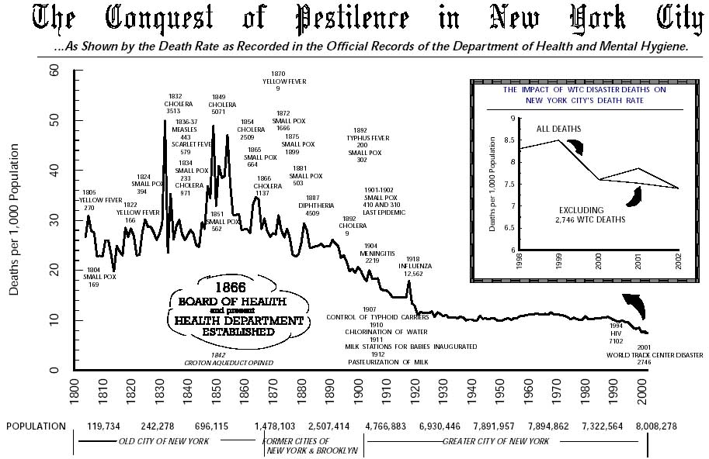

Slide 11
Early Epidemiology
The contagious characteristic of infectious disease was recognized in early epidemics, but the knowledge of the epidemiological basis of disease spread was lacking
For example, leprosy was considered highly contagious and equated religiously with sin.
In the Middle Ages, lepers were literally stricken from society and often delivered a “Mass of Separation” wherein a Priest issued specific orders to exclude them from interacting in public

Slide 12
Fracastoro (1478-1553)
Wrote “On Contagion, Contagious Disease and Their Treatment” in 1546
He proposed a revolutionary theory that infectious diseases were transmitted from person to person by invisible seeds he called “seminaria”
But he held to the ancient belief that these transmissions were influenced by the alignment of three planets: Mars, Saturn, and Jupiter
He postulated that the environment became polluted with seminaria when certain atmospheric and astrologic conditions occurred
It wasn’t until 200 years later with the invention of the microscope that his theory of seminaria would be confirmed with the visualization of microbes

Slide 13
Epidemiological Progress
While the exact biological basis for many diseases had not yet been determined, the science of epidemiology emerged as a valuable tool in combating disease
John Snow (1813-1858) evaluated the transmission of cholera 30 years prior to the identification of the causative organism
William Budd (1868-1953) chronicled the transmission of typhoid fever 35 years prior to the isolation of Salmonella typhi.
Ignatz Semmelweiss documented an outbreak of puerperal (or childhood fever) in 1847 in a hospital due to the absence of good hand hygiene

Slide 14
Microorganism Discovery
1683 Anton van Leeuwenhock invented the microscope and reported the presence of materials in rainwater and human excretions
1857 Louis Pasture demonstrated that fermentation depended on the presence of microorganisms
Robert Koch demonstrated in, 1876, that one could reproducibly transmit anthrax from diseased cows to mice and developed “Koch’s Postulates”

Slide 15
Further Progress
The identification of causative microorganisms lead to better epidemiological understanding of diseases
Microbiology, virology, and immunology emerged as professions in parallel to epidemiology, statistics and public health
Between 1887 and 1902 the NIH was created for “the study of infectious and contagious disease and matters pertaining to public health”
Better understanding of disease pathology also lead to better treatments. Vaccines for rabies, anthrax, diphtheria and tetanus were developed are considered one of the most important public health improvements of the century

Slide 16
The Significance of Public Health in America:
64% Increase in Average Life Expectancy Over 100 Year Period
Increased years due to medical care advances:
5 yrs
Increased years due to public health advances: 25 yrs
Source: Ten Great Public Health Achievements -- United States, 1900-1999 MMWR, April 02, 1999 / 48(12);241-243 http://www.cdc.gov/mmwr/preview/mmwrhtml/00056796.htm

Slide 17
Ten Great Public Health Achievements in the United States, 1900 to 1999
Vaccinations
Motor-vehicle safety
Safer workplaces
Control of infectious disease
Decline in deaths from coronary heart diseases and stroke
Safer and healthier foods
Healthier mothers and babies
Family planning
Fluoridation of drinking water
Recognition of tobacco use as a health hazard
Source: Ten Great Public Health Achievements -- United States, 1900-1999 MMWR, April 02, 1999 / 48(12);241-243 http://www.cdc.gov/mmwr/preview/mmwrhtml/00056796.htm

Slide 18
150 Years of Change

Slide 19
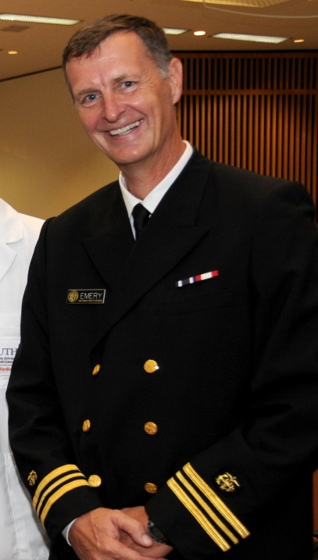
Line from the United States Public Health Service Commission Corps march song
“…In the silent war against disease, no truce is ever seen…”

Slide 20
Continued Disease Burden and Associated Professions
Despite all of this progress, the infectious disease burden in the United States is significant, resulting in over 100,000 deaths each year.
(Note – this is 22X the number of workplace fatalities each year: 4,400)
While the health care community is focused on the treatment of individuals with disease (a subset of which may be infectious), there are four professions that are focused primarily on the control and prevention of infectious disease:
(1) infection preventionists
(2) biosafety professionals,
(3) environmental health specialists
(4) public health professionals
Although the targeted populations for each of these professions differ, a common set of core competencies exists that are absolutely essential in order to successfully control and prevent infection.

Slide 21
Registered Environmental Health Specialist
(Registered Sanitarian)
Primarily focused on protection of public
from infection from
food, water, housing, waste
Professional organization: National Environmental Health Association (NEHA)
Certification: RHES/RS
Infection Preventionist
Primarily focused on protection of
patients in clinical settings
Biosafety
Primarily focused on protection of workers in labs
Common core
competencies for
Disease Control:
Basic mechanisms of infection
Germ theory
Koch’s postulates
Immunology
Disease reservoirs, hosts
Modes of transmission
Pathogens
Taxonomy
Genetics DNA/RNA
Professional organization: Association for Professionals in Infection Control and Epidemiology (APIC)
Certification: CIC
Professional organization: American Biological Safety Association (ABSA)
Certification: CBSP
Public Health (MPH)
Focused on protection of public, with core course work in:
Epidemiology
Biostatistics
Occupational and Environmental Health
Behavioral Sciences
Management and Policy Sciences
Professional organization: APHA
Certification: CPH

Slide 22
Infection Preventionists
Primarily focused on protection of patients in clinical setting
Examples diseases and organisms:
Clostridium difficile
Hepatitis
Human Immunodeficiency Virus (HIV)
Methicillin-resistant Staphylococcus aureus
Tuberculosis (TB)
Vancomycin-resistant Enterococci (VRE)
Areas of concern:
Healthcare Associated Infections (HAIs) –
Central line-associated bloodstream infection (CLABSI)
Catheter-associated Urinary Tract Infection (CAUTI)
Surgical Site Infection (SSI)
Ventilator-associated Pneumonia (VAP)
Key terms / concepts: patient safety, medication safety, injection / sharps safety, blood / transplant safety, vaccine safety, hand hygiene

Slide 23
Registered Environmental Health Specialist
Primarily focused on protection of public from infection from food, water, housing, waste
Example areas of concern:
Foodborne illness –
Norovirus
Clostridium perfringens
Camphylobacter spp.
Staphylococcus aureus
E. coli
Listeria monocytogenes
Water borne illness –
Giardia lamblia
Cryptosporidium parvum
Key terms / concepts: Swimming pools and recreational facilities, Vectors, pests, and poisonous plants, Solid and hazardous waste, air quality and noise, Occupational health and safety, General environmental health, Disaster sanitation and emergency planning

Slide 24
Biosafety Professional
Primarily focused on protection of lab workers
Areas of concern:
Risk grouping of infectious agents (RG 1-4)
e.g. bacteria, viruses, parasites, prions
Biosafety level designations (BSL 1-4)
Animal biosafety level designations (ABSL 1-4)
Plant biosafety
Recombinant and synthetic nucleic acid molecules (NIH Guidelines)
Select agents and toxins (CDC/USDA)
Dual use research of concern
Biosecurity
Training
Biosafety cabinetry (and other containment)
Transportation of infectious agents
Decontamination, disinfection, sterilization
Key terms / concepts: risk assessment, containment, laboratory acquired infections, good microbiological technique, safe work practices, laboratory facility design, gain of function

Slide 25
Public Health Professional
Primarily focused on the education and protection of public from non-contagious and contagious diseases
Example areas of concern:
Influenza
Tuberculosis
Sexually transmitted infections
Ebola
Key terms / concepts: immunizations, records, contact investigations, “fever watch”, “enforceable control orders”

Slide 26
Key Resource Across All Professions
“Preventing the transmission of infectious diseases has never been more challenging than today in a world that is characterized by tremendous globalization, connectivity, and speed. I can think of no other resources more vital than the APHA’s Control of Communicable Diseases Manual for health professionals to meet these challenges head-on”
Dr. Julie Gerberding, former Director, CDC

Slide 27
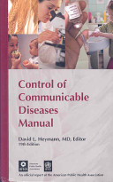
APHA Control of Communicable Disease Manual Consistent Format
Identification
Infectious agent
Occurrence
Reservoir
Modes of transmission
Incubation period
Period of communicability
Susceptibility
Methods of control

Slide 28
Texas DSHS Infectious Disease Outbreak Webpage

Slide 29
So What is Global Health Security?
The goal of the Global Health Security initiative is to prevent, detect, and respond to infectious disease threats where they start
The initiative consists of the US and more than two dozen countries and international organizations
A consequence of a more interconnected world is the increasing opportunity for human, animal, and zoonotic diseases to emerge and spread globally
“Global health security is shared responsibility. No one country can achieve it alone. A threat anywhere is indeed a threat everywhere”
Health and Human Services Secretary Kathleen Sebelius

Slide 30
Threats to Global Health Security
Five sources of threat to our global health security:
The emergence and spread of new microbes
The globalization of travel and food supply
The rise of drug-resistant pathogens
The acceleration of biological science capabilities and the risk that these capabilities may cause the inadvertent or intentional release of pathogens
Continued concerns about the acquisition, development, and use of biological agents by state or non-state actors
White House memo, July 18, 2014

Slide 31
Examples
Consider the recent outbreaks of:
Middle East Respiratory Syndrome (MERS)
H7N9 influenza
Ebola
Are all revealing gaps in the global system for managing emerging biological threats
The term “security” is used because healthier countries are more stable and prosperous, hence fewer failed states
The need for enhanced leadership to strengthen global capabilities to prevent, detect, and respond to biological threats, whether naturally occurring, deliberate, or accidental, is acute.

Slide 32
Basic Reproduction Number or Rate (R_{o})
R_{o} is the estimate of the number of cases a single case generates, on average, during the course of its infectious period
Disease | Transmission | R_{o}
Measles | Airborne | 12 - 18
Pertussis | Airborne droplet | 12 - 17
Smallpox | Airborne droplet | 5 - 7
Polio | Fecal-oral | 5 - 7
Mumps | Airborne droplet | 4 - 7
HIV/AIDS | Sexual contact | 2 - 5
SARS | Airborne droplet | 2 - 5
Ebola | Bodily fluids | 1 - 2

Slide 33
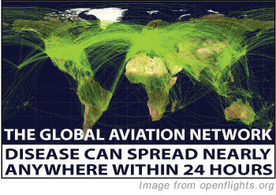
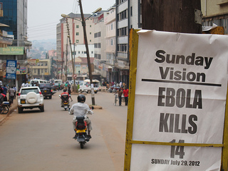
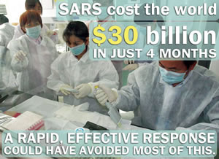
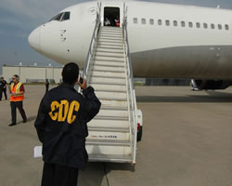

Slide 34
National Strategy for Countering Biological Threats: Global Health Security Agenda
Prevent avoidable outbreaks
Prevent the emergence and spread of antimicrobial drug resistant organisms and emerging zoonotic diseases, and strengthen international regulatory frameworks governing food safety
Promote national biosafety and biosecurity systems
Reduce the number and magnitude of infectious disease outbreaks
Detect Threats Early
Launch, strengthen and link global networks for real-time biosurveillance
Strengthen the global norm of rapid, transparent reporting and sample sharing in the event of health emergencies
Develop and deploy novel diagnostics and strengthen laboratory systems
Train and deploy an effective biosurveillance workforce
Respond Rapidly and Effectively
Develop an interconnected global network of Emergency Operations Centers and multisectoral response to biological incidents
Improve global access to medical and non-medical countermeasures during health emergencies

Slide 35
What Can/Should You Do?
For yourself and your family
Make sure you and your family are immunized
Develop good health habits – regular hand washing
Discuss the issues and monitor for developments (and as we’ve learned with Ebola, while effectively managing the data)

Slide 36
What Can/Should You Do?
For your workplace:
Appoint someone to regularly monitor for developments – worldwide
Subscribe to the Health Alert Network (HAN) hosted by the CDC
Monitor TX DSHS outbreak website
Procure the key reference for communicable diseases so you will have the facts – not media hype
APHA Control of Communicable Diseases Manual
Evaluate international impacts (supply chain and travel) – assess health warnings
Dedicate some of your professional development training efforts towards a better understanding of infectious disease

Slide 37
What Can/Should You Do?
For your workplace (continued):
Plan ahead – how might an outbreak (real or perceived) affect your business? Here and abroad?
Make sure outbreaks are one of the perils considered in your emergency response and business continuity plans
Policies for sick leave and time away from work
Consider stockpiles of protective equipment, cleaners, thermometers
Consider how you will communicate with employees and how work might be accomplished in a modified manner
Provide tips to workers about protecting their families

Slide 38
Summary
The five sources of threat to our Global Health Security consists of :
The emergence and spread of new microbes
The globalization of travel and food supply
The rise of drug-resistant pathogens
The acceleration of biological science capabilities and the risk that these capabilities may cause the inadvertent or intentional release of pathogens
Continued concerns about the acquisition, development, and use of biological agents by state or non-state actors
The national strategy to address these threats consists of:
Preventing avoidable outbreaks
Detecting threats early
Responding rapidly and effectively

Slide 39
Summary (con’t.)
Although there are four main professions focused on the control and prevention of infection…..
Infection prevention
Biosafety professional
Registered environmental health specialists
Public health
No single profession is sufficient to address this global challenge, hence why it is prudent for health and safety professionals of all types to be knowledgeable of the threat in order to aid in preparedness and response efforts

Slide 40
Final Quote
From Dr. Robert Earl in a July 2015 editorial in Forbes on the issue of Global Health Security:
“At one time, protecting the public’s health was considered a local community responsibility. But in this new world that’s no longer so. With people and goods moving so freely across borders, we are all now citizens of a global community. We must now undertake a collaborative world-wide enterprise – nothing less will do.”

Slide 41
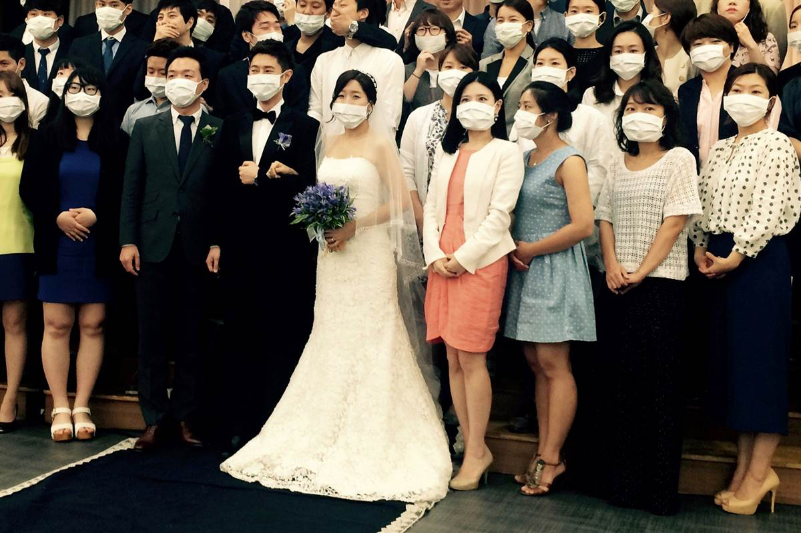

Slide 42
Useful References
Global Health government webpage http://www.globalhealth.gov
CDC Global Health Security webpage http://www.cdc.gov/globalhealth/security/
American Biological Safety Association www.absa.org
American Public Health Association www.apha.org
APHA Control of Communicable Diseases Manual http://secure.apha.org/imis/ItemDetail?iProductCode=978-087553-0185&CATEGORY=BK
American Society for Microbiology www.asm.org
CDC HAN Network http://emergency.cdc.gov/HAN/
Association for Professionals in Infection Control and Epidemiology www.apic.org
National Environmental Health Association www.neha.org
White House Fact Sheet http://www.whitehouse.gov/the-press-office/2011/09/22/fact-sheet-global-health-security
Texas DSHS outbreak website: http://www.dshs.state.tx.us/news/updates.shtm

