Slide 1
Program Measures and Metrics that Matter
Robert Emery, DrPH, CHP, CIH, CSP, CBSP, CHMM, CPP, ARM
Vice President for Safety, Health, Environment & Risk Management
The University of Texas Health Science Center at Houston
Professor of Occupational Health
The University of Texas School of Public Health

Slide 2
Learning Objectives
By the end of this learning module, you should be able to:
Identify basic institutional descriptors.
Identify staffing predictors and influencing factors.
Understand the difference between measures and metrics.
Describe the EH&S metrics model, identifying the four major categories of measurements we suggest to use as a balance scorecard.
Describe the difference between output and outcome.

Slide 3
What are Our Drivers?
To begin to articulate the risk control needs of an institution, we first must understand its basic characteristics
To accomplish this, we need some basic descriptive institutional data
Such as…

Slide 4
Institutional Measures
How big is your institution?
How is size measured?
What measures are important (e.g. resonate with resource providers?)
What risks are present?
How are these risks managed?
Are these risks real or hypothetical?
How might you determine that?
How does management determine that?

Slide 5
Loss Prevention Measures
How is your program’s performance measured?
In your opinion, are these measures true indicators of performance?
What do the clients served really think of your program?
Do clients feel there are real (or perceived) loss prevention program duplications of effort?
How many staff?
In your opinion, are you over or understaffed?
How would you know?
How would others know?
How are you performing?
Within the context of the mission of your institution, is your program viewed as hindering or helping?

Slide 6
Loss Prevention Staffing
An age old question - How many EH&S staff should I have?
Perhaps an equally important question is: What can we realistically hope to obtain from a benchmarking exercise involving staffing metrics?
At best, we can likely only achieve a reasonable estimation of “industry averages”, such as number of EH&S FTE’s for an institution exhibiting certain characteristics

Slide 7
Sampling of Possible Staffing Predictors and Influencing Factors
Quantifiable
Institution size
Number of labs
Level of funding
Population
Geographic location
Deferred maintenance
Public/private
Medical/Vet schools
Multiple locations
Non-quantifiable
Regulatory history & scrutiny
Tolerance of risk by leadership
Level of trust/faith in program
Ability of program to articulate needs

Slide 8
Desirable Characteristics of Predictors for Benchmarking
Consistently quantifiable
Uniformly defined by a recognized authority
Easily obtained
Meaningful and relevant to decision makers (provides necessary context)
Consider something as simple as the definition of “number of EH&S staff”

Slide 9
A Word About Comparisons: What do Universities Compare?
Revenues
Tuition and fees
Size
Number of students
Research productivity
Number of faculty
School rankings
Athletics
Student entry grade point average, SAT scores
Amount of grant funding and by whom
Revenues from Tech Transfer
Reputation
And people don’t think you can compare EH&S programs?

Slide 10
Suggested Definition
“EH&S Staff”: technical, managerial, and directorial staff that support the EH&S function
Suggest including administrative staff, but it probably doesn’t make a big difference
Can include staff outside the EH&S unit, but must devote half time or greater to safety function (0.5 FTE)
Example
Safety person in another department
Student workers (>0.5 FTE)
Contractors included only if onsite time is half time or greater (0.5 FTE)
Example –
contract lab survey techs, yes if >0.5 FTE
fire detection testing contractors, likely no.

Slide 11
Ongoing Research on Possible Predictors for EH&S Resourcing
Exploring three promising relationships – all imperfect, but each potentially useful with some degree of care
Campus square footage (non-lab and lab)
Cost of risk transfer (insurance premiums for property and worker’s compensation insurance)
Proportion of extramural research expenditures

Slide 13
Predictability of Various Models
Total campus sq ft | Lab + non-lab sq ft | ln (total campus sq ft) | ln (lab sq ft) + ln (non lab sq ft) | Med /Vet School | General “other” category | BSL3 or BSL4 | R Squared Value
X |  |  |  |  |  |  | 47.7
 | X |  |  |  |  |  | 50.5
 |  | X |  |  |  |  | 64.9
 |  |  | X |  |  |  | 71.1
 |  |  | X | X |  |  | 78.2
 |  |  | X | X | X |  | 78.4
 |  |  | X | X |  | X | 80.0

Slide 14
Current C/U Metrics Model
# EH&S FTE = e [(0.516*School) + (0.357*ln (Lab NASF)) + (0.398*ln (Nonlab NASF)) + (0.371*BSL)] - 8.618]
R² value based on 69 observations = 80%
Definitions for predictor variables:
Lab NASF: the number of lab net assignable square footage
Nonlab NASF: the number of non-lab net assigned square footage (usually obtained by subtracting lab from gross)
School: defined as whether your institution has a medical school as listed by the AAMC or a veterinary school as listed by the AAVMC; 0 means no, 1 means yes
BSL: this variable indicates if the institution has a BSL3 or BSL4 facility; 0 means no, 1 means yes

Slide 15
Staffing Predictors
The data from 102 colleges and universities from across the country indicate that four variables can account for 80% of the variability in EH&S staffing:
Non lab net assignable square footage
Lab net assignable square footage
Presence of Medical or Vet School
Existence of BSL-3 operations
These predictors important because they are recognized and understood by those outside the EH&S profession
With the collection of more data, the precision of the model could likely be improved to the benefit of the entire profession

Slide 16
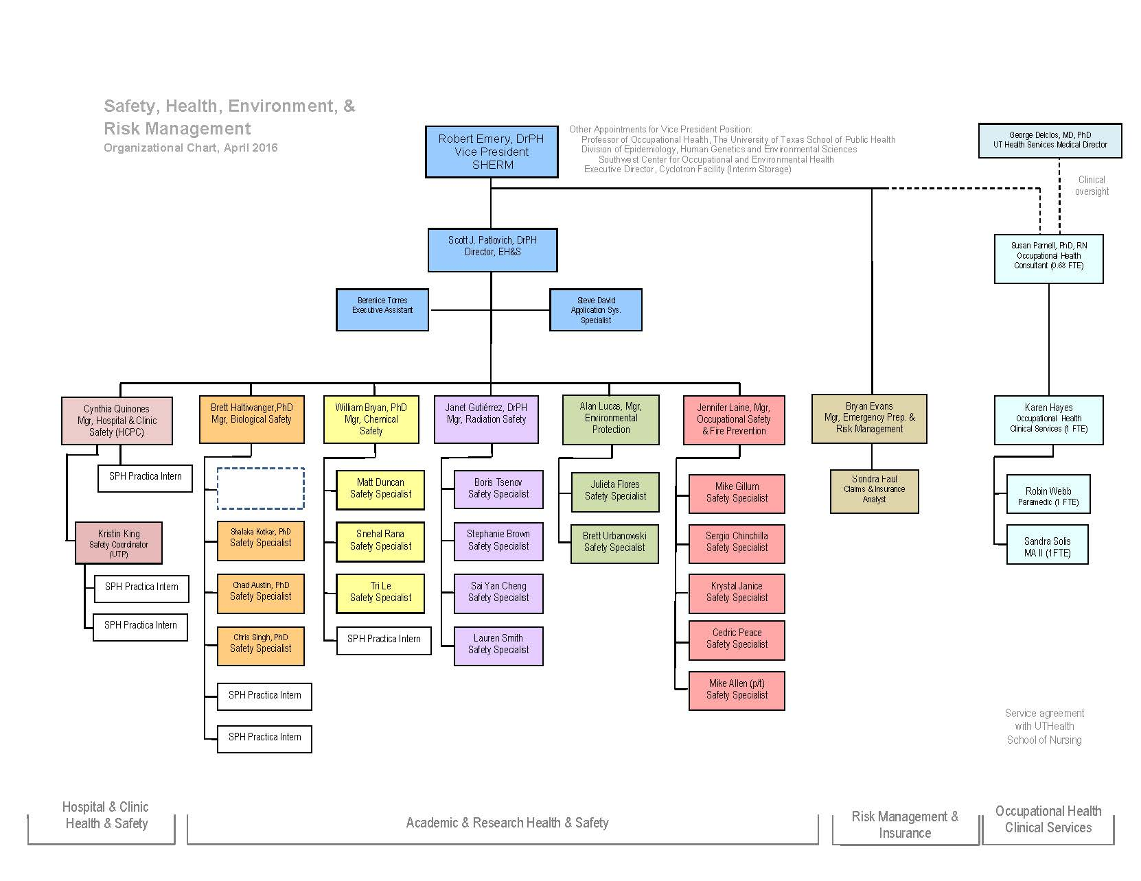

Slide 17
Campus Square Footage, SHERM Resource Needs, and Funding
(modeling not inclusive of resources provided for, or necessary for Employee Health Clinical Services Agreement)
Modeled SHERM Resource Needs and Institutional Allocations
(Not Inclusive of EHCSA)
Total Campus Square Footage
and Lab/Clinic Subset
Amount not funded
Lab area portion of total square footage
IMM funding
Institutional allocation
Non-lab portion of total square footage
SHERM Income
(Worker’s compensation insurance rebates, contracts, services)
Med
Foundation
Training Services
UTP
contract
WCI RAP rebate *
* In addition to $214,710 from “Employee Health Account”, EHCSA received 90% of FY09 WCI RAP allocation

Slide 20
Estimated Annual UTHSC-H Institutional Services Cost per Square Foot (FY 10 estimates based on UTHSC-H square footage of 3,164,000 state ^{(a)} + 1,836,000 auxiliary = 5,000,000 ft^{2 (b)} )
Utilities (electricity, gas, steam)ª $5.38
Facilities Services (salaries, maint & ops)ª $2.98
Policeª $1.00
Information Technology Supportª $1.00
Contract Services (housekeeping, trash)ª $0.58
Insurance Premiums (property, WCI)^{b} $0.50
Environmental Health & Safety^{b} $0.45

Slide 22
Ratio of Reported Total EH&S Budget and Extramural Research Expenditures

Slide 23
FY10 Cost of SHERM Institutional Services by Square Footage Type
(not inclusive of insurance premiums or employee health clinical services costs)
$15
$10
Dr. Ferrari
Dr. Fisher-Hoch
Dr. Gould
Dr. Jagganath
Dr. Koehler
Dr. Sevick-Muraca
Dr. Soto
Cost per Square Foot
$6.35 + $2.73 + $0.12/sq ft = $9.20 for all “intensive care” lab or clinic sq ft (0.4% of total space)
$5
$2.73 + $0.12/sq ft = $2.85 for all standard lab or clinic sq ft (15.6% of total space)
$0.12/sq ft for all sq ft
84%
15.6%
Percent Total Net Assignable Square Footage, based on a total for FY10 of 5,519,788 Square Feet
0.4%
Additional amount necessary to support “intensive care” space subset in FY10 equals $150,000, or a 5% increase based on previously projected FY10 budget of $3,001,177

Slide 24
3. Institutional & EHS Non-transformed Data Ratios (n= 118) from CSHEMA “Vital Statistics” Initiative
Institutional Statistics (independent variables) | EHS Statistics (dependent variables)
 | Number EH&S Staff FTEs | EH&S Expenditures
Population
Total Number of Institutional Employees (for EH&S staffing, results per 1,000) | 3.29 + 1.70 FTE Range: 0.23 to 10.52 FTE | $297.23 + $167.70 Range: $48.41 to $1,140.10
Total Number of Enrolled Students (for EH&S staffing, results per 1,000) | 1.25 + 1.72 FTE Range 0.03 to 12.09 FTE | $120.17 + $178.89 Range $4.75 to $1007.39
Area
Total Institutional Net Assignable Area (for EH&S staffing, results per 100,000 ft²) | 0.35 + 0.23 FTE Range 0.02 to 1.48 FTE | $0.31 + $0.20 Range $0.03 to $1.08
Research Net Assignable Area (for EH&S staffing, results per 100,000 ft²) | 5.17 + 5.33 FTE Range 0.48 to 36.28 FTE | $4.68 + $4.57 Range $0.48 to $28.46
Expenditures
Total Institutional Expenditures (for EH&S staffing, results per $1,000,000) | 0.026 + 0.020 FTE Range 0.002 to 0.149 FTE | 0.24% + 0.19% Range 0.04 to 1.19%
Research Expenditures (for EH&S staffing, results per $1,000,000) | 0.276 + 0.440 FTE Range 0.021 to 2.545 FTE | 2.61% + 4.66% Range 0.21 to 38.36%

Slide 25
Regression Model for EHS Full-time Equivalent Staff for All Institutions, n=118
Type of statistic | Degrees of freedom | Root mean squared error | R² | p-value | Intercept | ln total institutional assignable square footage | ln total institutional expenditures
Parameters | 115 | 0.6257 | 0.7189 | <0.0001 | -19.68 | 0.4932 | 0.7244
Standard Error |  |  |  |  | 1.324 | 0.1185 | 0.1084
T statistic |  |  |  |  | -14.86 | 4.162 | 6.682
p-value |  |  |  |  | <0.0001 | <0.0001 | <0.0001
Lower 95 bound |  |  |  |  | -22.31 | 0.2585 | 0.5096
Upper 95 bound |  |  |  |  | -17.06 | 0.7280 | 0.9391
ln (EHS FTE staff) = -19.6877 + 0.49324 * ln (total institutional assignable sf) + 0.72440 * ln (total institutional expenditures)

Slide 26
Regression Model for EHS Expenditures for All Institutions, n=118
Type of statistic | Degrees of freedom | Root mean squared error | R² | p-value | Intercept | ln total institutional assignable square footage | ln total institutional expenditures
Parameters | 115 | 0.5972 | 0.7301 | <0.0001 | -7.809 | 0.50506 | 0.69283
Standard Error |  |  |  |  | 1.264 | 0.1131 | 0.1035
T statistic |  |  |  |  | -6.176 | 4.465 | 6.695
p-value |  |  |  |  | <0.0001 | <0.0001 | <0.0001
Lower 95 bound |  |  |  |  | -10.31 | 0.2810 | 0.4879
Upper 95 bound |  |  |  |  | -5.305 | 0.7291 | 0.8978
ln (EHS expenditures) = -7.8093 + 0.50506 * ln (total institutional assignable sf) + 0.69283 * ln (total institutional expenditures)

Slide 27
Regression Model for EHS FTE Staff for AAHC Institutions, n=31
Type of statistic | Degrees of freedom | Root mean squared error | R² | p-value | Intercept | ln total institutional assignable square footage
Parameters | 29 | 0.3385 | 0.7346 | <0.0001 | -9.039 | 0.7899
Standard Error |  |  |  |  | 1.403 | 0.0881
T statistic |  |  |  |  | -6.444 | 8.961
p-value |  |  |  |  | <0.0001 | <0.0001
Lower 95 bound |  |  |  |  | -11.91 | 0.6096
Upper 95 bound |  |  |  |  | -6.170 | 0.9702
ln (EHS FTE staff) = -9.039 + 0.7899 * ln (total institutional assignable sf)

Slide 28
Regression Model for EHS Expenditures for AAHC Institutions, n=31
Type of statistic | Degrees of freedom | Root mean squared error | R² | p-value | Intercept | ln total institutional assignable square footage
Parameters | 29 | 0.3612 | 0.7334 | <0.0001 | 1.587 | 0.8397
Standard Error |  |  |  |  | 1.496 | 0.0940
T statistic |  |  |  |  | 1.061 | 8.931
p-value |  |  |  |  | 0.2973 | <0.0001
Lower 95 bound |  |  |  |  | -1.472 | 0.6474
Upper 95 bound |  |  |  |  | 4.647 | 1.032
ln (EHS expenditures) = 1.587 + 0.8397 * ln (total institutional assignable sf)

Slide 29
Applying the Models: An Example
Consider an institution with 5 million total institutional net assignable square feet and $900 million in total annual institutional expenditures
Since we don’t know lab density, assume $0.30/sq ft = $1,500,000
Based on prediction models from Vital Statistics project:
EHS expenditures = $1,568,967
EHS staffing = 16.7 FTE
If that same university was an AAHC institution
EHS expenditures = $2,064,581 (31% increase)
EHS staffing = 22.9 FTE (37% increase)
Our data suggests an average of 30% of total expenditures is research
expenditures at AAHC institutions, so (0.30)($900 million) = $270M
0.008 x $270M = $2,160,000

Slide 30
Forewarning
Note, even an estimate for the number of EH&S staff doesn’t give us any indication about their proficiency and effectiveness
So what should we be measuring in loss prevention?
And how should we communicate what loss prevention does?

Slide 31
Why Metrics?
“When you measure what you are speaking about, and express it in numbers, you know something about it; but when you cannot measure it, when you cannot express it in numbers, your knowledge is of a meager and unsatisfactory kind.”
William Thomson, Lord Kelvin

Slide 32
“If you can’t measure it, you can’t manage it” “If you don’t measure it and display it, you will soon be replaced by someone who can” Emery

Slide 33
Metrics
What measures?
What units?
How often to collect the data?
How to communicate the information?

Slide 34
Measures versus Metrics
A metric is a unit of measurement that objectively quantifies an organization’s performance

Slide 35
Measurements as Indicators
Output - workload
number of individuals trained
surveys or inspections completed
violations assessed
Outcomes – does the program achieve its desired results
is safety training or inspections effective in reducing injury or illnesses

Slide 36
Measures for Compliance Versus Performance
For regulatory purposes we document…
Pounds of hazardous waste
If a person is trained
If a person was hurt
For performance purpose we should document…
Number of pick ups
How many people were trained
How many people were hurt and what caused the injury

Slide 37
What Measures and Metrics?
Losses
Personnel
Property
Financial
Expenditures
Revenues
Compliance
External
Internal
Client Satisfaction
External
Internal

Slide 38
What Units?
$ (Cost)
Square feet
Time
Number of events

Slide 39
Biological Safety
Individuals trained
Laboratory inspections
Deficiencies identified and resolved
Incident response to biological agents
Biological Safety Cabinet verifications
Institutional Biosafety Committee protocols

Slide 41
Chemical Safety
Individuals trained
Laboratories inspections
Deficiencies identified and resolved
Incident response to chemical agents
Chemical fume hood verification

Slide 42
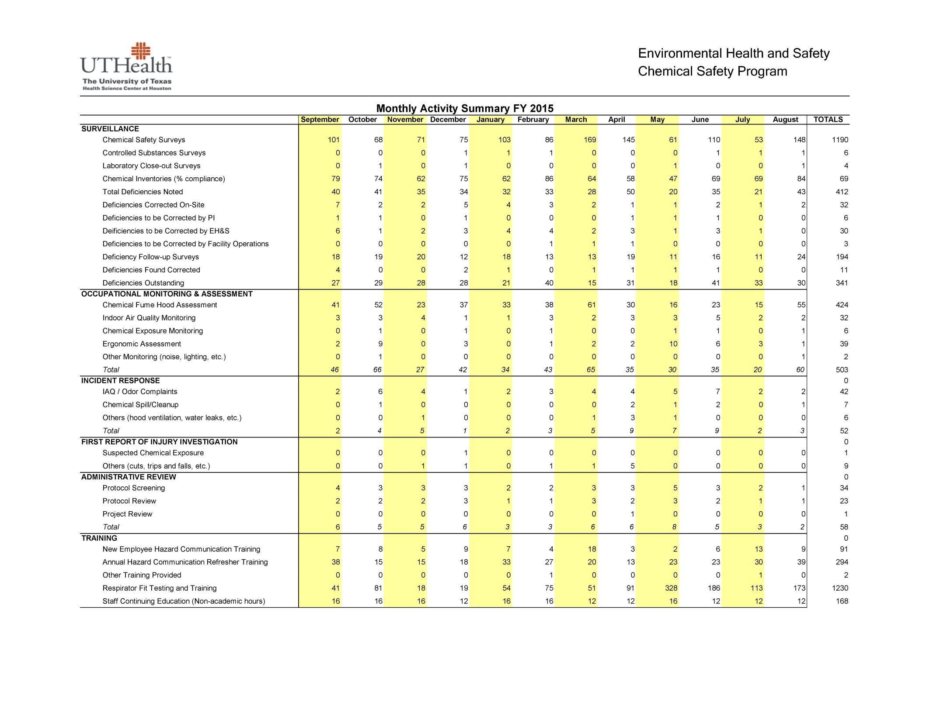

Slide 43
Radiation Safety
Individuals trained
Laboratory inspections
Dosimetry
Bioassays
Instrument calibrations

Slide 44
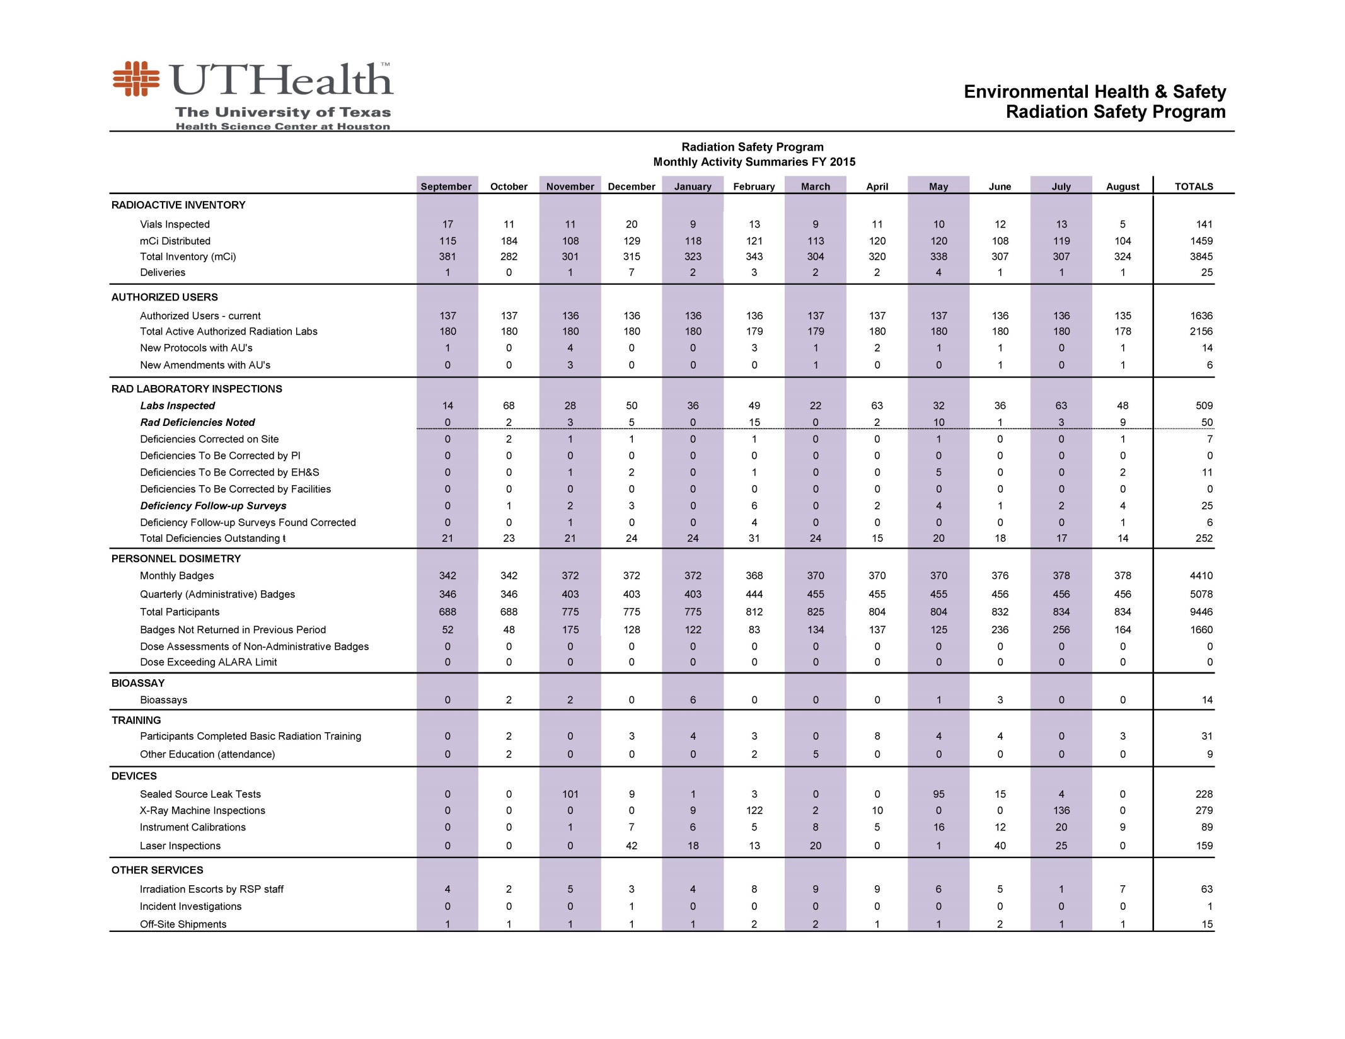

Slide 45
Environmental Protection
Disposal costs
Waste weights or volumes
Effluents released
Cost avoidance

Slide 46
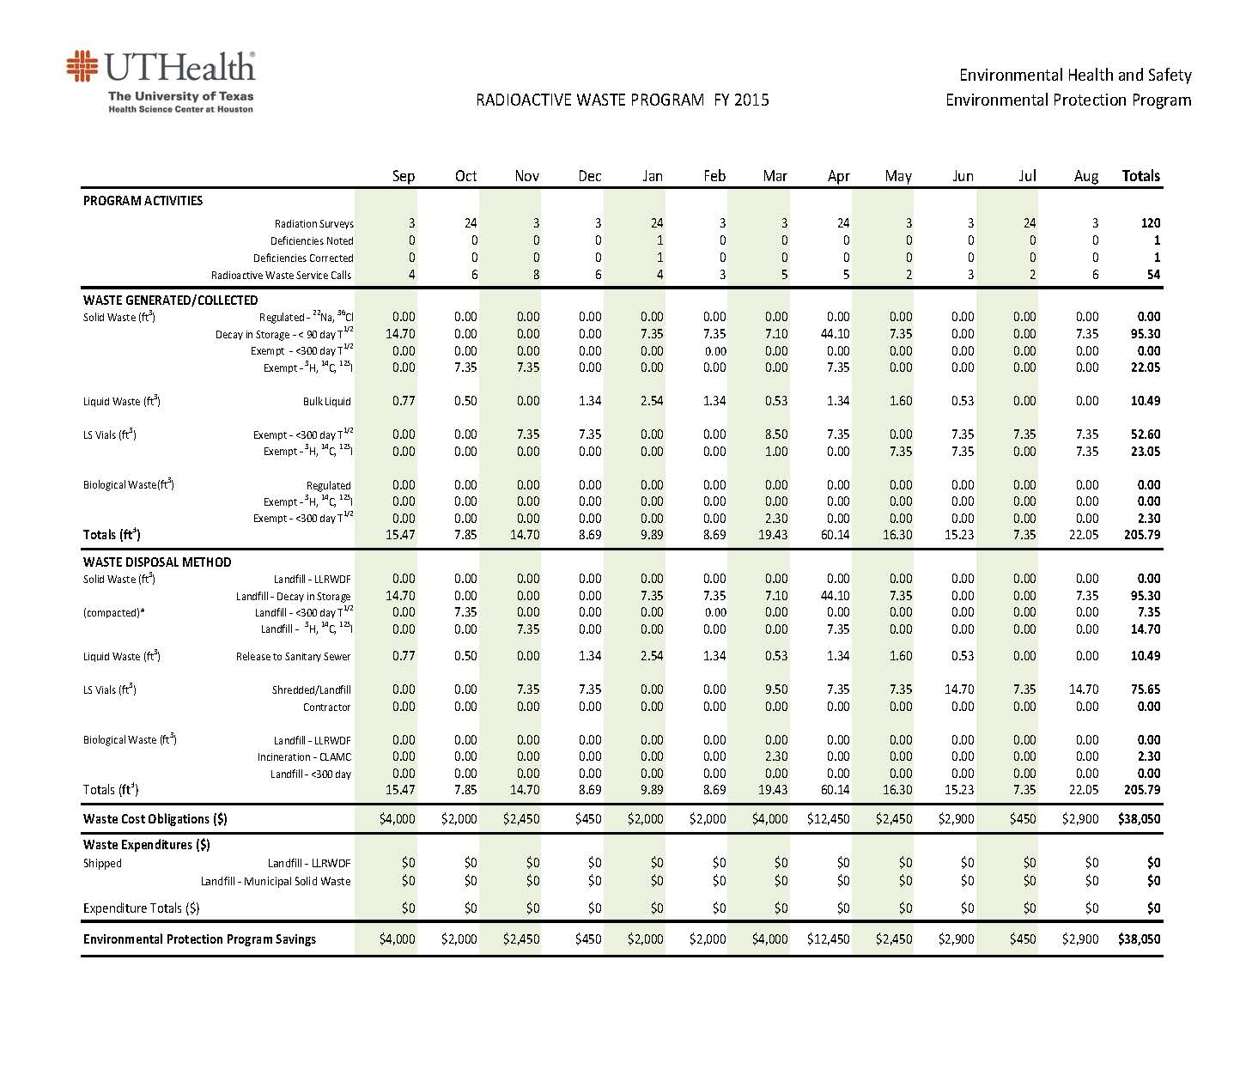

Slide 47
How Often?
“Smell the cheese often so you know when it is getting old.”
– Spencer Johnson
Ongoing metrics communicate the effectiveness of processes
“Every time you get the chance” – Emery

Slide 48
Communicating Metrics
Focus on outcome metrics not output
Select emerging issues and opportunities to communicate
Report on strategic goals
Remember to tie it to the mission of the organization

Slide 49
Caveat
“Not everything that can be counted counts, and not everything that counts can be counted”
- Albert Einstein

