Slide 1
Integrating Risk Management and Environmental Health & Safety
Robert Emery, DrPH, CHP, CIH, CBSP, CSP, CHMM, CPP, ARM
Vice President for Safety, Health, Environment & Risk Management
The University of Texas Health Science Center at Houston
Professor of Occupational Health
The University of Texas School of Public Health

Slide 2
A Changing Environment
Previously disjunct health and safety functions drawn into single, comprehensive Environmental Health & Safety (EH&S) programs
Now, EH&S functions are being drawn into “Risk Management” programs, organizationally aligned with institutional loss control and insurance activities
Is this trend good or bad?

Slide 3
Perhaps the Question is Moot
The trend appears to be inevitable – demonstrated by personal observation and the “show of hands” test
Perhaps a more important question is: “when this occurs, who is the boss?” – again the “show of hands” test suggests it is not the EH&S person!
Now that I have your attention….

Slide 4
What Should We Do?
Develop an understanding of the “risk management” concept
Learn how the risk management process functions
Discuss how an EH&S function might exist (and possibly prosper) within such a unit
Identify possible pitfalls of such arrangements
Discover possible career development opportunities in this field

Slide 5
Voluntary Disclosure
Despite attempts to be objective, this presenter makes no apologies about any possible unintended biases towards the EH&S profession!
Also, an academic interest and the completion of some exams does not take the place of years of practical experience.
So caveat emptor!

Slide 6
What is “Risk Management”?
Risk management is the process of making and implementing decisions that will minimize the adverse effects of accidental and business losses on an organization.

Slide 7
The 2 Components of Risk Management
Risk Financing is the process of obtaining funds to pay for or offset losses. This is traditionally what is thought of as “risk management”. Generally considered insurance.
Risk Control is the process to minimize the frequency and/or severity of accidental loss. This includes the conventional functions of an safety program.

Slide 8
Important Risk Management Vernacular
Risk: a potential variation in outcomes
Pure risk: outcome only negative (accidental losses)
Speculative risk: negative or positive outcomes (business losses or gains)
Loss: an event that reduces an organization's financial value
Loss exposure: anything that presents the possibility of a loss

Slide 9
Typical Risk Management Program Objectives
Minimize exposure to financial loss
Protect physical assets
Reduce frequency and severity of accidents
Provide for a safe environment
Minimize interruptions of service provided to clients

Slide 10
Risk Management Involves a 5 Step Process
Identifying and analyzing exposures to accidental and business losses
Examining feasible alternative risk management techniques
Selecting the best alternative(s)
Implementing chosen alternative(s)
Monitoring results

Slide 11
Exercise: Risk Identification
What risks are present in your organization?
How might we go about making this list?
or put another way…………..

Slide 12
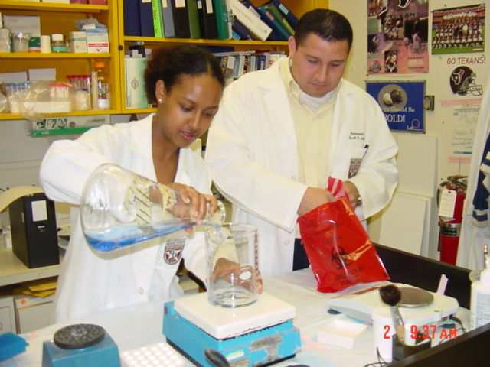
What is the greatest risk here?

Slide 13
Typical Risks Might Include…. (not an all-inclusive list)
Building structures and contents
Employees, visitors, surrounding community
Employment liability
Benefits
Automobile/trucks/fleet
Bullying, violence, sexual harassment
Discrimination
Theft
Technology & Computers (e-business, intellectual property)
Drinking, drug abuse
Health services, medical malpractice
Biomedical research involving humans, animals, potentially hazardous substances
International travel, exchanges
Special event risks
Reputation
Consortiums
EH&S

Slide 14
1. Identifying Exposure to Loss
Types of Exposures
Property
Net income
Liability
Personnel
Methods
Standardized surveys, questionnaires
Financial statements
Records and files
Flowcharts
Personal inspections
Expert opinions

Slide 15
Identifying Exposure to Loss (con’t)
Analysis – Organizational Objectives
Profit
Continuous operations
Stable earnings
Growth
Humanitarian concerns
Legal requirements
Analysis – Significance
Loss frequency
Loss severity

Slide 16
Three Dimensions of a Loss Exposure
1. Value exposed to loss
Property
Tangible (e.g. building, contents, personal property)
Intangible (e.g. copyrights, patents)
Net Income
Decrease in revenue or increase in expenses
Liability
Contractual, tort, statutory law
Personnel
Death, disability, retirement, resignation

Slide 17
Three Dimensions of a Loss Exposure
2. Peril Causing the Loss
Natural
Windstorm, hail, flood, fire
Human
Actions or inactions of individuals, e.g. arson, negligence, theft, homicide

Slide 18
Three Dimensions of a Loss Exposure
3. Financial Consequences of Loss
Frequency and severity of occurrence
Typically, the more severe, the less frequent

Slide 19
2. Risk Management Alternatives
Risk Control
Exposure avoidance
Loss prevention
Loss reduction
Segregation of exposures
Separation/duplication
Contractual transfer for risk control
Risk Financing
Retention
Current expensing of losses
Unfunded reserve
Funded reserve
Borrowing
Captive insurer
Transfer
Commercial insurance
Contractual transfer for risk financing

Slide 20
Example: Need a Car? Risk Control Options
Exposure avoidance (makes loss impossible)
Don’t buy a car
Loss prevention (reduces frequency)
Don’t drive at all, not much, or very, very carefully
Loss reduction (makes losses smaller)
Get a less expensive car
Separation/duplication
Own two or more cars, park in different locations
Contractual transfer
Lease a car

Slide 21
Example: Need a Car? Risk Financing Options
Retention through current expensing
Pay for damage from income
Retention through unfunded reserves
Recognize need to pay for damage if it occurs
Retention through funded reserves
Set aside funds to pay for damage
Retention through borrowing
Use loan or credit card to pay for damage repair
Retention through a captive insurer
Form or join a captive

Slide 22
Example: Need a Car? Risk Financing Options (con’t)
Contractual transfer for risk financing
Find a non-insurance indemnitor to pay for damages
Commercial insurance
Purchase auto collision insurance
Hedging
(Not applicable to accidental losses)

Slide 23
General Types of Insurance
Social
Medicare / Medicaid
Workers’ compensation
Unemployment
Private
Fire
Marine
Casualty
Surety
Life

Slide 24
General Types of Private Insurance
Property
Structure
Contents
Equipment
Liability
Auto
Product
Employee risks

Slide 25
Risk Transfer Financing: Types of Insurance and Coverages
Commercial property
Boiler and machinery
Commercial crime insurance
General liability
Inland Marine
Business auto
Workers’ compensation & employers liability
Directors and officers liability
Employment practices liability

Slide 26
Reviewing a Policy: Important (and Insightful) Questions
What losses are covered?
What property / locations are covered?
What people are covered?
What perils are covered / what hazards are excluded?
What time period is covered?
What conditions suspend coverage?

Slide 28
Cautionary Note: Moral Hazard and Deductibles
Moral hazard: when the behavior of the insured party is influenced by the presence of insurance
Example: availability of flood insurance in high risk flood prone areas could entice people to build there, despite known risks
Ex ante moral hazard – once insured, party behaves in a more risky manner
Example – with auto insurance, not locking car
Ex post moral hazard – after a loss occurs, asking the insurer to pay more than coverage was originally intended
After forgoing medical treatment because of lack of insurance, now asking insurance to cover health costs related to previous ailments

Slide 29
Cautionary Note: Moral Hazard and Deductibles
Extreme example - Wall Street Journal 12/23/74:
In a small Florida town, over 50 people suffered 'accidents' involving the loss of various organs and appendages, resulting in claims of up to $300,000 being paid out by insurers. Insurance investigators are positive the maimings are self-inflicted because many witnesses to the 'accidents' are prior claimants or relatives of the victims, and one investigator noted that 'somehow they always shoot off parts they seem to need least.'
Deductibles exist as a means to counteract moral hazard

Slide 30
3. Selecting Best Alternative(s)
Choosing selection criteria
Financial criteria
Criteria related to other objectives
Decision rules for applying criteria
Risk control
Risk financing

Slide 31
Exercise #4: Cash Flow Example
Large highway paving company exploring option to replace existing fleet of 10 roadgraders.
Cost $40,000 each, useful life 10 years, no salvage value
A major advantage is unit stability – advertised to reduce frequency of rollovers by one-half
Rollovers have been a constant problem for this company – over past ten years, average 5 injuries per month, average WCI claim $3,000 per event

Slide 32
Cash Flow Example (con’t)
Annual WCI payout
5 claims/month x $3,000/claim x 12 months/yr =$180,000 per year, or $18,000/yr/grader
Company expects to earn an annual after-tax, time adjusted rate of return of at least 22% on any funds invested in new fleet
What after-tax annual net cash flow amount must be generated by each grader to make this financial decision?

Slide 33
Present Value Factor Concept
Value Today | 1 yr | 2 yr | 3 yr | 4 yr | 5 yr | 6 yr | 7 yr | 8 yr | 9 yr | 10 yr
$0.820 | $1
$0.672 |  | $1
$0.551 |  |  | $1
$0.451 |  |  |  | $1
$0.370 |  |  |  |  | $1
$0.303 |  |  |  |  |  | $1
$0.249 |  |  |  |  |  |  | $1
$0.204 |  |  |  |  |  |  |  | $1
$0.167 |  |  |  |  |  |  |  |  | $1
$0.137 $3.92 |  |  |  |  |  |  |  |  |  | $1
The present value of a 10 year stream of $1 annual payments at 22% interest is $3.92

Slide 34
Cash Flow Example (con’t)
At 22% and 10 years the present value factor for $1 received annually at the end of each year is 3.92 (from table)
($40,000)/(x) = 3.92
x = $10,204
Compare to one-half WCI payout of $18,000 per grader, or $9,000 in savings (slightly less than needed)
What other sources of possible positive cash flow might stem from the purchase of these units?

Slide 35
The Bottom Line: Risk Control Expenses
Optimal Level of Risk Control
Marginal Cost
Marginal Benefit/ Marginal Cost
Marginal Benefit
Investment in Risk Control Measures

Slide 36
The Bottom Line: Risk Control Expenses
Optimal Level of Risk Control
Marginal Cost
Marginal Benefit/ Marginal Cost
Revised Marginal Benefit
Marginal Benefit
Investment in Risk Control Measures

Slide 37
4. Implement Selected Technique(s)
Technical decisions
Managerial decisions

Slide 38
Putting a Program in Place
Example considerations
Management commitment?
Are the goals clear?
Are measures defined and systems in place to capture?
Do all parties involved/affected really understand what’s going on?

Slide 39
5. Monitor Implementation
Purpose
Ensure proper implementation
Detect and adapt to changes
Control program
Results standard
Activities standards

Slide 40
What to Monitor?
What is the valid indicator of safety program performance?
OSHA 300 log?
Compliance?
Insurance costs?
Annual losses?
Complaints?
Service? Satisfaction?
Cost of program?
Macro vs. micro measures:
are outcomes within the program’s span of control ?

Slide 41
Exercise #5: Business Continuity Issues
Open your bag
What loss did you experience?
What are your immediate business continuity actions?
What about longer term business continuity issues?
What is the lesson for your emergency plan back home?

Slide 42
Common Risk Management Critiques of EH&S Programs
Consider the big picture – business perspective
Don’t always rush to measure – try simple fixes first
Rushing to the few highly exposed when the larger minimally exposed may be a bigger ROI
Better utilization of insurer services
What is the frequency and severity of the loss exposure? Is it imminent or hypothetical?
How do your operations further the mission of the organization?
An equally interesting question: what are common critiques of Risk Management programs?

Slide 43
Common EH&S Critiques of Risk Management Programs
Too focused on the numbers
Paralysis by analysis
May be the wrong numbers – compensable injuries versus first reports
Lack of communication
Not involved or aware of negotiations – what services will or can the insurer provide?
Lack of awareness or full understanding of risk control issues
Movement of problems from hypothetical to imminent (if its affecting their office)

Slide 44
Consider an IAQ Scenario
You have a building that contains a small group of persistently concerned individuals about the air quality in their offices.
There have been no compensable claims for IAQ in the past
IAQ issues consume 20% of EH&S’ resources
How would your new Risk Manager boss view this issue?
When has EH&S done enough to try and resolve the issue?

Slide 45
Survey of Leadership of University Risk Management Function
Background/experience of boss
Insurance claims 16%
Administrative VP 14%
Purchasing director 14%
Safety officer 14%
Finance director 12%
Director of EH&S 8%
Other 7%
Source: Query, T. Comparing and contrasting the risk management function at educational institutions: a survey of university risk manager, URMA Journal, 2001, p. 18-24.A survey of 288 universities, with a 38% response rate

Slide 46
Background
Educational level
AS, BS 55%
Masters, Doctorate 38%
J.D. 7%
Certifications
ARM 25%
CPA 11%
CPCU 8%
Safety 4%
Source: Query, T. Comparing and contrasting the risk management function at educational institutions: a survey of university risk manager, URMA Journal, 2001, p. 18-24.

Slide 47
Experience
Work Experience (may be duplicate entries)
Risk Management 51%
Insurance claims 29%
General management 24%
Accounting 18%
Security (perhaps safety) 11%
Purchasing 7%
Legal 5%
Environmental Health 4%
Human resources 4%
Source: Query, T. Comparing and contrasting the risk management function at educational institutions: a survey of university risk manager, URMA Journal, 2001, p. 18-24.

Slide 48
Ranking of Issues Important to Risk Managers
Employment liability practice
Sexual harassment
Discrimination
Source: Query, T. Comparing and contrasting the risk management function at educational institutions: a survey of university risk manager, URMA Journal, 2001, p. 18-24.

Slide 49
So How EH&S Might Mesh into the Risk Management Environment?
At a minimum, use the vernacular
Know your coverages and retention levels
Apply concepts to day-to-day activities
Take a research laboratory for example: what if, instead of just looking at potential hazards, a complete risk profile was created?
Clarifies to lab manager what risks are retained and what are covered (and at what levels), including funding risks
What risk control options are available
The cost benefits of each
Used as a catalyst to enjoin lab personnel in achieving desired endpoint?
Pay particular attention to uninsurable risks!

Slide 50
The Risk Management Profession
Professional organization of risk managers
Risk and Insurance Management Society (RIMS)
Active local chapters
For more information: www.rims.org
University Risk Management and Insurance Association (URMIA) – focused on campus issues
For more information www.urmia.org

Slide 51
The Risk Management Profession
American Institute for Chartered Property Casualty Underwriters
Chartered Property Casualty Underwriter (CPCU)
Insurance Institute of America Center for the Advancement of Risk Management Education (CARME)
Associate in Risk Management (ARM)

Slide 52
ARM Designation
Three separate exams
ARM 54 Essentials for Risk Management
ARM 55 Essentials for Risk Control
ARM 56 Risk Financing
Each are multiple choice, 80-100 question computer-based exams
Can be taken at Sylvan Learning Centers or equivalent
Local RIMS chapters offer study courses
For more information: www.aicpcu.org

Slide 53
ARM 54 Essentials of Risk Management Content
Framework for risk control
Establishing a risk management program
Identifying and analyzing loss exposures
Analyzing property loss exposures
Analyzing liability loss exposures
Analyzing personnel loss exposures
Analyzing net income loss exposures
Examining alternative risk management techniques
Cash flow analysis as a decision criterion
Making risk management decisions
Risk management information systems

Slide 54
ARM 55 Essentials of Risk Control Content
Framework for risk control
Crisis management planning
Controlling fire losses
Designing safer, more productive workplaces
Rehabilitation management
Controlling losses from fleet operations
Controlling liability losses
Controlling environmental losses
Controlling net income losses
Controlling crime losses
System safety
Motivating and monitoring risk control activities

Slide 55
ARM 56 Essentials of Risk Financing Content
Establishing risk financing objectives
Examining risk financing options
Retaining losses
Financing losses through captives and pools
Transferring losses through insurance
Excess insurance and reinsurance
Using noninsurnace contractual transfers
Financing employee benefits
Forecasting accidental losses and risk financing needs
Accounting and income tax aspects
Dealing with insurers’ representatives
Claims administration
Allocating risk management costs

Slide 56
Current Issues
“Cost of Risk” Concept
Developed in 1962 by D.A. Barlow, a past president of RIMS
Includes consideration of
Net insurance premiums
Retained losses
Risk control and loss prevention expenses
Administrative costs
Formalized in 1993 in “Practices and Techniques: Internal Accounting and Classification of Risk Management Costs
Typically expressed as a cost per $1,000 revenues.
For educational and non-profit organizations, base is net operating budget

Slide 57
Current Issues
“Enterprise Risk Management”
Comprehensive risk management program that evaluates all risks, including
Business
Environment
Compliance
Operational
Informational
Financial

Slide 58
Current Risk Management Issues – Sept. 11 Impact
World Trade Center attack the largest loss to ever hit insurance market
Estimated losses range from $30 B (Morgan Stanley) to $58 B (Tillinghast)
Number of insurance syndicates shrinking
1990 – 125 syndicates, in 2001 down to 35

Slide 59
Current Risk Management Issues – Sept. 11 Impact
11 Insurance/reinsurance companies downgraded and another 30 under review
Previous catastrophic loss models proven inadequate
Underwriters now focusing on catastrophic exposures
Capacity and pricing changing dramatically
Underwriters requiring very detailed submissions, tightened wording
Multi-year polices likely difficult to obtain
Significant increases in premiums for risk transfer – hence re-examination of other risk management options

Slide 60
Commentary
Increasing risk transfer costs means a re-examination of organizational risk retention levels
Risk retention requires a certain “tolerance for risk” which can be assuaged by solid risk control programs (e.g. robust safety programs)
Therein lies the opportunity for our programs!

Slide 61
Current Issue: “Informed Risk”
Mechanisms for succinctly communicating risk control and financing aspects so that all stakeholders are informed and understand the issues
Consider EH&S influence on premiums
Retained losses
Relative magnitude of premiums

Slide 62
Gauge Your Level of “Informed Risk” In an attempt to gauge the level of informed risk across campus, an online survey was circulated to manager and supervisory-level personnel via various institutional e-mail list servs for the period August 24 to September 9, 2009. Summarized below are the collective responses by percent from 19 respondents. The results indicate that certain opportunities to enhance community education and awareness exist, and will be pursed in FY10 to help further reduce the amount of retained losses experienced by the institution.
Did you know that….. | Response Yes No
When measured by dollar value of property loss, the most significant cause of property damage at the UTHSC-H is water? | 63% 37%
The most common source of the water damage is not from hurricanes or discharges from sprinkler heads, but rather from overflowed sinks, drainage leaks, and leaks in water supply lines? | 74% 26%
The deductible for the UTHSC-H property insurance policy is $250,000? | 37% 63%
Personal property stolen or damaged while on UTHSC-H property is not covered by the UTHSC-H property insurance policy? | 89% 11%
The insurance for UTHSC-H includes some amount of coverage for “business interruption” but only if the loss event is due to property damage at UTHSC-H? | 63% 37%
When contracting with a firm to move furniture and equipment that the standard coverage for anything damaged in the course of the move is $0.60/lb? | 16% 84%
“Special events” such as parties, catered gatherings and graduations are not covered by the standard UTHSC-H insurance policy, and require the purchase of a “Special Events Policy”? | 32% 68%
If you are injured on the job and cannot work, Worker’s Compensation Insurance will likely not cover your full salary during the period you are unable to work? | 84% 16%
If you drive your personal vehicle for work purposes and are involved in an accident, the primary insurance coverage is your personal auto insurance? | 79% 21%
If something is stolen from your workplace you would report it to UT Police. But if property is damaged or lost in some other way, did you know you need to report that type of loss to Risk Management & insurance? | 47% 53%

Slide 63
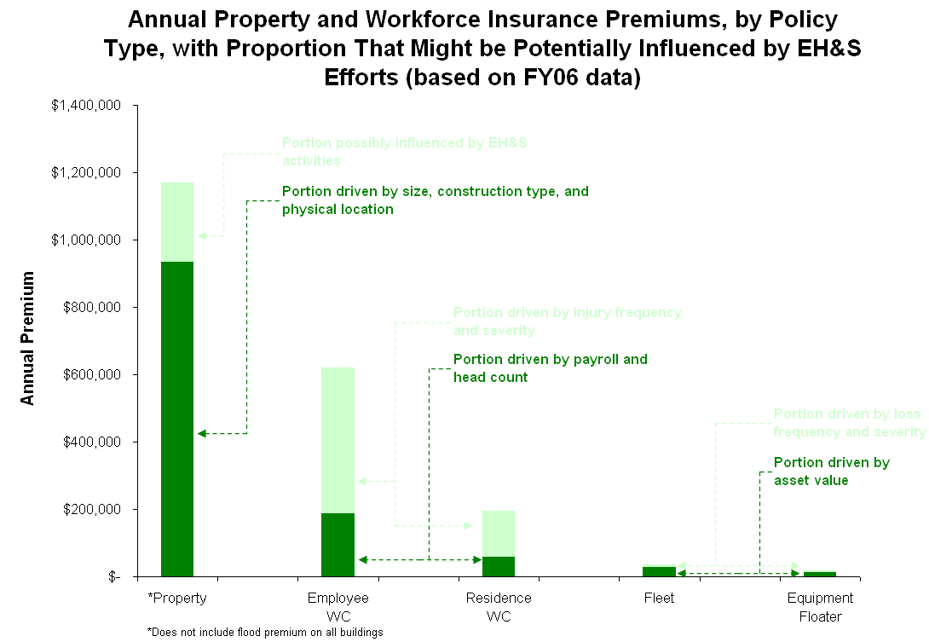

Slide 64
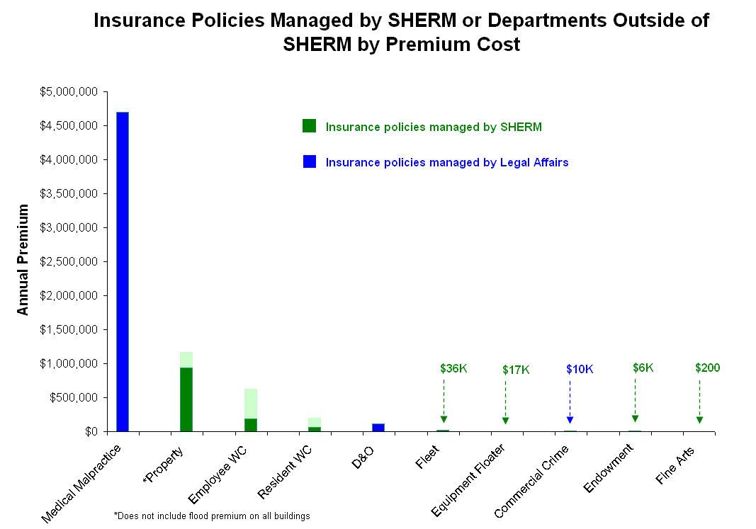

Slide 65
UTHSC-H Employee Injury Reports and Workers’ Compensation Insurance Premium Trends, FY01 to 09 Note: insurance premium influenced predominantly by market conditions, employee census, employee payroll, and injury frequency and severity
Oversight by SHERM
- $123,753
$1,893,572 in total premium savings since FY03
188 fewer reported injury events compared to FY 03
- $293,331
- $348,718
- $568,998
- $558,772
105 fewer injuries requiring medical compared to FY 03

Slide 66
Workers’ Compensation Insurance Premium Adjustment for UTS Health Components Fiscal Years 2002 to 2007 (discount premium rating as compared to a baseline of 1, three year rolling average adjusts rates for subsequent year)
UT Health Center Tyler (0.45)
UT Medical Branch Galveston (0.35)
UT HSC San Antonio (0.25)
UT Southwestern Dallas (0.20)
UT HSC Houston (0.16)
UT MD Anderson Cancer Center (0.11)
3 year period upon which premium is calculated

Slide 67
Projected Workers’ Compensation Insurance Premium Adjustment for UTS Health Components for Fiscal Year 2011 (discount premium rating as compared to a baseline of 1, three year rolling average adjusts rates for subsequent year)
Projected highest in class premium adjustment 0.64
Projected poorest UTHSCH performance 0.36
Projected steady state UTHSCH performance 0.17
Projected best UTHSCH performance 0.14
Projected lowest in class premium adjustment 0.11

Slide 68
Assuming no change in population, possible range of annual WCI Premium
Experience Modifier | 2007 | 2008 | 2009 | 2010 | 2011
Best Possible Performance |  | 0.163 | 0.156 | 0.150 | 0.143
No Change | 0.174 | 0.174 | 0.174 | 0.174 | 0.174
Poorest Possible Performance |  | $0.217 | 0.264 | 0.312 | 0.359
Estimated Premium | 2007 | 2008 | 2009 | 2010 | 2011
Best Possible Performance |  | $570,000 (-$30,000) | $540,000 (-$60,000) | $510,00 (-$90,000) | $480,000 (-$120,000)
No Change | $600,000 | $600,000 | $600,000 | $600,000 | $600,000
Poorest Possible Performance |  | $660,000 (+$60,000) | $720,000 (+$120,000) | $780,000 (+$180,000) | $840,000 (+$240,000)

Slide 70
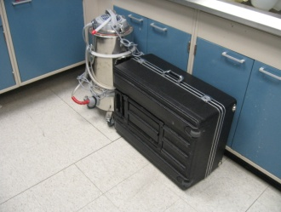
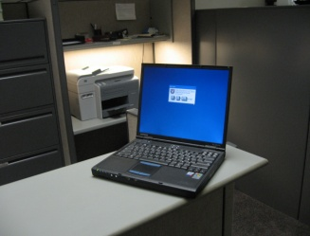
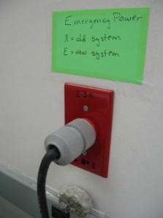
Help Avoid the 3 Main Causes of Property Loss at UTHSC-H
The three main causes of property loss at UTHSC-H in FY06 were water leaks, theft, and electrical power interruption. These three perils resulted in over $331,000 in direct loss and untold disruption to teaching, research, and service activities. The deductible for the UTS Comprehensive Property Protection Program is $250,000 per occurrence, in FY06 none of the losses exceeded the per occurrence deductible, however the sum of retained losses exceeded the deductible by $140,000. In special cases additional insurance can be purchased*. Summarized below are simple steps that can be taken to avoid such losses.
 | Potential For Loss | Simple Prevention Measures | For more information and assistance
 | Water Damage Water damage accounted for $221,000 of loss in FY06. Water can enter a lab or office from the same floor or from the floor above. | Move equipment off of the floor and cover when not in use. Evaluate possible purchase of supplemental insurance for certain types of equipment* | Contact Facilities Planning and Engineering for more information, (713)500-3498.
 | Theft Theft accounted for $90,114 of loss in FY06, the majority of which were theft of laptops, PDAs and cell phones. | Secure laptops, PDA’s, or cellular phones. Always backup data and keep it in a physically separate location. For more information about how to lock a PC or laptop: http://www.uth.tmc.edu/med /msit/howdoi/physical_security.htm Evaluate possible purchase of supplemental insurance for certain types of equipment* | Contact University of Texas Police Department for more information, (713)794-4357.
 | Electrical Power Interruption Electrical power disruption accounted for $20,000 worth direct losses in FY06. However this is not reflective of the loss of priceless research specimens. | Ensure that all critical equipment has backup power or has the ability to alert local personnel when power or temperature is disrupted. The production of duplicate or split samples is encouraged. Finally, some buildings are equipped with the necessary infrastructure to provide monitoring of temperature. | Contact Facilities Planning and Engineering for more information, (713)500-3498.
*Information about the purchase of additional insurance can be obtained by contacting Risk Management; 713-500-8100.

Slide 72
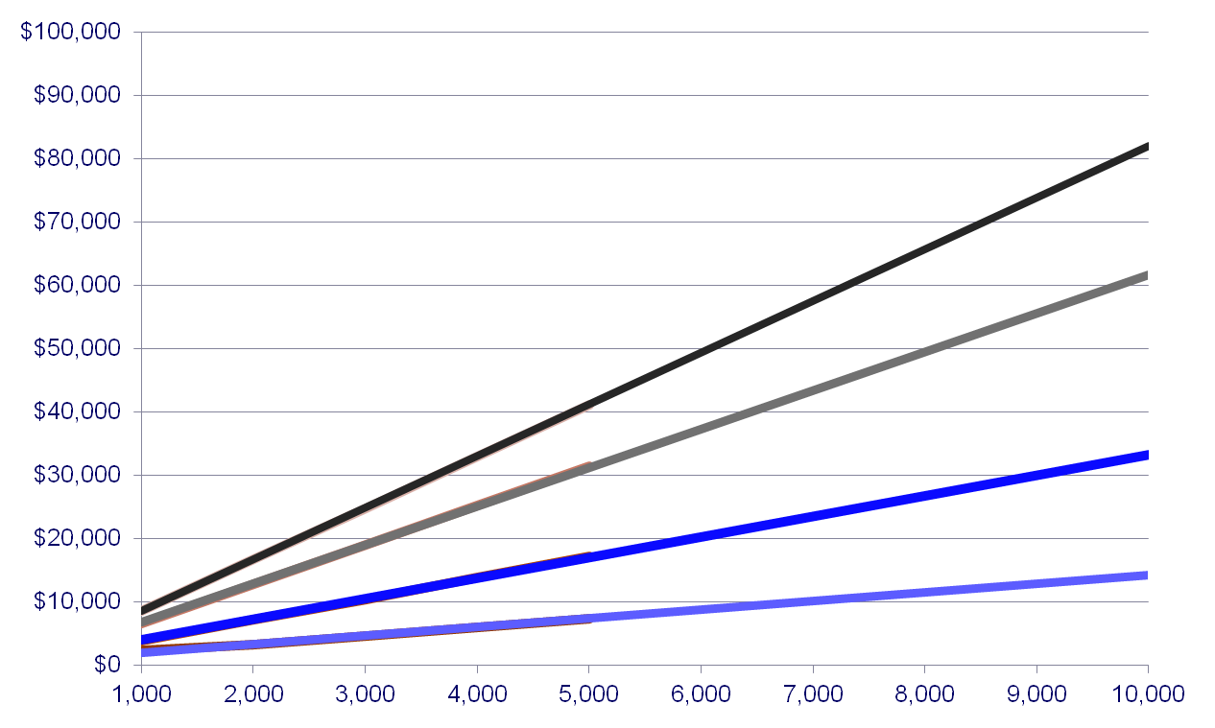
Rapid Estimate of Water Damage Clean Up Cost Based on Area Affected and Type of Water
If more than one room or one floor is affected ²
Dirty Water
One area affected ³
If more than one room or one floor is affected ²
Clean Water
One area affected ³
¹ Estimate does not include cost of any damaged electronics, furniture or office materials. Clean water is defined as potable water.
²Mitigating multiple rooms or multiple floors, inclusive of drying is more difficult if the affected area is separated by hard walls or floors, such as is the case of multiple offices or multiple floors.
³Estimated cost to clean up a single area affected that is not separate by hard walls.

Slide 73
Typical Steps Taken to Mitigate Water Losses
Clean Water Loss
Extract water
Remove baseboards
Drill holes in sheetrock
Spray biocide on affected areas
Set equipment (fans, dehumidifiers)
Run equipment 3-5 days
Dirty Water Loss
Extract water
Remove all affected materials (sheetrock, flooring, ceiling tiles, etc)
Spray biocide on remaining structure (wall studs, slab, etc)
Set equipment (air scrubbers, dehumidifiers)
Run equipment 3-5 days

Slide 74
Costs Not Included in this Estimate Tool
Content Restoration/Total Out
Computers, monitors, etc.
Fax machines, copy machines
Recovery of damaged paper or computer records
Furniture
Personal items
Art work
Build Back
Sheetrock
Paint
Baseboards
Flooring
Ceiling tiles
Labor to install
Cleaning Labor
Post-loss
Post-construction

Slide 75
*MHH Increase in BI coverage from FY08-FY09, $49MM to $75MM FY09 Premium reduced by $290K, due to scheduled risk control measures (robust EMP, flood doors, training, etc.) and risk based loss estimates.

Slide 76
Summary
Like it or not, the institutional risk management phenomenon is upon us
Requires a slightly different approach to the traditional EH&S mindset
Anticipate programmatic needs in this new environment – what measures are important?
Anticipate recognized pitfalls as well, and manage accordingly
Knowledge of trend also affords ability to prepare and respond professionally in new arena
Seize the opportunity!

Slide 77
References
Beaver, W.H. Parker, G. Risk Management: Problems and Solutions, New York: McGraw-Hill, 1995
Elliott, M.W. Risk Financing, 1st Ed. Malvern, PA: Insurance Institute of America, 2000.
Head, G.L, Horn, S. Essentials of Risk Management, 3rd Ed. Malvern, PA: Insurance Institute of America, 1997.
Head, G.L. Essentials of Risk Control, 3rd Ed. Malvern, PA: Insurance Institute of America, 1995.
Williams, A.C., Smith, M.L., Young, P.C. Risk Management and Insurance, 8th Ed. Burr Ridge, IL: Irwin/McGraw-Hill, 1998.

Slide 78
UTH
EHS

