Slide 1

Improving Communications Through the Compelling Display of EH&S Data
Robert Emery, DrPH, CHP, CIH, CSP, RBP, CHMM, CPP, ARM
Vice President for Safety, Health, Environment & Risk Management
The University of Texas Health Science Center at Houston
Professor of Occupational Health
The University of Texas School of Public Health

Slide 2
Why Training on Measures?
An interesting dilemma:
  Operational programs thrive on data
  Virtually every important decision is based on data to some extent
  Formal training in the area of compelling data presentations is somewhat rare for emergency preparedness professionals
  The ability to compellingly display data is the key to desired decision making

Slide 3
Why Training on Data Presentation (cont.)?
  Some professions are awash in bad examples of data presentations!
  We’ve all endured them at some point in our careers!
    Commentary: This may be the reason for repeated encounters with management who do not understand what their emergency preparedness programs do.

Slide 4
Program Measures
  Step 1. Actual field measurements
    Radiation exposure levels, rates
    Radiation dose levels, rates
    Amounts of radioactivity
    Other aspects – distance, mass, area
  Step 2. Programmatic measures
    Indicators of workload
      Number of principle investigators
      Number of authorized labs
      Lab inspections
    Indicators of program outcomes
      Regulatory inspection outcomes?
      Actual doses received? In excess of ALARA limits?

Slide 5
Program Measures
  Step 3: Programmatic metrics
  Comparing data to major organizational drivers, such as
    Institutional extramural research expenditures?
    Patient revenues?
    Institutional square footage?
    Example of the power of metrics: What does the license/registration cost versus what is it worth?

Slide 6
Program Measures
  Step 4: Actually presenting or communicating the data to others
  Some key questions:
    To whom might we be presenting your data to?
    Will these different stakeholders understand or comprehend what you’re trying to say?
    How long do you typically have to tell your story?

Slide 7
How Do We Achieve Data
Display Excellence?
The goal is to present complex ideas and concepts in ways that are
  Clear
  Precise
  Efficient
How do we go about achieving this?

Slide 8
Go to The Experts On Information Display
Tukey, JW, Exploratory Data Analysis, Reading, MA 1977
Tukey, PA, Tukey, JW Summarization: smoothing; supplemented views, in Vic Barnett ed. Interpreting Multivariate Data, Chichester, England, 1982
Tufte, ER, The Visual Display of Quantitative Information, Cheshire, CT, 2001
Tufte, ER, Envisioning Information, Cheshire, CT, 1990
Tufte, ER, Visual Explanations, Cheshire, CT, 1997

Slide 9
Sample Recommendations
Don’t blindly rely on the automatic graphic formatting provided by Excel or Powerpoint!
Strive to make large data sets coherent
Encourage the eye to compare different data
Representations of numbers should be directly proportional to their numerical quantities
Use clear, detailed, and thorough labeling

Slide 10
Sample Recommendations (cont.)
Display the variation of data, not a variation of design
Maximize the data to ink ratio – put most of the ink to work telling about the data!
When possible, use horizontal graphics: 50% wider than tall is usually best

Slide 11
Compelling Tufte Remark
Visual reasoning occurs more effectively when relevant information is shown adjacent in the space within our eye-span
This is especially true for statistical data where the fundamental analytical act is to make comparisons
The key point: “compared to what?”

Slide 12
Three UTHSC-H “Make Over” Examples
Data we accumulated and displayed on:
  Nuisance Fire Alarms
  Workers compensation experience modifiers
  Corridor clearance
But first, 2 quick notes:
  The forum to be used:
    The “big screen” versus the “small screen”?
    In what setting are most important decisions made?
  Like fashion, there are likely no right answers – individual tastes apply, but some universal rules will become apparent

Slide 13
Results of the Great UTHSC-H Nuisance Fire Alarm Challenge

Slide 14
Results of the Great UTHSC-H Nuisance Fire Alarm Challenge

Slide 15
Results of the Great UTHSC-H Nuisance Fire Alarm Challenge

Slide 16
Results of the Great UTHSC-H Nuisance Fire Alarm Challenge

Slide 17
Results of the Great UTHSC-H Nuisance Fire Alarm Challenge

Slide 18
Results of the Great UTHSC-H Nuisance Fire Alarm Challenge

Slide 19
Results of the Great UTHSC-H Nuisance Fire Alarm Challenge

Slide 20
Results of the Great
UTHSC-H Nuisance Fire Alarm Challenge (FY04)
Fiscal Year 04

Slide 21
Results of the Great UTHSC-H Nuisance Fire Alarm Challenge

Slide 22
Employee Worker’s Comp Experience Modifier compared to other UT health components, FY 98-FY 04
Rate of "1" industry average, representing $1 premium per $100
UT-Tyler
UTMB
UT-SA
MDA
UT-H
UT-SW

Slide 23
Worker’s Compensation Insurance Premium Adjustment for
UTS Health Components Fiscal Years 2002 to 2007
(discount premium rating as compared to a baseline of 1, three year rolling average adjusts rates for subsequent year)
UT Health Center Tyler (0.45)
UT Medical Branch Galveston (0.35)
UT HSC San Antonio (0.25)
UT Southwestern Dallas (0.20)
UT HSC Houston (0.16)
UT MD Anderson Cancer Center (0.11)
3 year period upon which premium is calculated

Slide 25
MSB Corridor Blockage in Cumulative Occluded Linear Feet, by Month and Floor
(building floor indicated at origin of each line)
7th
6th
5th
4th
3rd
2nd
1st
G
2004
2005

Slide 26
Important Caveats
Although the techniques displayed here are powerful, there are some downsides to this approach
  Time involved to create assemble data and create non-standard graphs may not mesh with work demands
  Relentless tinkering and artistic judgment
Suggested sources for regular observations to develop an intuitive feel for the process
  Suggested consistent source of good examples:
    Wall Street Journal
  Suggested consistent source of not-so-good examples:
    USA Today “char-toons”

Slide 27
Summary
The ability to display data compellingly is the key to desired decision making
Always anticipate “compared to what?”
Maximize the data-to-ink ratio – e.g. eliminate the unnecessary
Think about what it is you’re trying to say
Show to others unfamiliar with the topic without speaking – does this tell the story we’re trying to tell?

Slide 28
Your Questions at This Point?
Now Let’s Look at
Some Other Real World Examples

Slide 29
COLLABORATIVE LABORATORY INSPECTION PROGRAM (CLIP)
During October 2005, 80 Principle Investigators for a total of 316 laboratory rooms were inspected
A total of 30 CLIP inspections were performed
PI Inspections:
 | Total PI’s | #Without Lab Violations | # With Lab Violations | %Without Lab Violations | %With Lab Violations
May 2005 | 94 | 53 | 41 | 56.38 | 43.62
June 2005 | 78 | 40 | 38 | 51.28 | 48.72
July 2005 | 84 | 54 | 30 | 64.29 | 35.71
August 2005 | 74 | 54 | 20 | 72.97 | 27.03
September 2005 | 69 | 39 | 30 | 56.52 | 43.48
October 2005 | 80 | 50 | 30 | 62.50 | 37.50

Slide 30
Comprehensive Laboratory Inspection Program (CLIP) Activities and Outcomes, 2005
Month in Number of Principle Inspections Inspections
Year 2005 Investigators Inspected Without Violations With Violations
May 94 53 (56 %) 41 (44%)
June 78 40 (51%) 38 (49%)
July 84 54 (64%) 30 (36%)
August 74 54 (73%) 20 (27%)
September 69 39 (56%) 30 (44%)
October 80 50 (62%) 30 (38%)

Slide 31
2005 Collaborative Laboratory Inspection Program (CLIP)
Inspection Activities and Compliance Findings
Number without violations
Number with violations

Slide 32
2005 Collaborative Laboratory Inspection Program (CLIP)
Inspection Activities and Compliance Findings
Number without violations
Number with violations

Slide 34
Fig. 3. Receipts of Radioactive Materials
Number of non-medical use radioactive material receipts
Number of medical use radioactive material receipts

Slide 35
Fig. 3. Receipts of Radioactive Materials
Number of non-medical use radioactive material receipts
Number of medical use radioactive material receipts

Slide 37
Results of Routine Lab Inspection Program, 2003 to 2005
Number of labs existing but not inspected
Number of labs inspected and one or more violation detected
Number of labs inspected and no violations detected
Note: 33 labs added to campus in 2005, increasing total from 269 to 302.

Slide 39
Average Cost of Workers Compensation Claims, by Cause, for Period FY01 - FY06
Slips, trips, falls – inside
Cumulative trauma
Overextension, twisting
Slips, trips, falls – outside
Lifting/handling
Uncontrolled object
Average cost from total of 3 events
Average cost from total of 10 events
Average cost from total of 4 events
Average cost from total of 3 events
Average cost from total of 4 events
Average cost from total of 4 events

Slide 41
Number caused by non-needle sharps
Number caused by hollow-bore needles
Start of
Academic Year

Slide 42
Fire Extinguisher Systems
Fire Extinguishers
Fire Related Incidents
Asbestos
Projects
1986
0
0
0
0
1996
203
19
91
55
1998
208
25
15
68
2003
437
46
-18
191

Slide 43
Growth in Occupational Safety Responsibilities 1986 to 2003

Slide 44
Growth in Occupational Safety Responsibilities 1986 to 2003

Slide 45
Figure 1: Laboratory Waste verses Total Waste Generated

Slide 46
Figure 1: Hazardous Waste Generation in Pounds by Type of Institutional Activity
Total hazardous waste
generation in pounds
Amount from
laboratory operations
Amount from renovation projects
Amount from administrative
departments

Slide 47
Figure 1: Laboratory Waste verses Total Waste Generated

Slide 48
Figure 2: Annual Hazardous Waste Disposal Cost by Type of Institutional Activity
Total cost
Cost of waste
from lab operations
Cost of waste from
renovation projects
Cost of waste from
administrative departments

Slide 50
2005 Total Number of Monthly Workers Compensation Claims inclusive of the three most frequent identifiable classes of injuries
Total
Fall
Strain
Cut, Puncture

Slide 52
UCR Campus Growth Indicators
Compared to EH&S Staffing

Slide 53


Journal of Environmental Health, September 2006, page 49

Slide 54
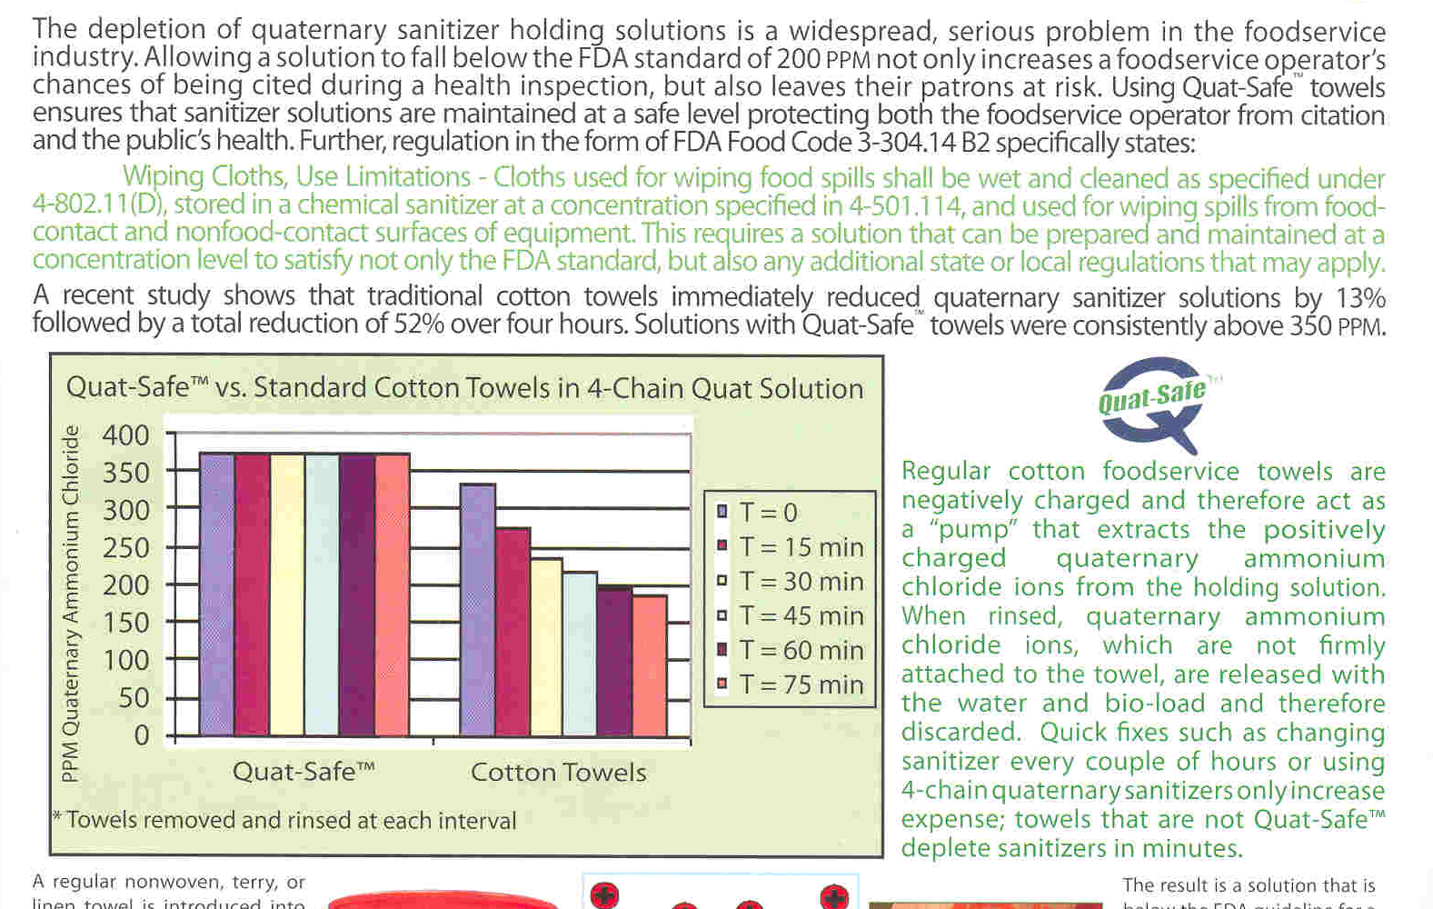

Slide 56
Quat-Safe and Cotton
Food Service Towel Quanternary Ammonium Chloride Solution Concentration Compared Over Time*
EPA Limit
EPA Limit
*Towels removed and rinsed at each interval

Slide 57
Offshore Benzene
Time Sample Taken (Hours) | Sampling Result in ppm
0 | 0
2 | 0.25
4 | 0.3
6 | 0.4
8 | 0.1
10 | 0.002
12 | 0.3
14 | 0.2
16 | 0
18 | 0.25
20 | 0.3
22 | 0.4
24 | 0.1
26 | 0.002
28 | 0.3
30 | 0.2
32 | 0
34 | 0.25
36 | 0.3
38 | 0.4
40 | 0.1
42 | 0.002
44 | 0.3
46 | 0.2
48 | 0
50 | 0.25
Example of oil spill worker benzene exposure monitoring data posted on OSHA website by BP industrial hygiene program prior to the availability of any independent OSHA sampling results (June 2010)

Slide 59
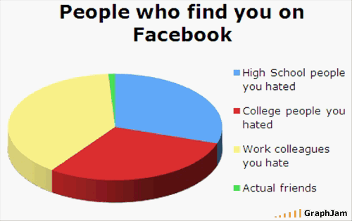

Slide 60
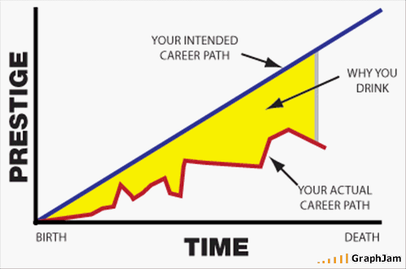

Slide 61
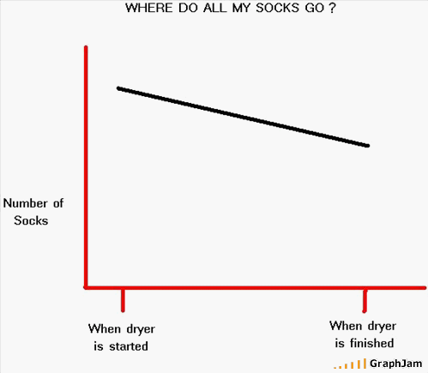

Slide 62
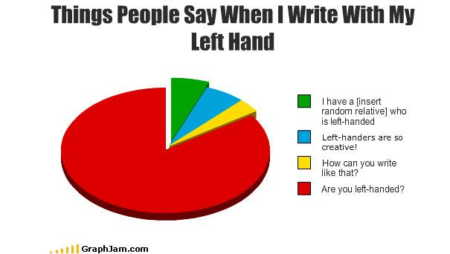

Slide 63
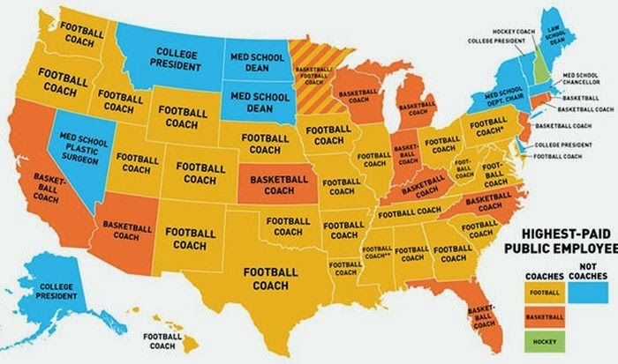
Highest Paid Public Employee by State

Slide 64
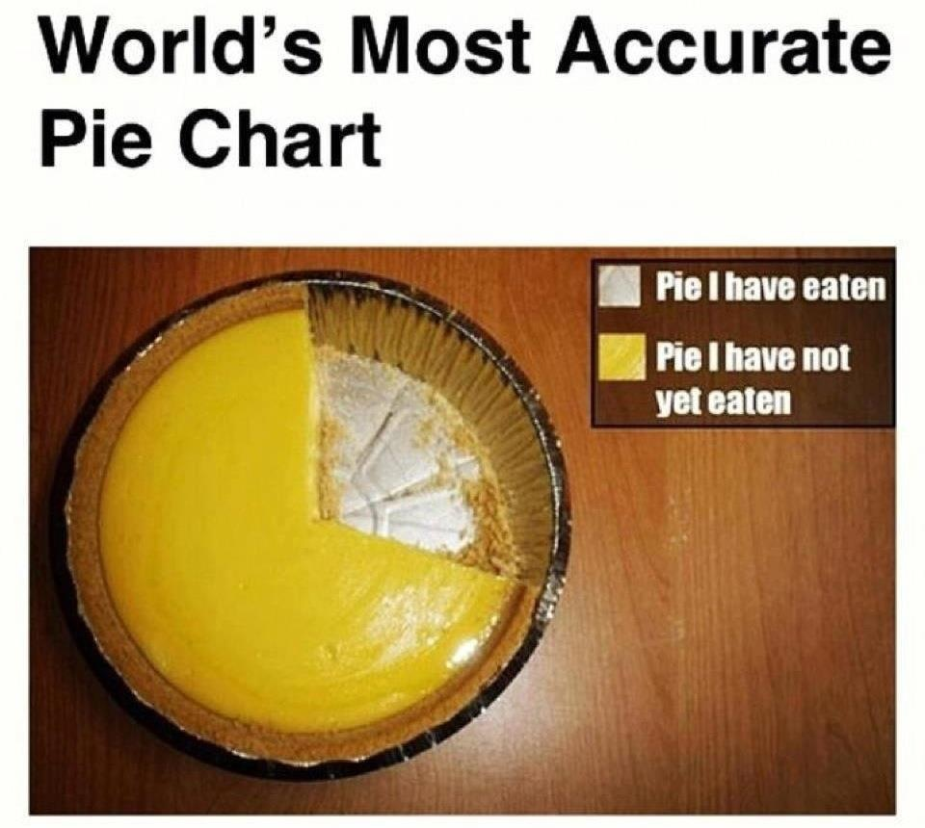

Slide 65
