Slide 1
UT House Medics 2017 About the House – Mrs. Betty Thomas (79 Years Old) 6804 Conley, Houston TX 77021
by Dennie Clemons

Slide 2
UT House Medics 2017 Saturday, April 22nd & Saturday, April 29th
Ms. Thomas is a joy and a nice lady who likes to visit with everyone. She gets around pretty well and is looking forward to any improvements we can do to her home.

Slide 3
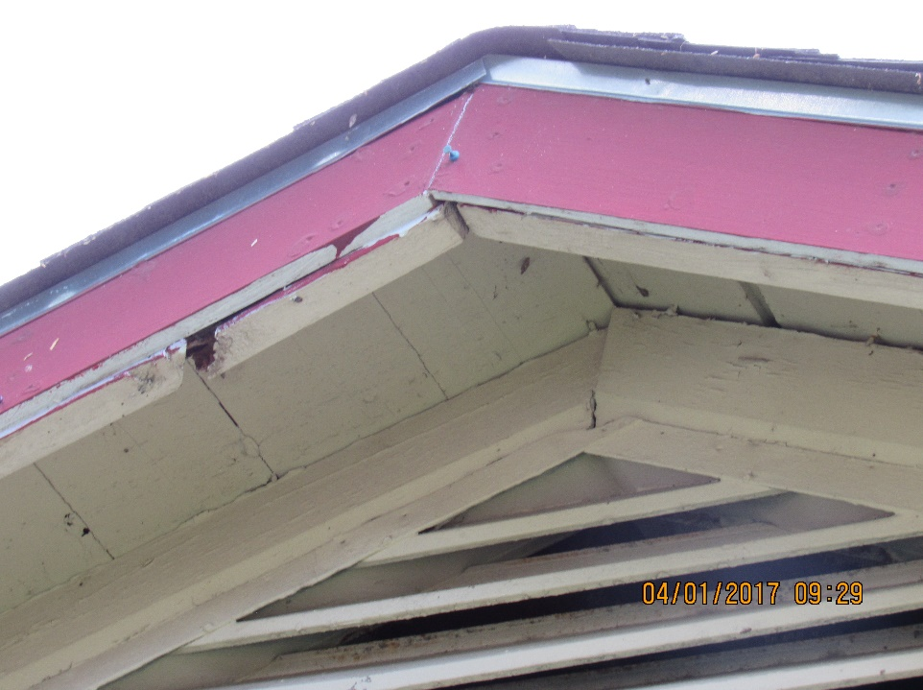
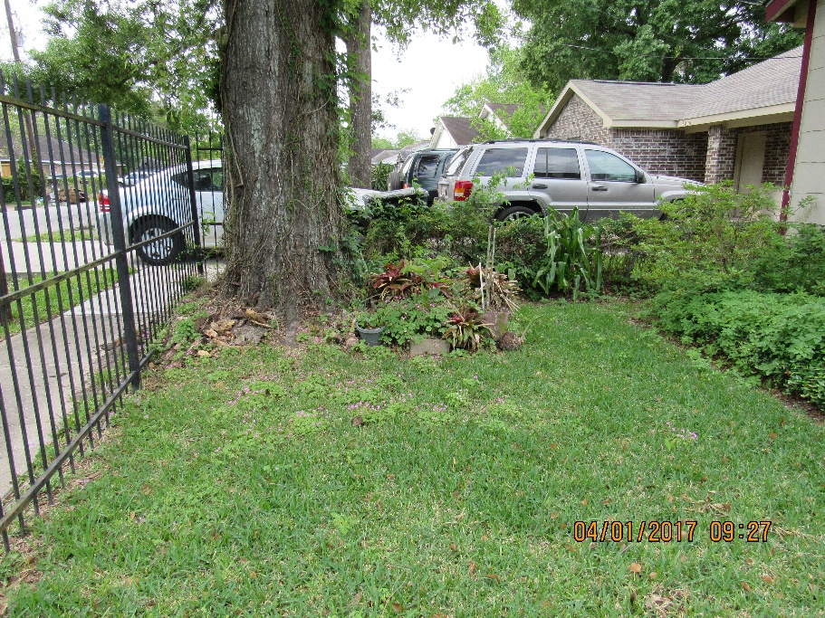
Front – Garden, Window & Eave
On this section of the house we will replace a board on the eave, pull the vines off the window and eaves, and get control of the flower bed under the window. The base of the tree is another story. Anyone have flowers to share? Ms. Thomas needs some color here, don’t you think? Notice the overgrowth in the short fence behind the tree! Then there is the wrought iron burglar bars and gate.

Slide 4
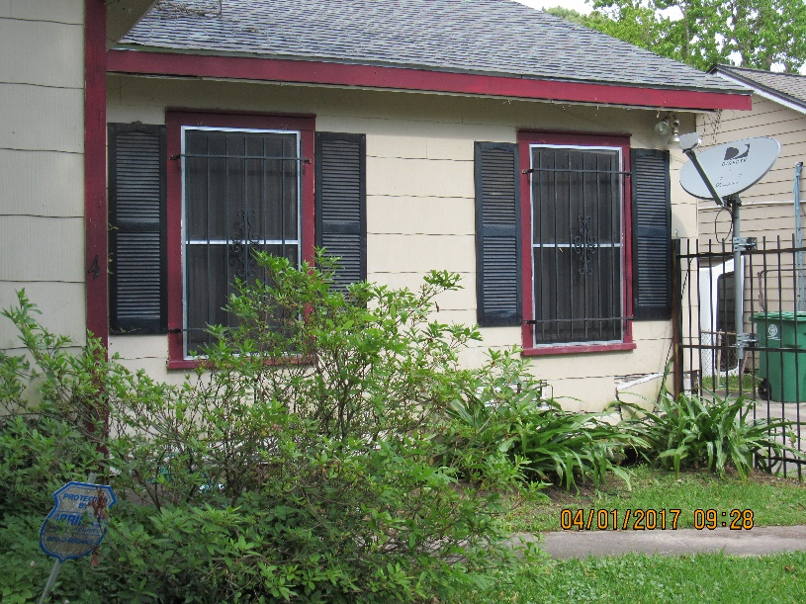
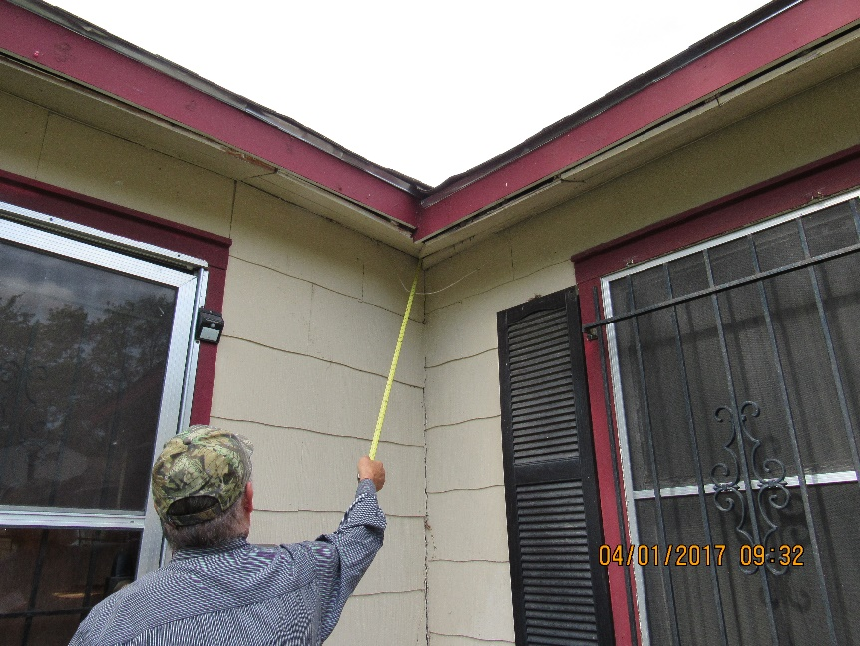
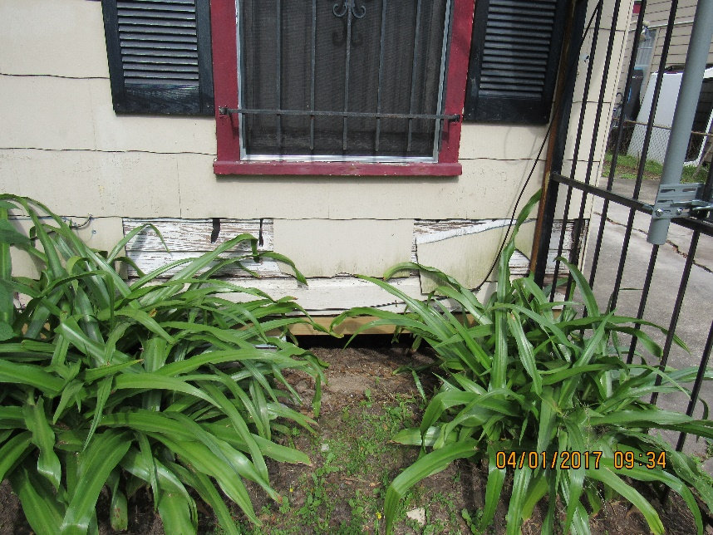
Front Entry – Handrail, Eaves, Storm Door & Siding
We will install a handrail, construct a door sill and replace the storm door. A strip of wood will be installed to seal corner and around the eave of entire house to seal the attic space from critters. Rebuilding Together Houston recently leveled the house so there is much siding to fix on the base line of the home.
Volunteers did such a great job on the wrought iron gates last year! The difference it made was amazing. Can we do it again?

Slide 5
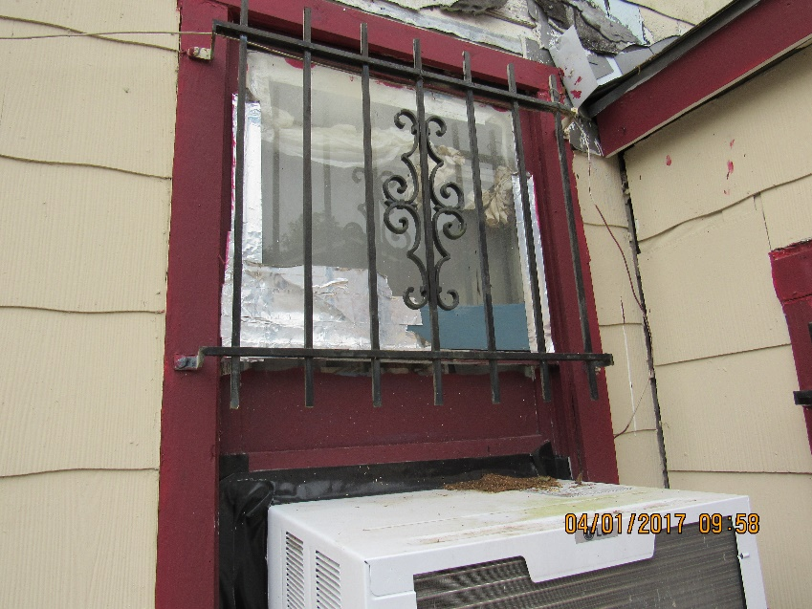
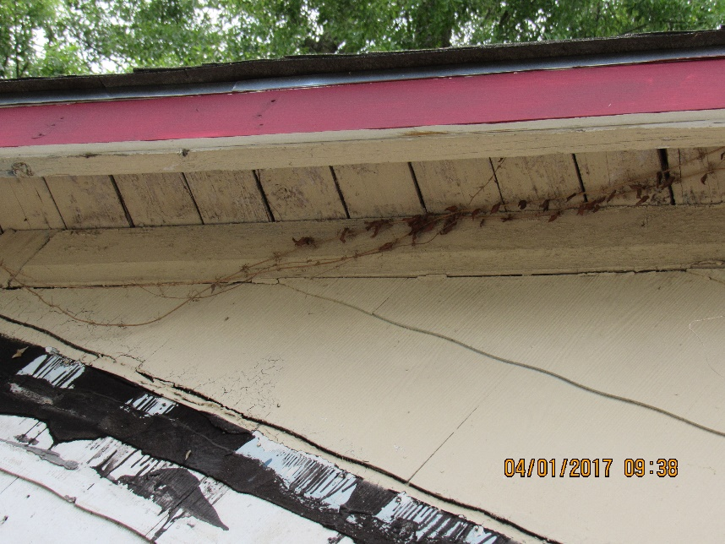
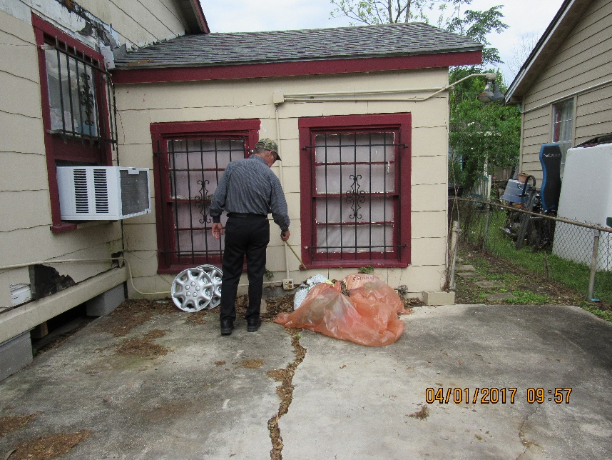
Front Driveway – Siding, Seal in Windows and A/C Unit
Install new siding at base of house, clean up siding where carport used to hang, seal in window at A/C unit (currently filled in by black electrical tape), clean vines from eave and re-caulk windows. The thick glazing cannot be completely remove or the glass panes may break. We will do the best we can to improve the look and efficiency of the windows. the burglar bars need rust removed and painting.

Slide 6
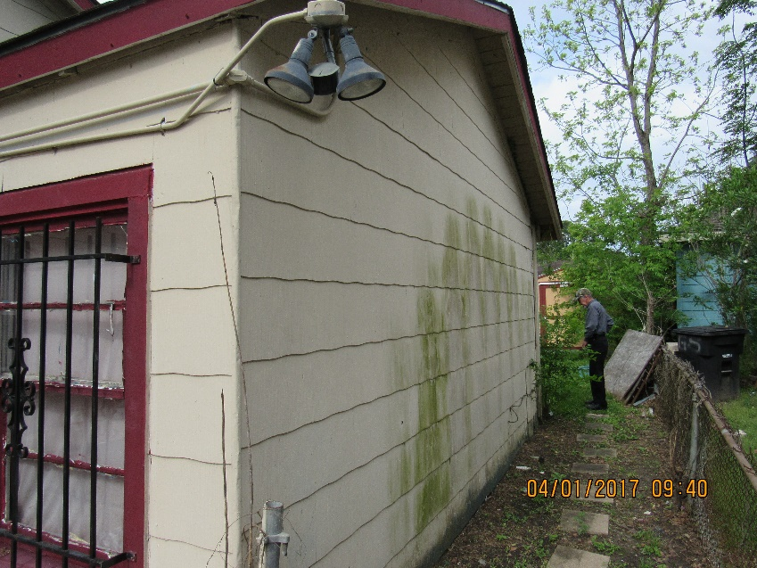
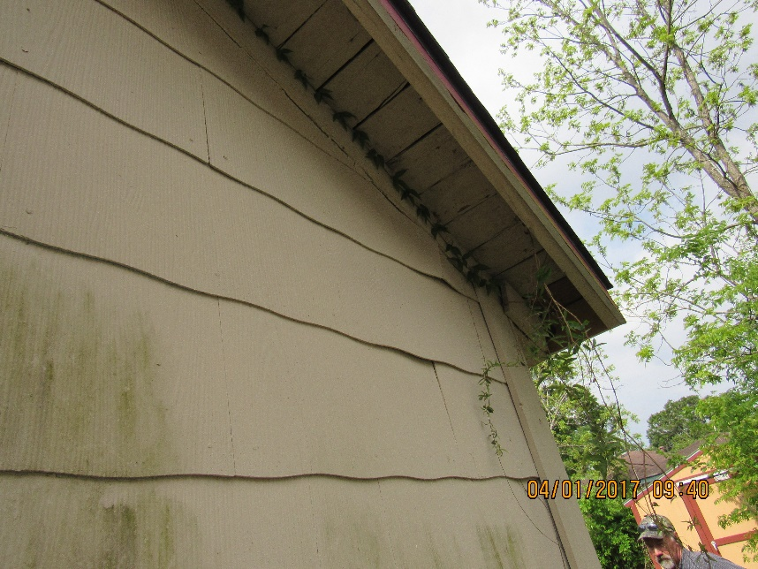
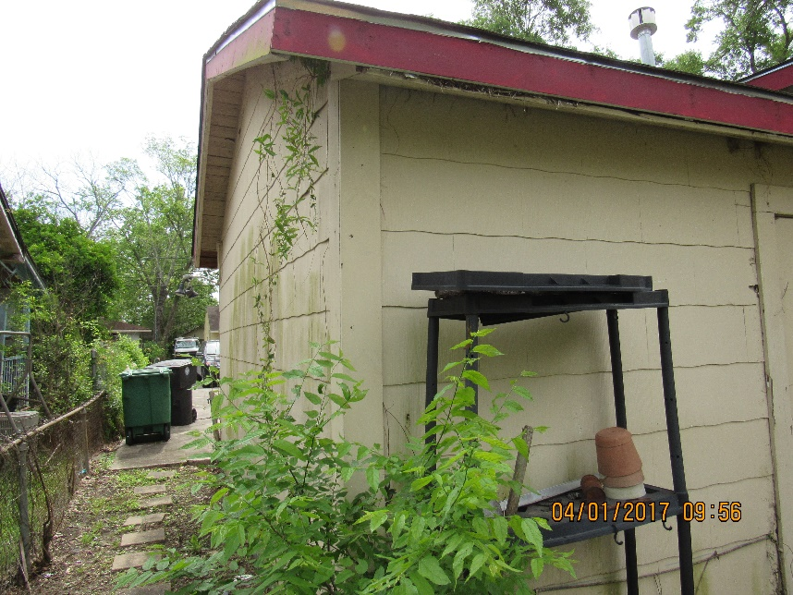
Right Side – Mold, Security Lighting, & Fence Line
Adjust security light fixture to affix piping to house and clean mold from siding. Remove vines growing in the eaves. Clear fence of all weeds.

Slide 7
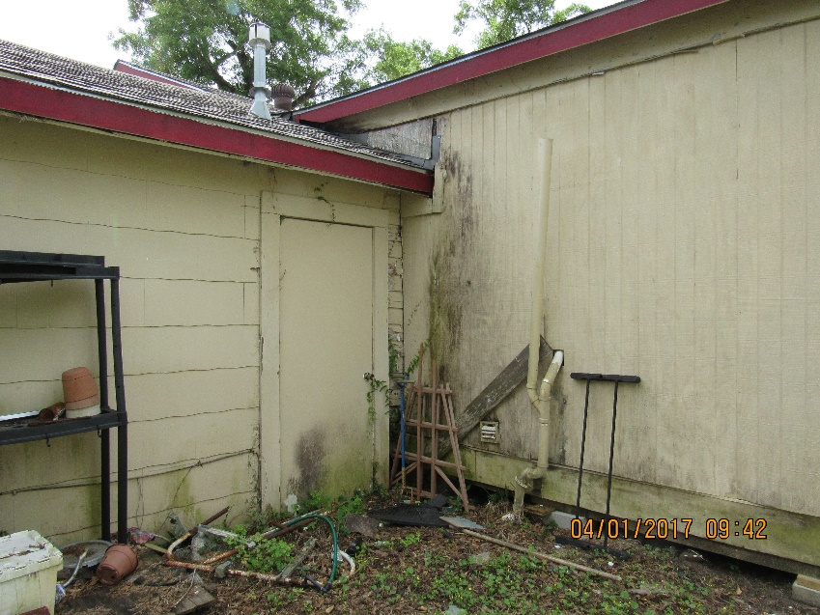
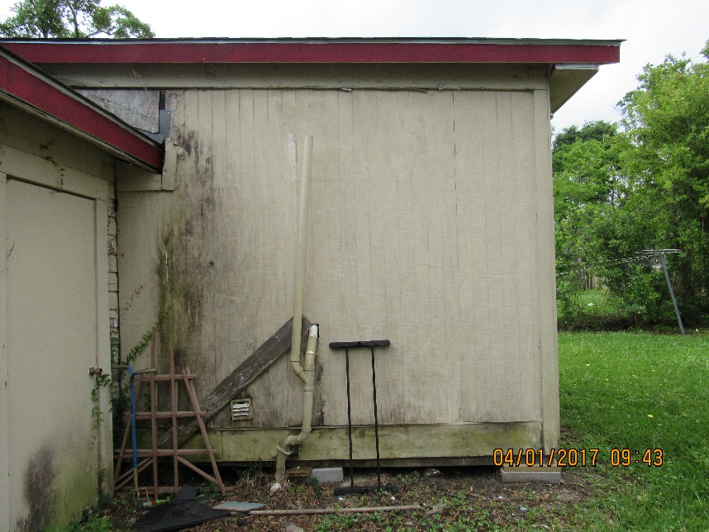
Rear Left Side – Debris, Mold, Eaves, Damaged Siding, Soffits & Trim
Remove trash and debris, clear mold on siding, replace soffit and fascia, install trim at roof line, repair eaves, paint.

Slide 8
Rear Extension – Replace Door, Security Lighting, New Steps, Paint
Install 36” pre-hung door and lockset, install new security light set, build new steps, paint.

Slide 9
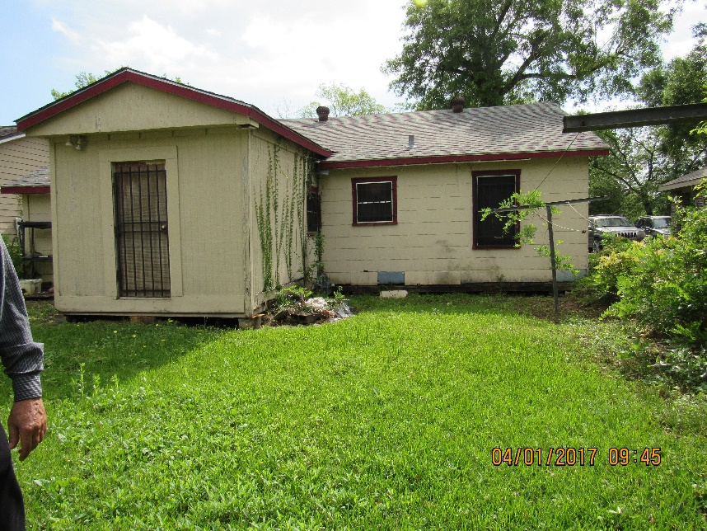
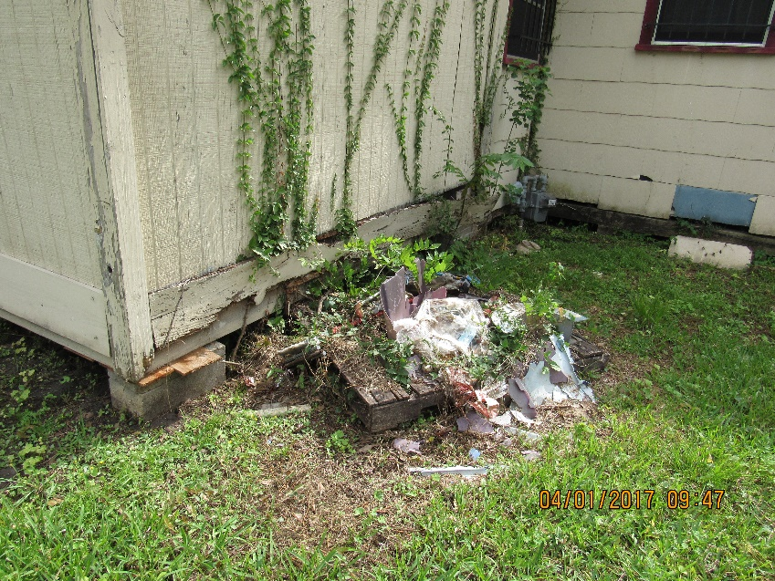
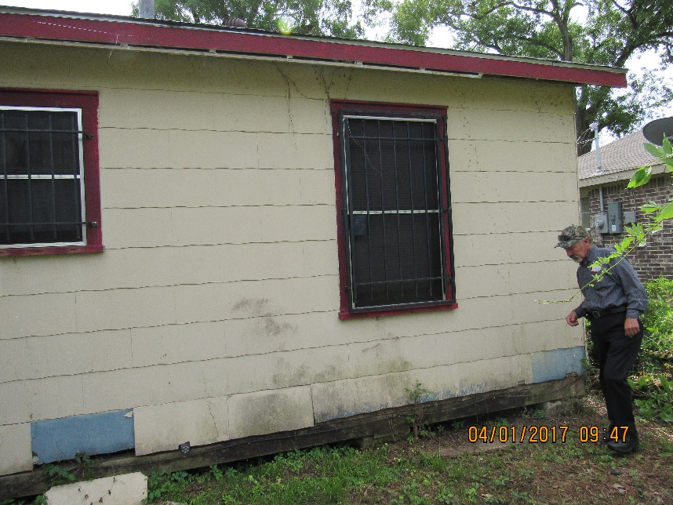
Rear Right Side – Clear Debris, Vines & Mold, Eaves, Damaged Siding, & Trim
Remove trash and debris, clear vines and mold on siding, replace siding, repair eaves, and paint.

Slide 10
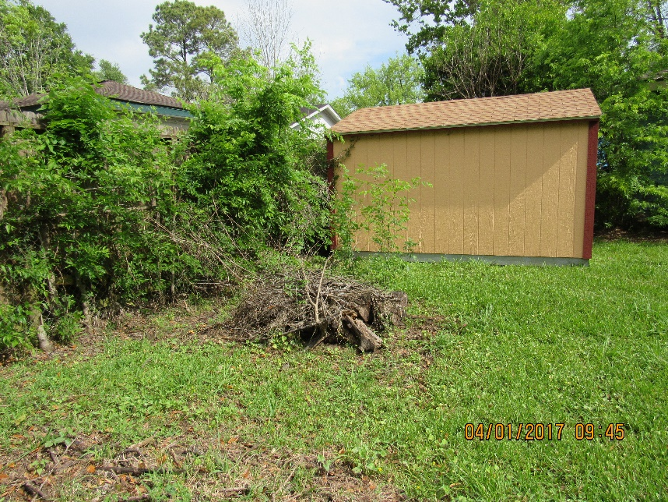
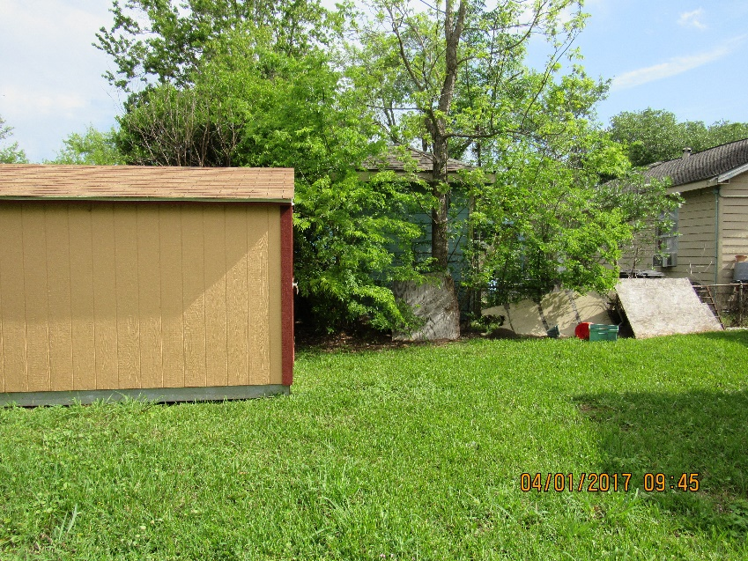
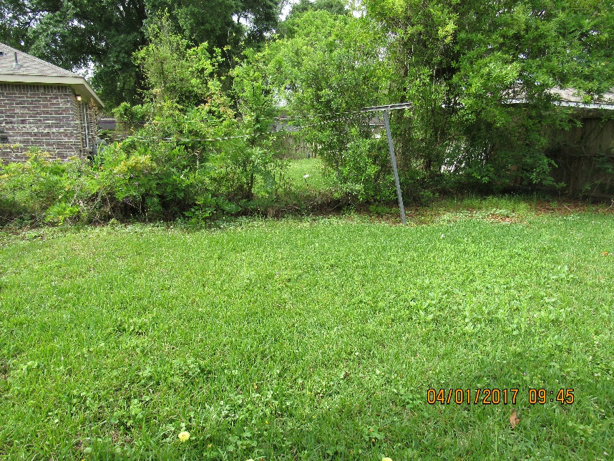
Back Yard - Gardening
Clear growth from fence lines, haul off plywood, remove clothes lines from posts and watch for poison Ivy.

Slide 11
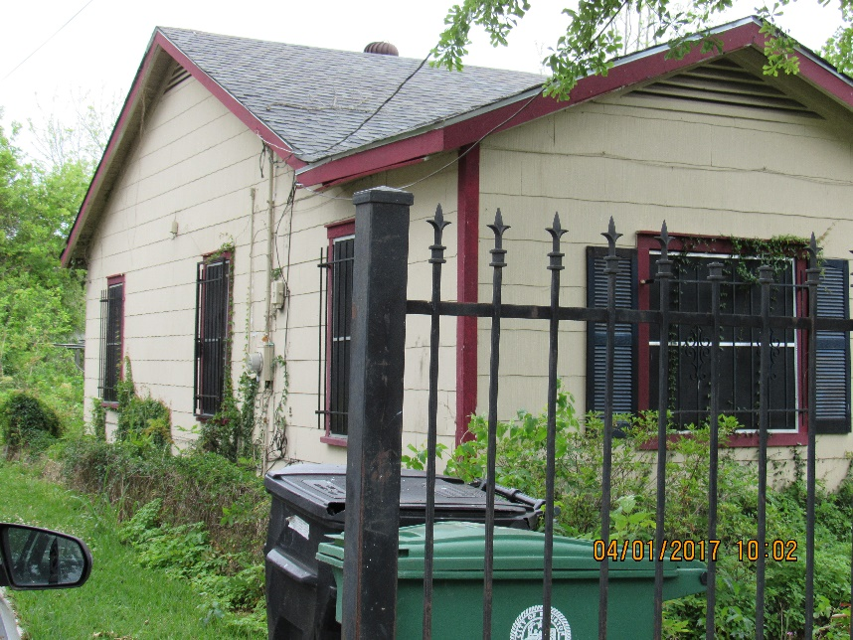
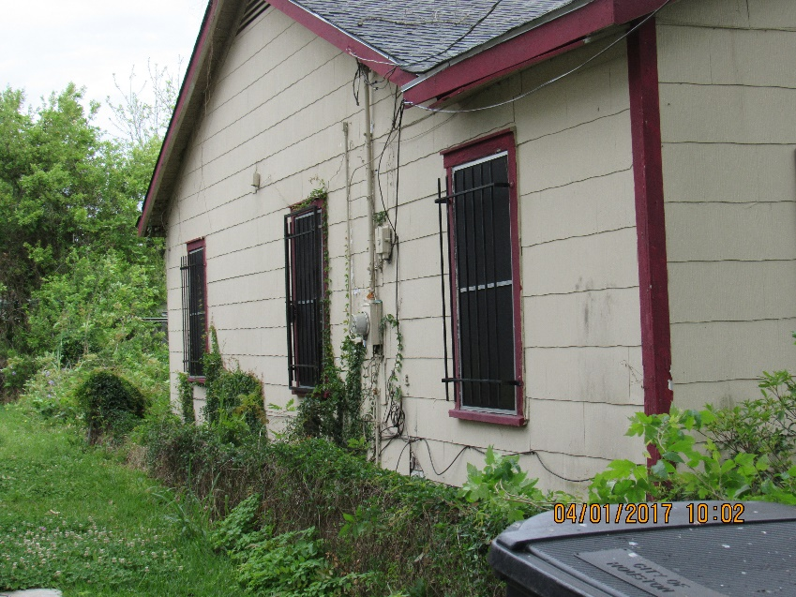
Left Side - Gardening
Clear growth from fence lines, remove vines and mold from house clear walking path, paint.

