Slide 1




the ADA
@ 28
Joe Bontke M.Ed.
EEOC Houston
713 651 4994
joe.bontke@eeoc.gov
Notes:
28 Years of the ADA (Joe Bontke, Outreach and Education Manager, EEOC, Houston District) Joe gives a unique perspective on his 28 years of service to people with disabilities and his efforts to educate employers about the law. How far have we come in 28 years and how much further do we need to go?

Slide 2




What’s in your “backpack”
It’s what we “bring” to work
It’s who I am
It’s my “stuff”

Slide 3

I know you are thinking …. where have I seen him before?

Slide 4




Protected Federal Categories
Race National Origin Color
Genetic Information
Disability Religion
Sex Age +40

Slide 5
Generational Groups
The Builders (prior 1945) 73 years old+
Baby Boomers (1946-1963) 72 - 55
Generation X (1964-1980) 54 - 38
Millennials (1981-2000) 37 - 18
Linksters (2000- today) 17- 0

Slide 6
“universal” Dynamics ?
Define these terms
  Appropriate
  Casual
  Team player
  Effective communication
  A Person with a Disability
Notes:
6

Slide 7


The year was 1990
Notes:
Impermissible stereotypes that might cause an employer to be reluctant to hire someone with a disability:
What Events Happened In 1990
KuwaitSaddam Hussein orders Iraq invasion of Neighboring Kuwait
KuwaitOperation Desert Shield Begins as the United States and UK send troops to Kuwait
PolandLech Walesa becomes president of Poland
U.S.The Saturn range of cars are launched by GM
United StatesThe most complete skeleton of a T-Rex is found in South Dakota ( Sue ).
More Information and Timeline for Sue the T. Rex.
One of the largest and most well-preserved Tyrannosaurus Rex fossilized skeletons is found by paleontologist Sue Hendrickson near Faith, South Dakota in August of 1990. The skeleton was named “Sue” after the person who discovered it. “Sue” was over 90 percent complete and measured about thirteen feet all and forty feet long. A team of six uncovered the skeleton over about seventeen days to remove “Sue” from the bluff where she was discovered. Chicago’s Field Museum eventually purchased the specimen for over 8 million dollars and spent tens of thousands of hours preserving and assembling one of the most important dinosaur discoveries to ever be seen.
IranEarthquake in Iran kills 50,000
U.S.Americas Favorite animated family "The Simpsons " is aired on Fox for the first time
U.S.The US Enters a Major Recession
BurmaThe National League for Democracy NLD wins free elections by a landslide majority, but the military regime has refused to hand over power.
WorldA Formal Ban on the Trade of Ivory is introduced
South AfricaNelson Mandella is released from Prison in South Africa after 28 years
GermanyThe demolition of the Berlin Wall officially begins during June.
The advertising world talk radio and business community also added to the confusion
The ADA will effect all hiring and firing and one mistake could put your business out of business.

Slide 8

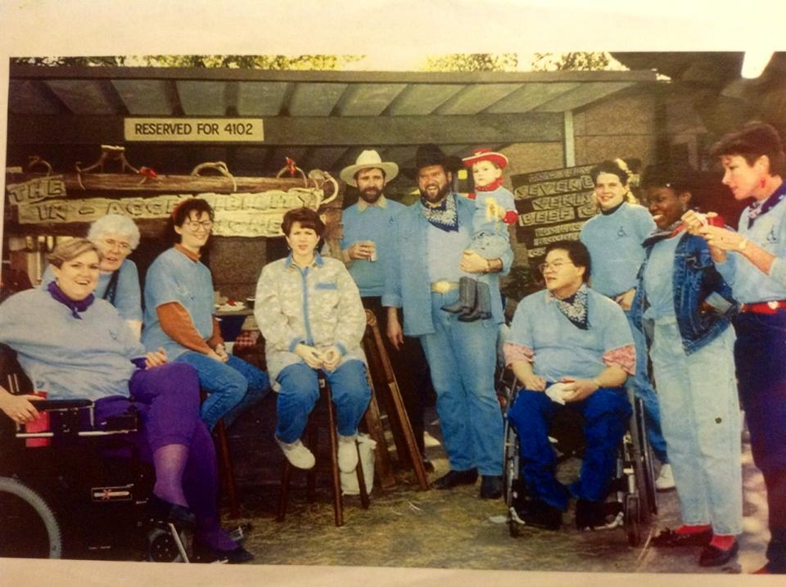
Irrational fear
“It’s contagious!”
Myths, Fears & Stereotypes

Slide 9
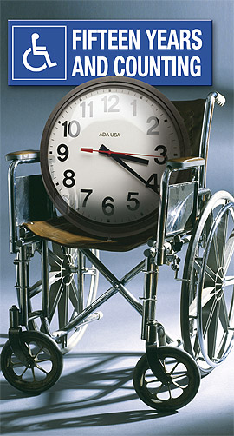
Before the ADA
No federal law prohibited private sector discrimination against people with disabilities
Most hotels and restaurants were not accessible. There were fewer curb cuts
Ugly Laws
People with disabilities were rarely seen in advertisements and TV shows
We rarely saw interpreters at public events
There were few team sports for people with disabilities
People with disabilities were more hidden and excluded
25 Years
and Counting
Notes:
No person who is diseased, maimed, mutilated or in any way deformed so as to be an unsightly or disgusting object or improper person to be allowed in or on the public ways or other public places in this city, or shall therein or thereon expose himself to public view, under a penalty of not less than one dollar nor more than fifty dollars for each offense.^{[4]}
^{No curb cuts}Curb cuts are those little ramps on the corners of sidewalks. ... a few minutes of furtive Googling did not rate me a definitive history of the roller-bag. But the story goes this way. Roller-bags were rare before curb cuts.

Slide 10
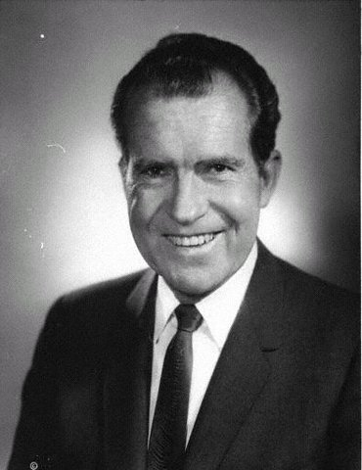
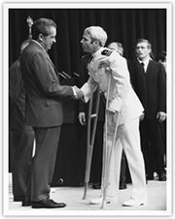
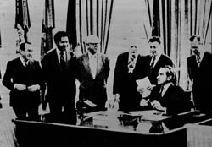

1970’s
1972 Rehabilitation Act was passed by congress
Mills vs. Board of Education
Social Security Amendments
Notes:
1972 Rehabilitation Act was passed by congress
Vetoed by Richard Nixon
Disabled in Action protested in New York
Disabled in Action staged a sit-in against Nixon’s veto of the Rehabilitation Act, in New York City. This protest was lead by Judy Heumann. Other demonstrations were held in Washington, D.C. and were lead by groups such as, Paralyzed Veterans of America, Disabled in Action and other groups.
1977
Joseph Califano, U.S. Secretary of Health, Education and Welfare, refused to sign meaningful regulations for Section 504, which forbids organizations and employers from excluding or denying individuals with disabilities an equal opportunity to receive program benefits and services. Protests were held in several U.S. cities. 504 regulations were later issued.
Mills vs. Board of Education
Mills vs. Board of Education of District of Columbia was a case against the District of Columbia that declared that students with disabilities must be given a public education, and that financial limits were a moot point in providing education to these students. It set a precedent that educational services must be made based on children's needs, not on the schools’ fiscal capabilities to provide such services.
Social Security Amendments created SSI relieving family members of the financial responsibility of caring for their adult children
The U.S. District Court overturned various state laws used to exclude children with disabilities from the public school system.
Section 504 – The Accidental Civil Rights Law
These early origin stories of the ADA are stirring and dramatic — all the more because they’re true. But they can give the mistaken impression that America was a disability rights wasteland, and then along came the ADA. Certainly the nation was much less accessible, yet the ADA was built upon the solid work of earlier pieces of legislation. Part of its brilliance is how it took those earlier laws and wove them together into one comprehensive act.
In 1977, disability rights activists in San Francisco held a rally in support of Section 504, and then streamed into the Health, Education and Welfare building, where they stayed for 25 days.
In 1977, disability rights activists in San Francisco held a rally in support of Section 504, and then streamed into the Health, Education and Welfare building, where they stayed for 25 days. Photo by Anthony Tusler.
Probably the most important precursor to the ADA was Section 504 of the Rehabilitation Act of 1973. It’s very short, a tiny part of the overall law: “No otherwise qualified handicapped individual in the United States, shall, solely by reason of his handicap, be excluded from the participation in, be denied the benefits of, or be subjected to discrimination under any program or activity receiving federal financial assistance.”
Nixon refused to sign the Rehab Act into law, as it called for new funding for Independent Living programs, a new idea back then. The law came before him twice, and twice he would not sign it. The third time it hit his desk, it was watered down and most of the funding for Independent Living was removed. So he signed it, without understanding that the language in the law’s Section 504 would usher in civil rights for people with disabilities.
And this is where it gets interesting.

Slide 11

Willow Brook State Hospital
1972
Arc vs. Rockefeller
Lawsuit to halt the inhume practices of the state institution in New York school
Practices included human experimentation (Hepatitis testing), isolation, overcrowding, etc.
Institution closed 1987
Notes:
In New York, ARC v. Rockefeller, parents and advocates of residents at the Willow Brook State School in Staten Island, an institution for childen with developmental disabilities, filed suit to terminate the inhumane practices of the institution. The institution closed in 1987.
“Unforgotten – 25 Years after Willow Brook” documentary
1975
O’Connor v. Donaldson ruled that people cannot be institutionalized in a psychiatric hospital against their will unless they are determined to be a threat to themselves or to others.

Slide 12

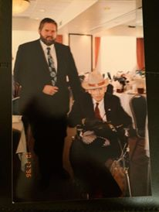

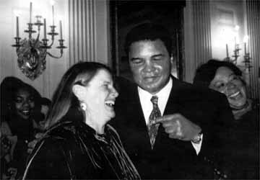
The ADA
1988 Original Version introduced
Key names: Lex Friedan Chai Feldblum, Patrisha Wright, Marilyn Golden, Liz Savage, Justin Dart Jr., Elizabeth Boggs and many others.
ADA Was redrafted and reintroduced in Congress.
Notes:
There would be no ADA without thinkers like law professor Chai Feldblum, currently serving a second term as a commissioner with the Equal Employment Opportunity Commission, who was the lead attorney on the team that drafted the ADA, or Patricia Wright, nick-named “the General,” for how well she kept the lobbying heat on in Congress. Or without leaders like Lex Frieden, executive director of the National Council on Disability at the time, who oversaw early drafts of the law.
1988 Original Version introduced
Key names: Patrisha Wright, Marilyn Golden, Liz Savage, Justin Dart Jr., Elizabeth Boggs and many others.
ADA Was redrafted and reintroduced in Congress.

Slide 13
Only 18% of PWD are born with it
Source: NIDRR Demographics and Statistics RRTC at Cornell University’s Employment and Disability Institute, calculations from 2003 ACS PUMS file performed by Robert Weathers, 2005.
13

Slide 14

Defining fairness

Slide 15
Notes:
U.S. FY 2014
Retaliation 43% Race 35% Sex 29% Disability 27% Age 23% National Origin 11% Religion 4% GINA 0.4%

Slide 16
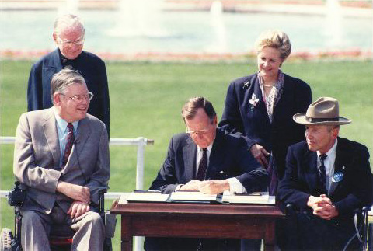
The ADA
July 26, 1990
The American with Disabilities Act signed
Protects the rights of 49 million Americans with disabilities
ADA opened doors to participation in:
Employment
State and local government
Public accommodations
Telecommunications
Transportation
Notes:
On July 26, 1990, as he signed the sweeping civil rights legislation, the Americans with Disabilities Act, into law, President George H. W. Bush declared, “Let the shameful wall of exclusion finally come tumbling down.”
He said a lot more than that, of course. He thanked Evan Kemp and Justin Dart, who flanked him during the signing, and he cited the mighty coalition that succeeded in getting the ADA before him to sign. He noted there were too many instrumental people to name, a salute to how robust the movement to pass the civil rights law was.
But when telling the tale of the ADA, most agree that the two men who flanked President Bush while he signed the law deserve special recognition. On his right sat Evan Kemp, who had muscular dystrophy, and on his left sat Justin Dart, who had polio.
Evan Kemp, The Inside Man
Kemp was the disability movement’s “inside man” in many ways. In the 1970s, Kemp worked as an attorney in Washington, D.C., and struck up a friendship with C. Boyden Gray, who years later would become Bush’s chief counsel. Through Gray, Kemp also became friends with Bush, for whom Kemp wrote speeches for disability-related events. Kemp, a wheelchair user, was a tremendous advocate for disability issues. He pushed back against the Reagan administration when it tried to weaken disability-related regulations in the early 1980s and also served as the chair of the Equal Employment Opportunity Commission.
Separate is never equalLike many with disabilities, Kemp, a lawyer, was no stranger to the indignities of discrimination. Diagnosed with a form of muscular dystrophy when he was 12, he walked with a pronounced gait at a time when private law firms wouldn’t hire a man with a disability. So he worked for the federal government. At first he held a position with the Internal Revenue Service, and then moved up to the Securities and Exchange Commission. He became a wheelchair user in 1971 when a garage door slammed on his leg, fracturing it so badly that even after it healed he could no longer walk. “When I was walking I had the same disability,” he once said. “But when I was in a wheelchair it was more visible.” Formerly in line for a promotion, he was told a wheelchair user could not hold a supervisory position.
In 1977 Kemp was able to successfully sue for job discrimination — and win. But he had had enough of being denied positions for which he was more than qualified. So he left the government in 1980, took over as director of the Disability Rights Center, and became the most prominent disability rights advocate in Washington, D.C.
From his friendship with Gray and Bush to his experience working within government to his intimate knowledge of being excluded because of a disability, Kemp, a Republican, was in exactly the right place at the right time to help shepherd the ADA toward passage.
Justin Dart, The ‘Father of the ADA’
While Evan Kemp and other advocates in Washington, D.C., kept the heat on Gray and Bush from inside the beltway, Justin Dart, a wealthy man from a wealthy family, used his fortune to fire up the grassroots. Dart’s father, Justin Whitlock Dart, Sr., was president of Dart Industries — the company’s most famous product is probably Tupperware — and his mother, Ruth Walgreen Dart, was the daughter of Charles R. Walgreen, of Walgreen Pharmacies.
Advocates, including Justin Dart (right), marched to spur passage of the ADA.
Advocates, including Justin Dart (right), marched to spur passage of the ADA. Photo by Tom Olin.
Dart contracted polio in 1948 as he was preparing to enter the University of Houston. He earned degrees in history and education, but the university wouldn’t give him a teaching certificate because he was disabled. Today the university is home to the Justin Dart, Jr. Center for Students with Disabilities, which assists all students with disabilities to achieve their academic goals.
After graduating, Dart’s father sent him overseas to launch Tupperware Japan, a company that he grew from four employees to 25,000. He embraced the “corporate playboy” lifestyle — chasing booze, women and money. He founded a greeting card company staffed by employees with disabilities during this time period, but said he felt like a fraud, as if he’d fallen off the “Gandhi track” to race along the “Donald Trump” track.
This all changed dramatically when he came face-to-face with the evils of institutionalization. In 1966, he toured a facility for children with polio in Saigon, Vietnam. “The floor of the whole place was covered with children ages 4 to 10, with bloated stomachs and matchstick limbs,” he told NEW MOBILITY. “They were starving to death and lying in their own urine and feces, covered with flies. A little girl reached up to me and looked into my eyes. I automatically took her hand and my photographer took pictures. She had the most serene look I have ever seen — and it penetrated to the deepest part of my consciousness. I thought, here is a person almost dead, and she knows it. She’s reaching out for God and has found a counterfeit saint doing a photo op. I was engulfed by the devastating perception that I have met real evil, and I am part of it. The way I’m living and dealing with disability is killing this little girl. I’m going to go to my hotel, drink Johnnie Walker, eat a steak, and this picture is going to be in some magazine. I told [my fiancée] Yoshiko, ‘We cannot go on as we have been. Our lives have got to mean something. We have got to get into this fight and stop this evil.’”
When Dart and Yoshiko moved back to the United States, Dart began serving the public in high-level roles, including being appointed by President Ronald Reagan to be vice chair of the National Council on Disability, in 1981. Dart, like Kemp, was a high-profile Republican with a visible disability — and it didn’t hurt that Reagan was a close friend of the Dart family.
While vice chair of NCD, Dart used his own money to tour every state and territory to meet with all who were interested in disability policy. The tour allowed Dart to meet face-to-face with people who have every type of disability and hear their concerns. This trip took place in pre-ADA America, a time period where there were no guarantees of accessible hotel rooms or transportation. When Dart returned to Washington, D.C., he shared these conversations with his fellow councilmembers, and NCD drafted a report, “Toward Independence,” calling for a law that would protect the civil rights of people with disabilities. This would eventually become the Americans with Disabilities Act.
After the ADA was introduced as a bill, Dart and Yoshiko repeated their national tour, once more visiting every state and territory, to hold public forums about the ADA and to keep the grassroots engaged. It is estimated that over 30,000 people attended these forums, and many of them advocated for the civil rights legislation in one way or another.
These tours of the nation and subsequent personal connection to the grassroots of the still-young disability rights movement led to Dart becoming known as the “Father of the ADA.”
Those in power, too, connected Dart with the ADA. Once, when he saw Dart wearing his iconic cowboy hat at a White House reception, President Bush introduced him as “the ADA man.” That hat is now lodged in the Smithsonian, along with Dart’s basic steel-framed manual wheelchair. Although he could afford the finest equipment, Dart insisted on using a type of wheelchair afforded by impoverished Americans with disabilities.

Slide 17

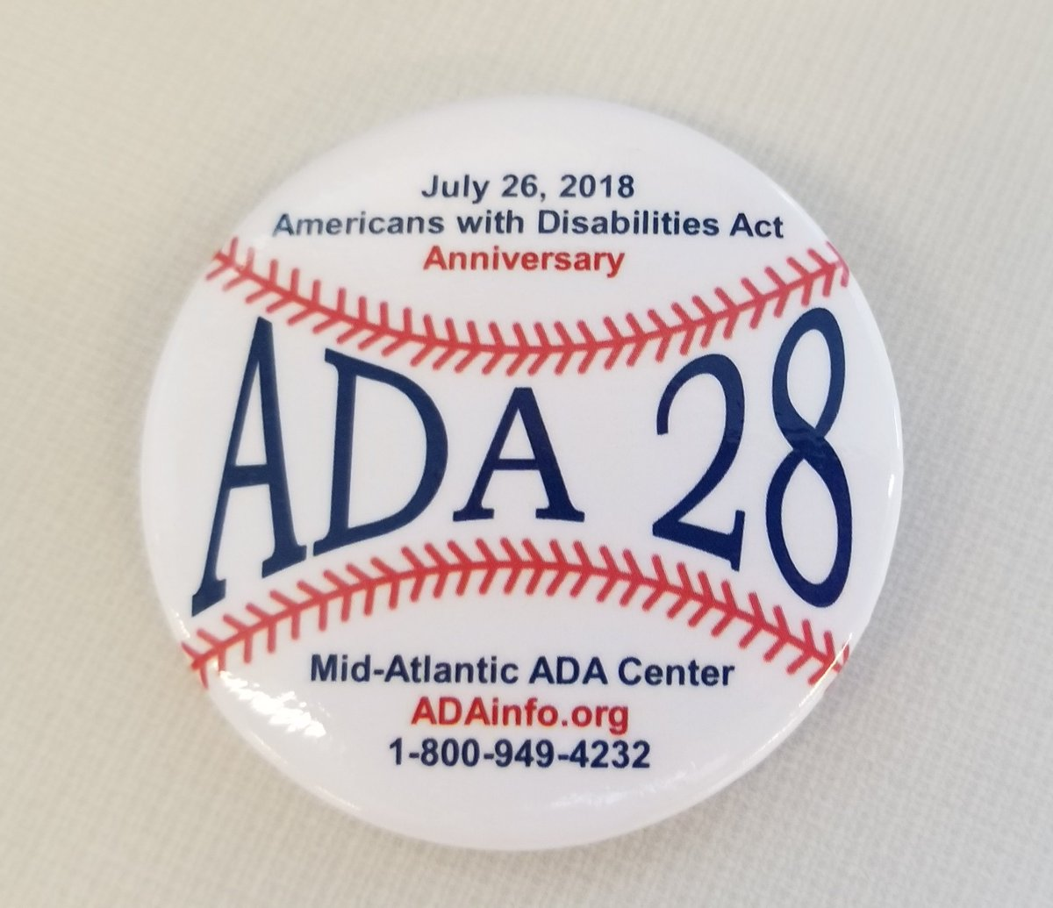
Reflections on a Promise
Reactions of the ADA passage
Notes:
Whose idea was the ADA? In a sense, it was everyone’s who was active in disability rights at the time. It was born in the Washington, D.C., beltway in discussions between Evan Kemp and Phil Calkins who dreamed about such a thing while serving together with the Equal Employment Opportunities Commission. It was born on the interstate highways connecting the public forums held by Justin and Yoshiko Dart. It was fought for in the HEW building of San Francisco and yearned for by young Judy Heumann who demanded the right to teach school in New York City — the first wheelchair user to do so.
When the ADA was signed on July 26, 1990, the president was flanked by two men, but those two were flanked by thousands more. The ADA was most certainly one-of-a-kind legislation, comprehensively granting broad civil rights to citizens with disabilities, but it came about because of a long history of legislative action.
When Bush proclaimed that the shameful walls of exclusion finally were falling down, thousands of activists nationwide felt a strong sense of accomplishment. But the ADA itself was neither a beginning nor an ending. It was a bold expansion of, and a future catalyst for, disability rights laws passed prior to and following its passage.
The movement for full recognition of the civil rights of people with disabilities has come a long, long way, and the 25th anniversary of the ADA deserves to be celebrated, as do those who helped to make it possible. But like those activists who have come before us, we must continually look to what can come next. And once we achieve that, we must reach for more, until every person with a disability has full and equal access to all our great society has to offer, and full inclusion is no longer a dream but a reality.

Slide 18

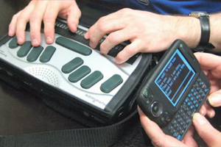




ADA & the Basics
Notes:
The most controversial portions of the ADA — when it was being considered by Congress — did not become the most controversial part of the law after enactment. Looking backwards 25 years after the ADA’s passage, the most controversial section of the act turned out to be the definition of “disability,” something the Congress hardly discussed.
Early congressional consideration included such mind-boggling discussions as should homosexuals and people with sexual identity disorders be protected by the Act (they were specifically excluded); should food handlers who were HIV-positive be excluded from coverage (they were not); should buses be required to be accessible (they were); and should people with mental disabilities, both intellectual and psychological, be protected (they were). These subjects and several others, equally not controversial in retrospect, did not generate much litigation after enactment.
The definition of disability, however, which was borrowed from the Rehabilitation Act of 1973, was misinterpreted by the U.S. Supreme Court and used to unfairly deny a judicial remedy to people with disabilities discriminated against because of their disabilities.

Slide 19

Five Titles of the ADA
Title I. Employment
Prohibits disability discrimination in all employment processes
Title 2. Accessibility in public entities
Physical and program accessibility in state/local govt. entities
Title 3. Accessibility in businesses
Physical and program accessibility in restaurants, hotels, stores, places of business
Title 4. Telecommunications
Telephone and communications systems for the public
Title 5. Miscellaneous
Protection from retaliation
Notes:
Title 5 Miscellaneous
Some of these items include:
Coverage of Congress by the ADA
Recovery of legal fees
Prohibition of coercing, threatening or retaliating
Requirements for historic properties
The role of federal agencies enforcing the ADA and providing technical assistance

Slide 20
Who would you pick for a CEO position?
Candidate A cannot walk. He cannot stand without braces that run the entire length of his legs; cannot get out of bed, get dressed, reach the bathroom or get to his desk without the assistance of another person and a wheelchair.
Candidate B has a glandular disorder and back problem. He takes daily medication and often uses painkillers. He has been hospitalized nine times in the last decade, once for 19 days, a couple of times for a week at a time.
Candidate C has a history of depression.
Notes:
Candidate A= Pres. FDR, B = Pres. JFK, C= Pres Lincoln

Slide 21
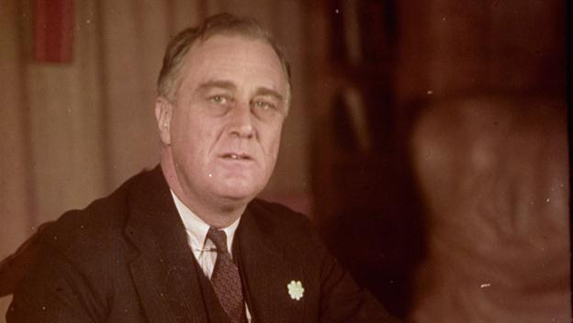

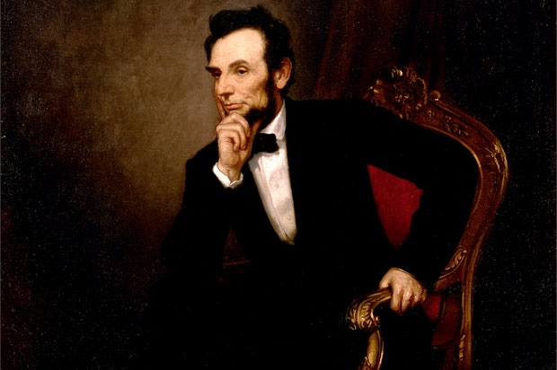

Slide 22
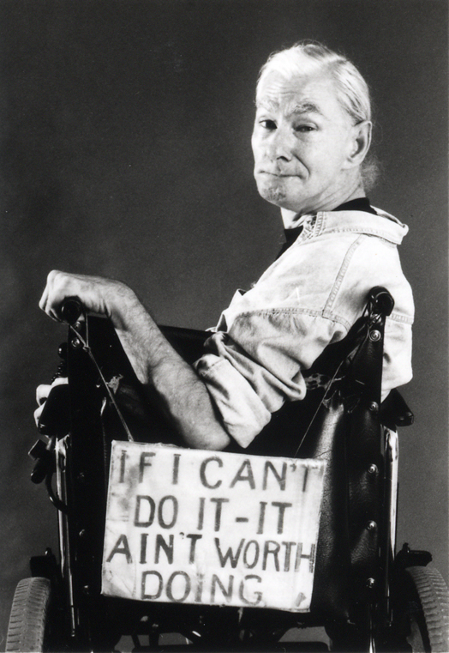
The ADA
July 1990
Passage was overwhelming in both Houses of Congress
Senate: 91 – 6
House: 377 – 28
Implementation Began in 1992
1999
- Three Employment Cases decided that individuals whose conditions do not substantially limit any life activity are not disabled under the ADA.
Notes:
Sutton vs. American Airlines
Definition of a disability
Mitigating measures (if it can be corrected its not a disability
Substantially Limits
Murphy vs. United Parcel Service
Mitigating measures
Regarded As
Albertsons vs. Kirkingburg
Vision Standards
Not meet the standards
Not qualified
The First Legal Disaster
The Supreme Court’s first attempt to deal with the definition was a disaster. However, since the disabled plaintiff prevailed, it wasn’t immediately alarming. In the 1998 case, Abbott v. Bragdon, an HIV-positive woman in Maine sought dental treatment. When the dentist learned of her condition, fearing for his and his staff’s safety, he sent her away. The evidence in the case indicated that danger was not probable if standard precautionary measures (eye shield, gloves and mask) were used. If she posed a danger to herself or others — that is, if danger were probable not merely possible — the dentist would have prevailed. In Abbott the Court considered whether the plaintiff was disabled as defined by the ADA, because if she wasn’t, she couldn’t sue the dentist. The ADA defined a covered disability as a physical or mental impairment that substantially limits one or more major life activities, a history of having such an impairment, or being regarded as having such an impairment.
The Court ignored the “regarded as” part of the definition and decided to wedge the plaintiff into the functional limitation portion of the definition. They found her disability to be the inability to procreate, ignoring both the reality that those with HIV can have children and that the dentist clearly regarded the plaintiff as having a disability and treated her accordingly, whether or not she was substantially limited from life activities at all.
Catch 22: Disability Nonexistent When Temporarily Corrected
Misunderstanding the three prongs of the “who is covered by the act” provisions of ADA began with Abbott but was personified in the Sutton trilogy of cases decided by the Supreme Court together. In the 1999 case, Sutton v. United Airlines, twin sisters who were commercial pilots but wore eyeglasses applied for jobs with United Airlines. The airline had an employment policy that required their pilots to have better than 20/200 vision when not wearing glasses. Both pilots wore glasses and, when corrected, had normal vision. But no law or regulation required pilots to see better than 20/200 without their glasses — the policy was strictly the airline’s. The women were denied employment by United Airlines, and the Court held that disability must be considered in its mitigated state. The women were not disabled within the meaning of the ADA, according to the Court, because when mitigated, their low vision was eliminated — with glasses they saw normally. Therefore, the Court held that they were not disabled and could not sue the airline even though they were denied employment because of their low vision.
ADA lawOn the same day in Murphy v. United Parcel Service, and Albertsons v. Kirkingburg, the Court denied relief to an individual whose high blood pressure was normal because he took medication for it — even though he was denied employment because of his high blood pressure; and the Court also denied relief to an individual denied employment as a truck driver because he only had vision in one eye. The Court found that his monocular vision was not a disability since it didn’t substantially limit his ability to engage in a major life activity.
This complete disregard of the “regarded as” prong of the test for who is protected by the ADA spawned dismissals of hundreds of employment discrimination claims throughout the United States. People with epilepsy whose seizures were controlled by medication but who were discriminated against because of the epilepsy had no remedy; diabetics whose symptoms were controlled by insulin were denied remedies even though they were discriminated against because they were diabetic. In one case, a diabetic pharmacist who needed reasonable accommodation — the ability to eat lunch at the same time every day to regulate his blood sugar — was denied that accommodation. The Court, incredibly, found that he was not disabled within the meaning of the ADA because if he ate at the same time every day — that is, if his disability was considered in its mitigated state — he would have no functional impairment.

Slide 23
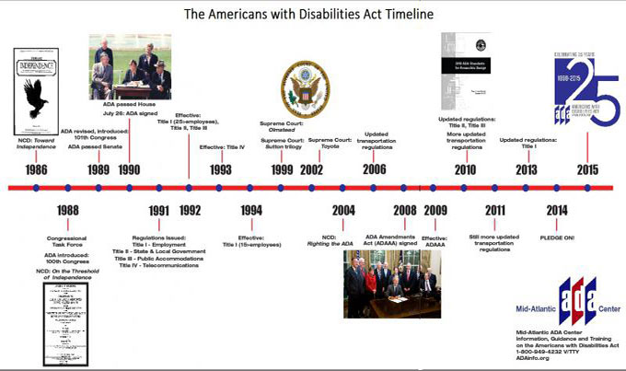

Slide 24

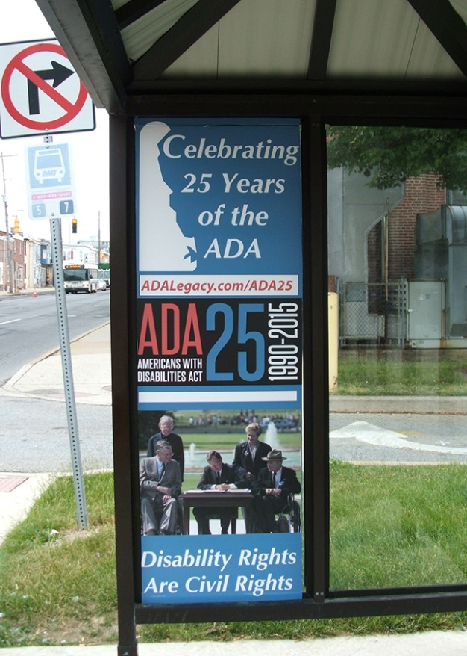

The ADA Amendments Act
Effective January 1, 2009
Restored the ADA back to its original intent
Notes:
The ADAAA overturns a decade of restrictive policy that has barred the door to ADA eligibility for many people with disabilities, including epilepsy, diabetes, intellectual and developmental disabilities, multiple sclerosis, muscular dystrophy, and cancer, among many others. The reforms in the law will apply to both the ADA and Section 504 of the Rehabilitation Act. The reforms will restore the intent of the bipartisan Congress that passed the ADA in 1990.
Changes to the Amendments Act were adopted in 2011.
ADA Amendments Act of 2008 and Olmstead
Consideration of disability in its mitigated state became a hurdle that defendants put between those they discriminated against and the plaintiffs’ ability to seek relief. Since this was clearly not Congress’s intent in enacting the law, organizations of people with disabilities asked Congress to amend the ADA in a manner that would specifically nullify the Sutton trilogy. Despite the risk that Congress might attempt to weaken the ADA once the Act was being reconsidered, the disability community pushed forward, and with the help of Republican Rep. Jim Sensenbrenner of Wisconsin and Democratic Sen. Tom Harkin of Iowa, the ADA Amendments Act of 2008 passed. It instructed the courts to disregard Sutton and its mitigation language and restored the “regarded as having a disability” basis for claiming discrimination.
Meanwhile, legislative and litigation victories and advances fostered more litigation as well as state legislation to prevent and redress discrimination. Many cases were brought and settled, not resulting in judicial decisions that could be used by others as precedents, but clearly reflecting changing social mores. For example, United Spinal Association sued New York City for failure to install curb ramps. Following seven years of litigation with the Giuliani administration, Mayor Bloomberg settled the case. The city has spent $243 million so far to ramp its 168,000 corners and all but 3 percent are complete. United Spinal and other plaintiffs with disabilities persevered and finally forced Mayor Bloomberg to settle ADA litigation to make taxis accessible. After 11 years of opposing accessible taxis, prompted by ADA litigation, Bloomberg agreed to have 50 percent of the City’s yellow cabs accessible by 2020.

Slide 25

Olmstead
1999
Olmstead v. L.C. and E.W.
Supreme Court ruled that individuals with disabilities must be offered services in the most integrated setting.
Notes:
Under Title II of the federal Americans with Disabilities Act, said Justice Ruth Bader Ginsburg, delivering the opinion of the court, "states are required to place persons with mental disabilities in community settings rather than in institutions when the StateÕs treatment professionals have determined that community placement is appropriate, the transfer from institutional care to a less restrictive setting is not opposed by the affected individual, and the placement can be reasonably accommodated, taking into account the resources available to the State and the needs of others with mental disabilities. "

Slide 26
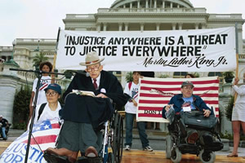
ADA Changes Behaviors
DOJ publishes title II & III revisions in the federal register
Major changes to ADA standards adopted
March 15th, 2011 policy changes took effect
March 15th, 2012
- 2010 Standards take effect
Notes:
The Big Picture: ADA Changes Behavior
From a jurisprudential point of view, the ADA changed the meaning ascribed traditionally to “nondiscrimination.” Prior to ADA nondiscrimination was passive. Refraining from treating people differently because of their race, gender, religion, etc., and treating everyone equally was all that was necessary to guarantee compliance and socially correct behavior. ADA made the failure to act — that is, to make reasonable accommodation — discriminatory and unlawful.
However, the ADA, while requiring accommodation, only does so to the extent that such accommodation is reasonable. The ADA merely requires reasonable behavior — and that is its simple beauty.
The final DOJ regulations revising Title II and Title III of the ADA were published in the Federal Register on September 15, 2010. Major changes to the ADA Standards for Accessible Design were also adopted. The title II&II policy changes take effect March 15th, 2011. Compliance with the 2010 Standards for Accessible Design is permitted as of September 15th, 2010, but not required until March 15th, 2012.

Slide 27
The Nation’s Largest Minority Group
59 million Americans live with a disability
High unemployment rate
Employment Statistics
 | With Disabilities | Without Disabilities
Unemployment Rate unemployed people are those who did not have a job, were available for work, and were actively looking for a job in the 4 weeks preceding the survey | 14.8% | 9.4%
Not in Labor Force neither employed nor unemployed | 80% | 30%
2010 U.S. Department of Labor Statistics

Slide 28
Education
FACT
Over 1/2 of individuals with disabilities have high school diplomas
Over 1/3 have post-secondary degrees
MYTH
Individuals with disabilities don’t have the education that I require.
Bureau of Labor Statistic
At each level of education, persons with disabilities are more likely to be unemployed.

Slide 29

Meeting Performance Standards
FACT
Louis Harris and Associates survey of 920 employers found employees with disabilities have about the same (57%) or better (30%) productivity levels than persons without disabilities
MYTH
Individuals with disabilities are unable to meet performance standards or productivity goals.

Slide 30
Employee Supervision
FACT
In most cases,
individuals with disabilities have already adjusted to their disability
With proper job training, they can work unaided
MYTH
Supervising employees with disabilities is more difficult. Someone will always have to help them!
TIP: Hold employees with disabilities accountable
to the same job standards as other employees.

Slide 31

Job Accidents
FACT
In 4 national studies, the U.S. Dept of Labor found that workers with disabilities experience fewer disabling injuries than the average employee exposed to the same hazards
MYTH
Workers with disabilities are more likely to have accidents or be prone to additional injuries.
TIP: Listen to safety concerns of workers with disabilities. Sometimes they are more aware than peers.

Slide 32
Worker Compensation Rates
FACT
Insurance rates are based solely on relative hazards of operation and organization’s accident experience
U.S. Chamber of Commerce study found 90% of manufacturers surveyed reported no effect on insurance costs as a result of hiring workers with disabilities
MYTH
Worker compensation rates increase when an employer hires persons with disabilities.

Slide 33
Hiring
FACT
Ask the same job-related questions that you would ask other applicants.
Focus on abilities not disabilities
MYTH
It’s impossible to interview someone with a disability because of human rights laws.
TIP: Don’t make assumptions about someone’s performance—everyone has the right to fail or succeed by their own doing.

Slide 34
Discipline and Termination
FACT
There are no special procedures for disciplining or firing employees with disabilities
Discuss problems with the employee, try to find solutions and document the situation
MYTH
Once hired, I can’t discipline or fire an employee with a disability.
TIP: Establish clear performance expectations from the start.

Slide 35
Absenteeism
FACT
On average, employees with disabilities are not absent any more than employees without disabilities
U.S. Chamber of Commerce study found workers with disabilities had an 80% lower turnover rate
MYTH
Employees with disabilities are less reliable and absent more often.
Bureau of Labor Statistic
Persons with disabilities are more likely to be working part-time due to economic reasons.
Notes:
Economic reasons—slack work or unfavorable work conditions, inability to find full-time work, seasonal declines

Slide 36
Special Characteristics
FACT
Persons with disabilities are just like any other person you would employ
Each person is individual and unique
MYTH
Persons with disabilities are more sensitive.
They are braver, kinder and more conscientious.
TIP: Remember we are all human with a range of emotions.

Slide 37
Accommodation Expenses
FACT
Most job accommodations are simple and inexpensive
Most frequently reported accommodations were changes in job duties and modified hours
MYTH
Considerable expense is necessary to accommodate workers with disabilities.
TIP: Look at the big picture. An accommodation might end up helping other employees or even customers.

Slide 38
Creativity Does Not Have To Be Costly
Source- Succeeding Together: People with Disabilities in the Workplace, A Resource Manual

Slide 39

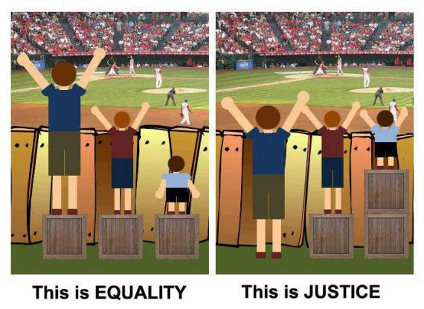
Notes:
the Americans With Disabilities Act (ADA) promotes social justice by protecting disabled persons from discrimination and prejudice. It seeks equality of opportunity for them and protects their well being by giving them fair access to goods, services and benefits. These rights are circumscribed in the ADA, however, by constraints of cost, efficiency, utility, and certain social mores.

Slide 40

Employer
must
accommodate
unless
undue hardship
Notes:
The ADA offers little direction about how to set priorities when these values come into conflict, or about whether equality or opportunity favors equivalent or preferential treatment for disadvantaged indaviduals, the unemployed, the underemployed.
Until these ambiguities and potential value conflicts are resolved, a central moral and social problem remains unresolved: How can we demonstrate commitment to the rights and welfare of those with severe disabilities while placing fair limits upon their claims?

Slide 41

Find a partner
One will be person A the other B

Slide 42

Interactive Process
Discussion, discussion, discussion
Employee is the best position to know limitations/needs
Employer in the best position to determine if undue burden
Multiple options? Employer gets to chose
Notes:
Discussions, discussion, discussion
Employee is the best position to know limitations/needs
Employer in the best position to know whether something would be undue burden or not
Multiple options? Employer gets to chose
Try an accommodation. If it doesn’t work, ongoing obligation under the interactive process to reassess, refine if necessary.

Slide 43
If at first you don’t succeed
Try an accommodation: If it doesn’t work, employer has an ongoing obligation to reassess and refine if needed

Slide 44
Bless her heart
Jill tells her manager, Bob, that she is pregnant. As a result of the information, Bob immediately provides a chair for her to sit as needed and disallows her from lifting anything assigning others within the department to lift for her.
Notes:
Discuss benevolent stereotyping; Discuss how this could be discriminatory if other disabilities are not given similar accommodations; Discuss failure to engage in the interactive process; Discuss to contact Skye or me for all ADA/medical concerns

Slide 45
This is how it’s done
Ted reveals that he has a chronic back condition that limits his ability to lift more than 10 pounds. He asks to be able to stock bottle by bottle with a shopping cart instead of rolling full cases on a dolly. Is this reasonable?
Notes:
Please discuss that Skye should be contacted for all situations even when they are able to be accommodated.

Slide 46
The Un-Interpreter
Susan is a new employee who is deaf and does not use her voice. The agency has an interpreter who cannot understand Susan’s sign language. Susan requested that the agency hire a different interpreter. Is Susan’s request reasonable?
Notes:
Discuss change of position if possible; Discuss steps if we cannot accommodate – FMLA if available; Reiterate to contact Skye or me in all circumstances

Slide 47

Don’t play doctor
Employers do not get to choose medical treatment

Slide 48

Purpose of
Reasonable Accommodation
Allows employee with disability to
Perform essential functions of job
Enjoy privileges and benefits of employment
Notes:
(Placer Arc – Debra/DOB, UPW- Marcy, UPS – Dana – ASL interpreters)

Slide 49

Lets go to the video tape

Slide 50
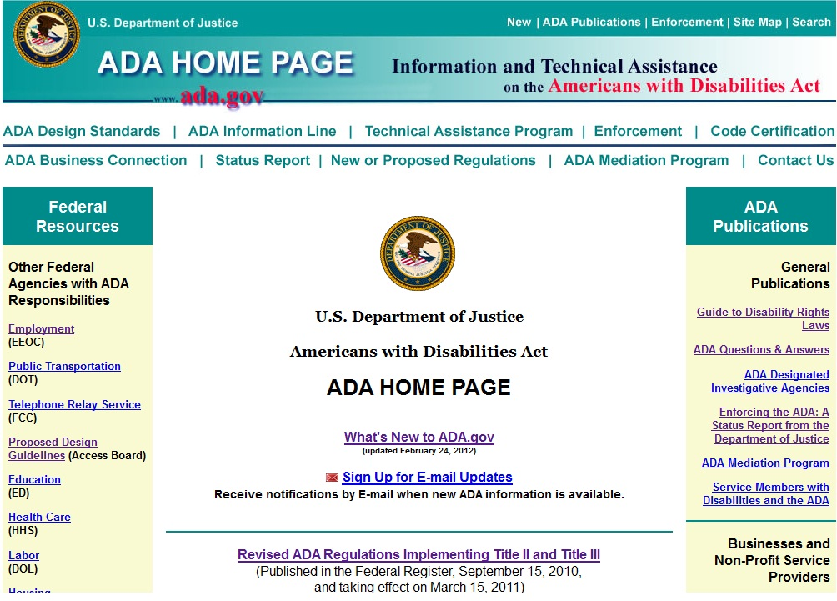
U.S. Department of Justice http://www.ada.gov

Slide 51

Equal Employment Opportunity Commission
http://www.eeoc.gov

Slide 52

Job Accommodation Network
http://www.askjan.org

Slide 53

Texas Resource https://www.disabilityrightstx.org/
Learn about Assistive Technology
See and Try Assistive Technology
Buy, Sell & Recycle Assistive Technology
http://www.mdtap.org
1-800-832-4827 (Voice-Toll Free)
1-866-881-7488 (TTY-Toll Free)

Slide 54
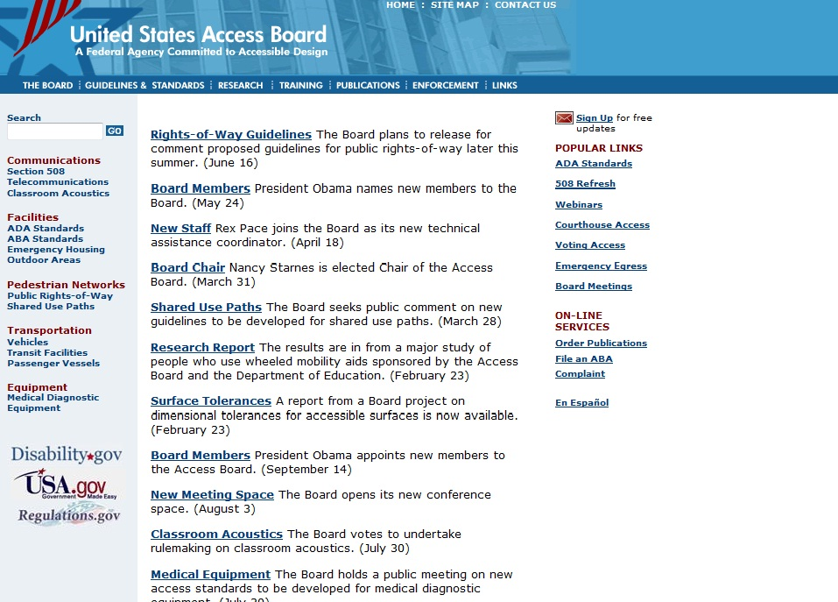
United States Access Board
http://www.access-board.gov

Slide 55

1 of 10 Regional Centers Providing:
Information
Guidance
Materials
Newsletter/E-Bulletin
Training
Toll-free phone number:
800-949-4232 V/TTY
Website: www.ADAinfo.org
55
Notes:
55

Slide 56
The Implicit Association Test https://implicit.harvard.edu/implicit
Project Implicit is a long-term research project based at Harvard University that aims to measure people’s preferences for certain social groups over others.
The IAT is designed to examine which words and concepts are strongly paired in people’s minds.
Is taken anonymously, requires only about 5-10 minutes to complete and provides insight into personal biases, including race, gender, sexual orientation, etc.
The test requires Macromedia Flash Player
More than 4.5 million people have completed the online demonstration tests since 1998.
Notes:
56
56

Slide 57

Add
Music Within to your queue

Slide 58


Slide 59


What can one person do?

Slide 60
Adolph Hitler
Ivan the Terrible
Adolph Eichmann
Pol Pot
Mao Tse-tung
Idi Amin
Joseph Stalin
Genghis Khan

Slide 61
Buddha, Rosa Parks, César Chavez Dalai Lama
Jesus Christ, Moses, Susan B. Anthony
Abraham Lincoln,Martin Luther King
Joan Ganz Cooney, Mohandas Gandhi Amelia Earhart, Muhammad,
Dorothy Day, Bono
A teacher you remember

Slide 62


Slide 63


Contact Information & Resources
U.S. Equal Employment Opportunity Commission
Joe Bontke M.Ed.
Education & Outreach Coordinator
713 907 2855 cell
713 651 4994 Desk
joe.bontke@eeoc.gov
@EEOC_Houston
Joe Bontke
Toll-free: 1-800-669-4000
TTY: 1-800-669-6820
www.eeoc.gov
eeoc.traininginstitute@eeoc.gov

