Slide 1

Biosafety Basics
Module 2:
Regulations and Committees

Slide 2
Topics Covered
  Biosafety in Microbiological and Biomedical Laboratories (BMBL)
  NIH Guidelines for Research Involving Recombinant or Synthetic Nucleic Acid Molecules
  OSHA Bloodborne Pathogens Standard
  Respiratory Protection, including Tuberculosis
  IATA Dangerous Goods Regulations
  Select Agents and Toxins Regulations
  UTHealth Houston Institutional Biosafety Committee (IBC)
      Work that requires an IBC protocol, IBC protocol submission, and review process

Slide 3
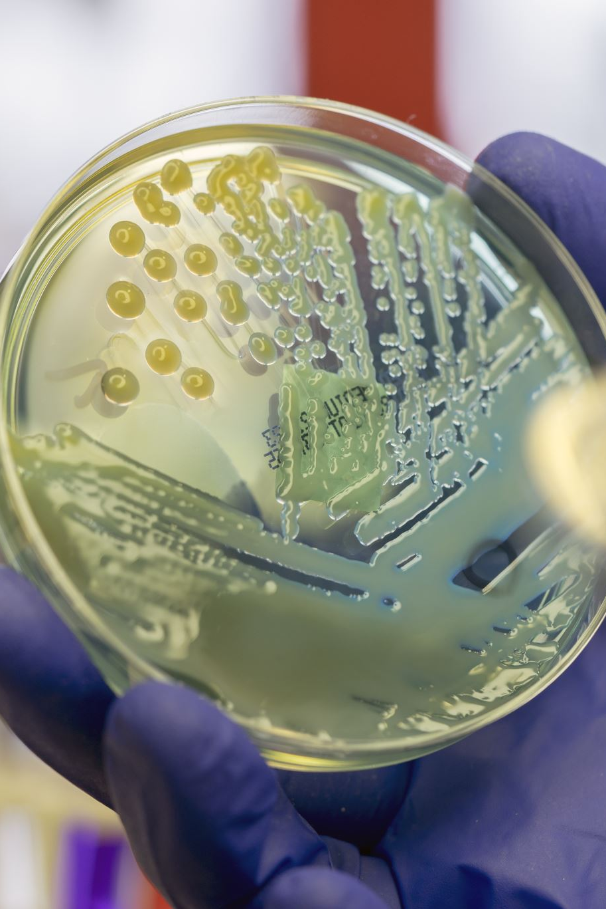
Biosafety in Microbiological and Biomedical Laboratories (BMBL)
Joint publication by CDC and NIH
Originally released in 1984
Most recent version (6th Edition) released 2020
Evolution of NIH Guidelines set foundation for BMBL development
Sets code of practice for biosafety in microbiological and biomedical laboratories
Link to BMBL 6th Edition

Slide 4
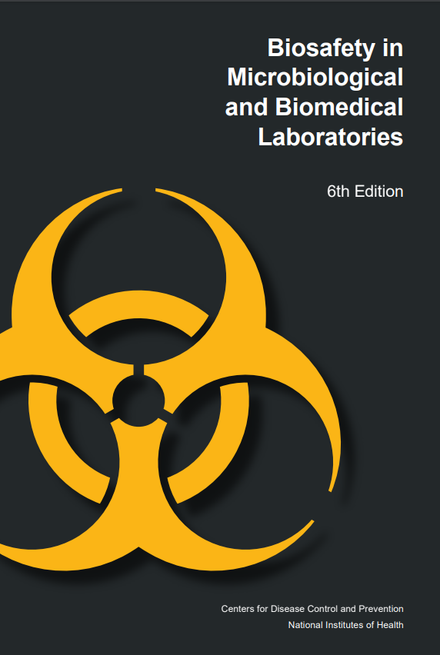
BMBL – Key Sections
Biological Risk Assessment
Principles of Biosafety
Laboratory Biosafety Level Criteria
Vertebrate Animal Biosafety Level Criteria
Principles of Biosecurity
Occupational Health & Immunoprophylaxis
Biological Agent Summary Statements

Slide 5
BMBL – Key Appendices
Appendix A – Primary Containment for Biohazards (Biosafety Cabinets)
Appendix B – Decontamination and Disinfection
Appendix C – Transportation of Infectious Substances
Appendix D – Agriculture Pathogen Biosafety
Appendix E – Arthropod Containment Guidelines
Appendix F – Select Agents and Toxins
Appendix G – Integrated Pest Management
Appendix H – Human, Non-Human Primate (NHP) and Mammalian Cells and Tissue
“Recommended Practices. Human and other primate cells should be handled using Biosafety Level 2 practices and containment.”

Slide 6
BMBL – Key Appendices
Appendix I – Toxins of Biological Origin
Appendix J – NIH Oversight of Research Involving Recombinant Biosafety Issues
Appendix K – Inactivation and Verification
Appendix L – Sustainability
Appendix M – Large-Scale Biosafety
Appendix N – Clinical Laboratories
Appendix O - Acronyms

Slide 7

NIH Guidelines for Research Involving Recombinant or Synthetic Nucleic Acid Molecules
The NIH Guidelines were implemented in response to public and scientific concern over the emerging science of rDNA technologies in the early 1970’s
Most recent revision released April 2024
Purpose of Guidelines: Specify the practices for constructing and handling:
(i) recombinant nucleic acid molecules (rDNA),
(ii) synthetic nucleic acid molecules (sNA), including those that are chemically or otherwise modified but can base pair with naturally occurring nucleic acid molecules,
(iii) cells, organisms, and viruses containing such molecules
Link to NIH Guidelines

Slide 8
NIH Guidelines
Section I: Scope and Applicability
  If your institution receives Federal funding, then it must comply with the NIH Guidelines for recombinant DNA research.
    Even if a project is privately sponsored, that research experiment must still be conducted in accordance with the NIH Guidelines.
Section II: Safety Considerations:
Risk Group and Risk Assessment

Slide 9
NIH Guidelines
Section III: Experiments Covered by the NIH Guidelines
Section | Level of Review | Research Example
III-A | IBC and NIH Director review and approval prior to initiation of work | Transfer of drug resistance (e.g. Cipro resistant Bacillus anthracis)
III-B | IBC approval and NIH OSP review for containment determination prior to initiation of work | Cloning of lethal toxins (e.g. cloning botulinum toxin expression into adenovirus)
III-C | IBC and IRB review and approval before participant enrollment | Human Gene Transfer
III-D | IBC approval before initiation of work | Infectious agents as vectors and transgenic animals (e.g. expression of non-native protein in Staphylococcus aureus) Gene drives
III-E | IBC notification at initiation of work | Transgenic rodents (e.g. germline alteration of animals that can be housed at ABSL-1)
III-F | Exempt work | Exempt work/BSL-1 (e.g. purchase of transgenic rodents)

Slide 10
NIH Guidelines
Section IV: Roles & Responsibilities
Ensure compliance with NIH Guidelines
Establish IBC
Appoint a Biosafety Officer, if conducting BSL-3, BSL-4, or large-scale work
Ensure IBC has expertise in the research that is reviewed
Establish a medical surveillance program as needed
Report all incidents to the NIH-Office of Science Policy

Slide 11
NIH Guidelines
Section IV: Roles & Responsibilities
Responsibilities of the IBC:
Review rDNA research and approve those research projects that are found to conform with the NIH Guidelines.
This review shall include:
1) independent assessment of the containment levels required by the NIH Guidelines for the proposed research;
2) assessment of the facilities, procedures, practices, training, and expertise of personnel involved in rDNA research;
3) ensuring that the PI has appropriately addressed all aspects of Appendix M and
4) ensure compliance with all surveillance, data reporting, and adverse event reporting requirements set forth in the NIH Guidelines.

Slide 12
NIH Guidelines
Section IV: Roles & Responsibilities
Responsibilities of the IBC:
Notify the PI of the results of the IBC’s review and approval.
Lower containment levels for certain experiments as specified in Section III-D-2-a, Experiments in which DNA from Risk Group 2, Risk Group 3, Risk Group 4, or Restricted Agents is Cloned into Non-pathogenic Prokaryotic or Lower Eukaryotic Host-Vector Systems.
Set containment levels as specified in Sections III-D-4-b, Experiments Involving Whole Animals.
Periodically review rDNA research conducted at the institution to ensure compliance with the NIH Guidelines.
Adopt emergency plans covering accidental spills and personnel contamination resulting from rDNA research.

Slide 13
NIH Guidelines
Section IV: Roles & Responsibilities
Responsibilities of the IBC:
Report any significant problems with or violations of the NIH Guidelines and any significant research-related accidents or illnesses to the appropriate institutional official and NIH/OSP within 30 days.
The IBC may not authorize the initiation of experiments that are not explicitly covered by the NIH Guidelines until NIH establishes the containment requirement.
Perform such other functions as may be delegated to the IBC.

Slide 14
NIH Guidelines
Section IV: Roles & Responsibilities
Responsibilities of the Principal Investigator:
Initiate or modify no recombinant DNA research which requires IBC approval prior to initiation until that research or the proposed modification thereof has been approved by the IBC and has met all other requirements of the NIH Guidelines;
Determine whether experiments are covered by Section III-E, and ensure that the appropriate procedures are followed;
Report any significant problems, violations of the NIH Guidelines, or any significant research-related accidents and illnesses to the BSO, Animal Facility Director (where applicable), IBC, NIH OSP, and other appropriate authorities (if applicable) within 30 days;
Report any new information bearing on the NIH Guidelines to the Institutional Biosafety Committee and to NIH OSP
Be adequately trained in good microbiological techniques;
Adhere to IBC-approved emergency plans for handling accidental spills and personnel contamination;
Comply with shipping requirements for rDNA molecules.

Slide 15
NIH Guidelines
Section IV: Roles & Responsibilities
Responsibilities of the Principal Investigator:
Responsible for full compliance with the NIH Guidelines in the conduct of rDNA research.
Responsible for ensuring that the reporting requirements are fulfilled and will be held accountable for any reporting lapses.
Prior to initiating research:
1) Make available to all laboratory staff the protocols that describe the potential biohazards and the precautions to be taken;
2) Instruct and train laboratory staff in: (i) the practices and techniques required to ensure safety, and (ii) the procedures for dealing with accidents; and
3) Inform the laboratory staff of the reasons and provisions for any precautionary medical practices advised or requested (e.g., vaccinations).

Slide 16
NIH Guidelines
Section IV: Roles & Responsibilities
Responsibilities of the Principal Investigator:
During conduct of research:
1) Supervise the safety performance of the laboratory staff to ensure that the required safety practices and techniques are employed;
2) Investigate and report any significant problems pertaining to the operation and implementation of containment practices and procedures in writing to the BSO, Animal Facility Director (where applicable), IBC, NIH OSP, and other appropriate authorities (if applicable)
3) Correct work errors and conditions that may result in the release of rDNA materials; and
4) Ensure the integrity of the physical containment (e.g., biological safety cabinets) and the biological containment (e.g., purity and genotypic and phenotypic characteristics).

Slide 17
NIH Reporting Requirements
Any significant problems, violations of the NIH Guidelines, or any significant research-related accidents and illnesses must be reported to NIH within 30 days.
Spills or accidents in BL2 laboratories resulting in an overt exposure must be immediately reported to NIH.
Spills or accidents occurring in high containment (BL3 or BL4) laboratories resulting in an overt or potential exposure must be immediately reported to NIH.
Relevant incidents would include spills and accidents which result in overt exposures to organisms containing recombinant or synthetic nucleic acid molecules in the laboratory

Slide 18
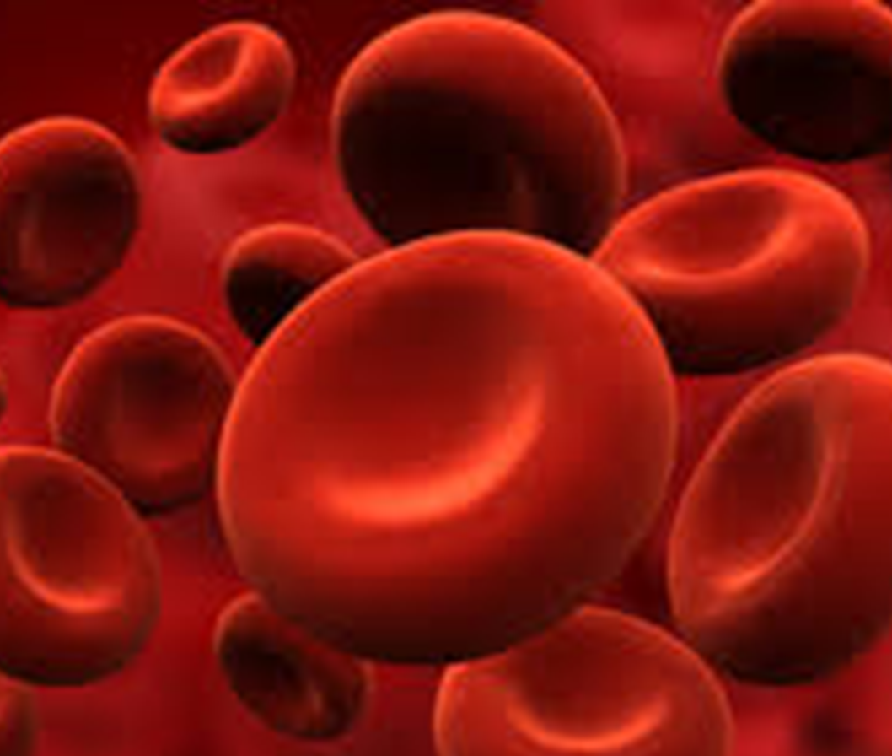
OSHA Bloodborne Pathogens Standard
29 CFR 1910.1030
Covered in Initial and Annual Refresher Laboratory Safety Training
Define bloodborne pathogens and the risks associated with occupational exposure
Identify employer responsibilities related to compliance with the Standard
Needlestick Reduction Act (added in 2001)
Texas Department of State Health Services, Bloodborne Pathogens Control

Slide 19
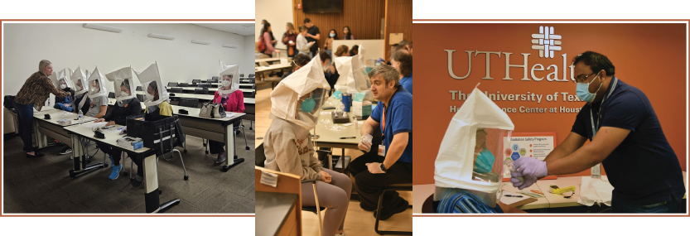
Respiratory Protection including Tuberculosis 29 CFR 1910.134 (independent standard 1910.139 repealed)
The goal of the respiratory protection program is to protect individuals at UTHealth Houston from breathing in harmful airborne contaminants or infectious aerosols while they work or learn. This is accomplished through implementation of procedures to ensure the proper use of respiratory protection and adherence to the guidelines from Occupational Safety and Health Administration (OSHA) Respiratory Protection Standard (29 CFR 1910.134).
Respiratory Protection Program

Slide 20
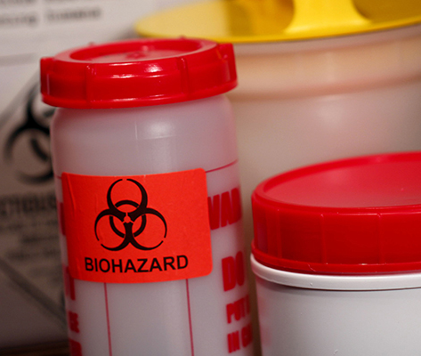
IATA Dangerous Goods Regulations, DOT 49 CFR 171-185, & USPS 39 CFR Part 111
Needed for shipment or transport of any infectious substance or biological material
Separate Training Module Required
Transportation & Shipment of Biological Materials

Slide 21
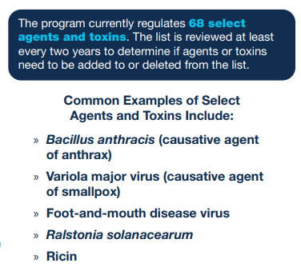
Select Agents and Toxins Regulations
7 CFR Part 331 and 9 CFR Part 121 (USDA, APHIS)
42 CFR Part 73 (CDC)
Notify the Biosafety Program immediately of any planned work

Slide 22

The U.S. NAC is responsible for ensuring containment requirements are effectively implemented and maintained in facilities retaining poliovirus materials.
Wild poliovirus (WPV)
Vaccine-derived poliovirus (VDPV)
Oral polio vaccine (OPV)
Poliovirus potentially infectious materials (PIM) include human fecal samples and upper respiratory secretions collected for polio or non-polio related work in a time and place when WPV, VDPV or OPV were circulating or in use
Facilities may collect, use, or store polioviruses to serve critical functions, but they pose a risk for reintroduction of poliovirus into communities after eradication. These facilities should identify, destroy, transfer, and contain IM and PIM to reduce the risk of polioviruses being released where they are worked with or stored. “Poliovirus-essential” facilities (PEFs) have stringent biorisk management controls. PEFs must participate in the national survey, apply for containment certification, and implement U.S. NAC policies.
More information on the U.S. NAC
UTHealth Houston PIs are responsible for identifying biological materials that may be applicable to U.S. Poliovirus containment regulations.
Notify the Biosafety Program immediately of any planned work

Slide 23
UTHealth Houston’s
Institutional Biosafety Committee (IBC)
Reviews work with biological agents and Recombinant or Synthetic DNA Molecules
Full Members
Serve staggered two-year terms
3+ faculty members with rDNA experience and/or biological safety and containment
2 community members
Director, Environmental Health & Safety (BSO)
At least 1 member from each school
At least 1 member with animal containment expertise
At least 1 with infectious disease expertise
1 student member
Ex-Officio Members
Representative from Legal Affairs
Safety Manager, Biological Safety Program
Safety Manager, Environmental Protection Program
Executive Vice President and Chief Academic Officer
Center for Laboratory Animal Medicine and Care
Representative from Employee Health Services

Slide 24
What work requires an IBC Protocol?
All Work with Recombinant and Synthetic Nucleic Acid Molecules
In vitro and In vivo
Human and animal studies
Plasmids
Viral vectors
Recombinant vaccines
Transgenic animals
Gene editing tools
Gene drives
siRNA
shRNA
miRNA
dsRNA
REQUIRES IBC APPROVAL

Slide 25
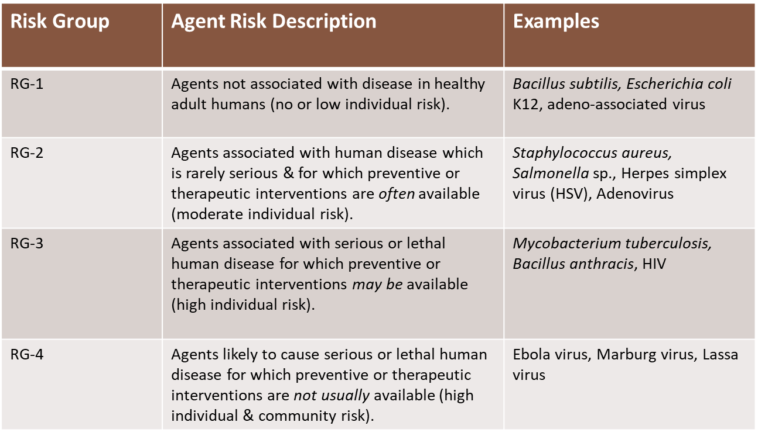
What work requires an IBC Protocol?
Cultures or Materials that is Risk Group 2 or higher
Human cell lines
Human samples
Refer to Module 1: Risk Group Resources
REQUIRES IBC APPROVAL

Slide 26
What work requires an IBC Protocol?
Samples of soil, water, animals, plants or insects suspected or known to contain pathogens
REQUIRES IBC APPROVAL

Slide 27
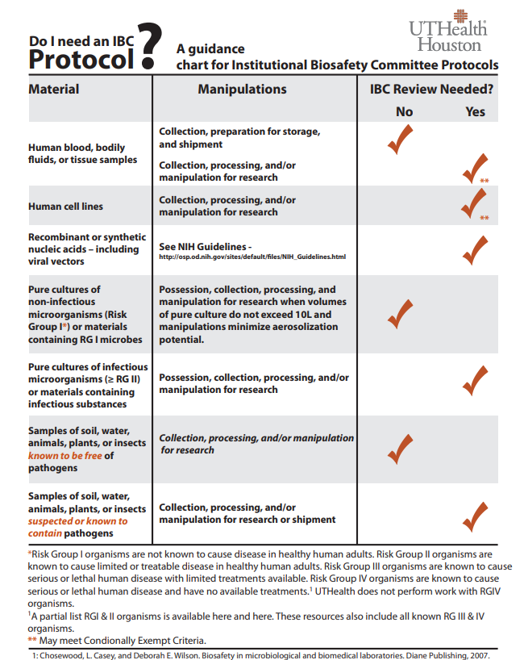
What work requires an IBC Protocol?

Slide 28
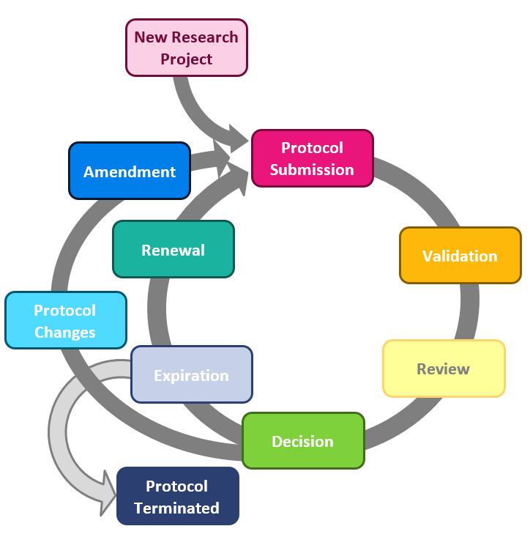
Online Protocol Submission Interface
Additional resources available at:
Biological Safety Program
It is the PI's responsibility to keep the IBC up to date with changes to title, scope of work, biological agents, rDNA, AWC or CPHS, personnel, and location.

Slide 29
Questions
If you have any questions or concerns, please contact the Biological Safety Program at 713-500-8170

